Slide 1

The Road Forward – Settlement Policy Paper
Adrian Jenkins
9 December 2025

Slide 2
Overview
Latest from Pixel MTFP model – forecast funding at class level
Change in funding between June and December (overview, movement for county councils/ unitaries) – what are the key changes (e.g. IDACI)
Model showing the change will be available immediately after this webinar
Quantum
Recovery Grant
RNF weighting, including removal of remoteness
Measuring BR income
Transitional support and cliff edges
Individual local authority analysis
Next steps and lobbying recommendations

Slide 3
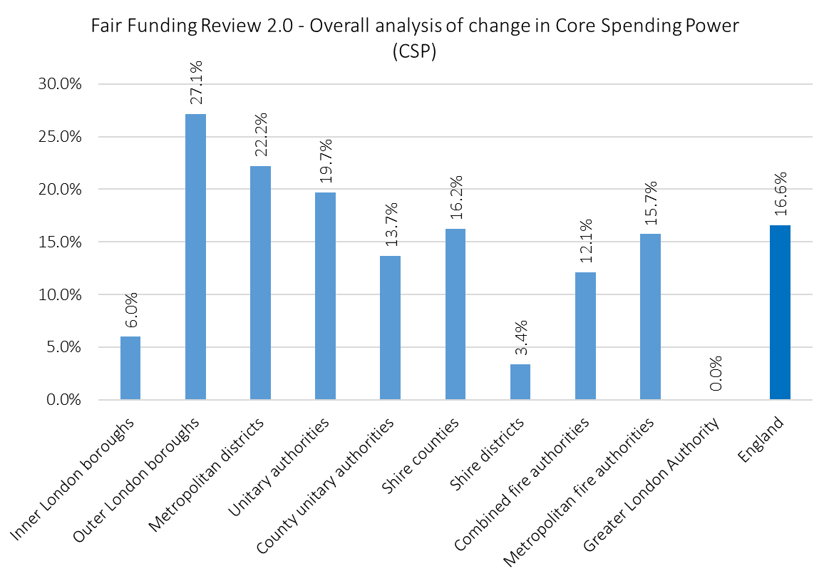
Overall change in Core Spending Power (25-26 to 28-29)
Latest from Pixel MTFP model – forecast funding at class level
Broad shape is consistent with MHCLG modelling
Above-average gains for outer London and metropolitan authorities
Inner London still well below over UT authorities but improved on June forecasts
Shire counties below the UT average, and county unitaries now well below the UT average
Shire districts receiving the smallest average increases – will be a county problem following LGR

Slide 4
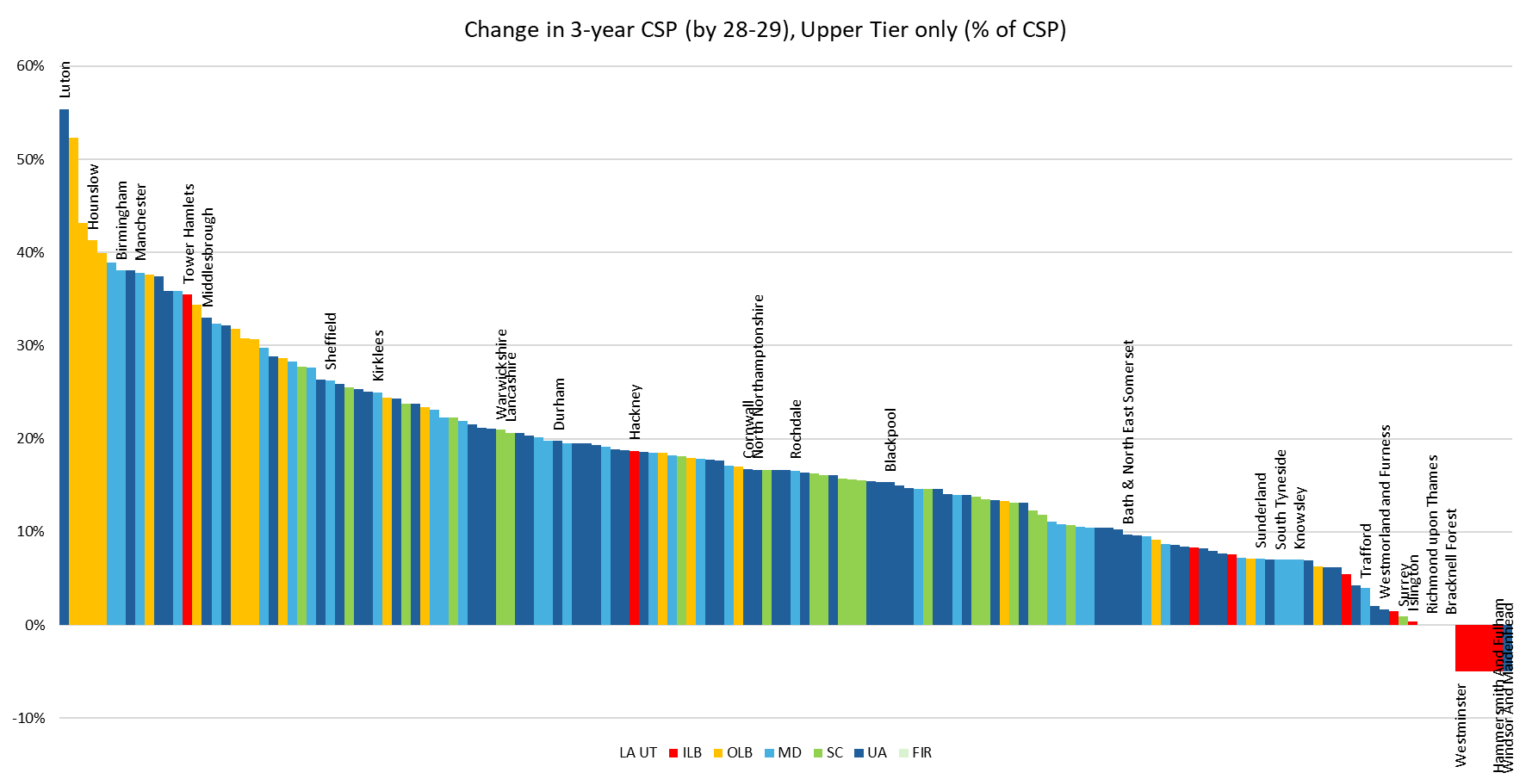
Notes:
Pick 10 or so authorities to focus on. Some of your will have been given your 3-year growth in CSP (£M and %age). Let me know how it matches to the MTFP model – counties have been close, but our forecasts for Mets and boroughs have been on the high side. Still be cautious about the modelling even though there has been some positive feedback about accuracy.

Slide 5
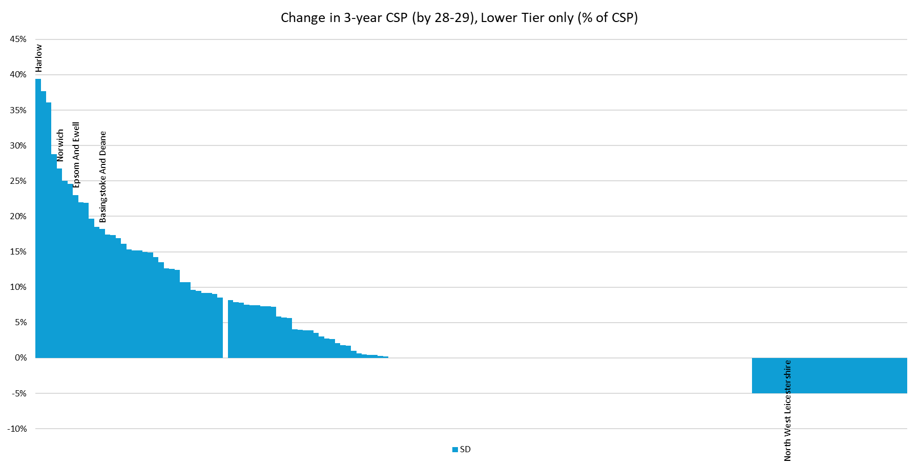
Notes:
Districts

Slide 6
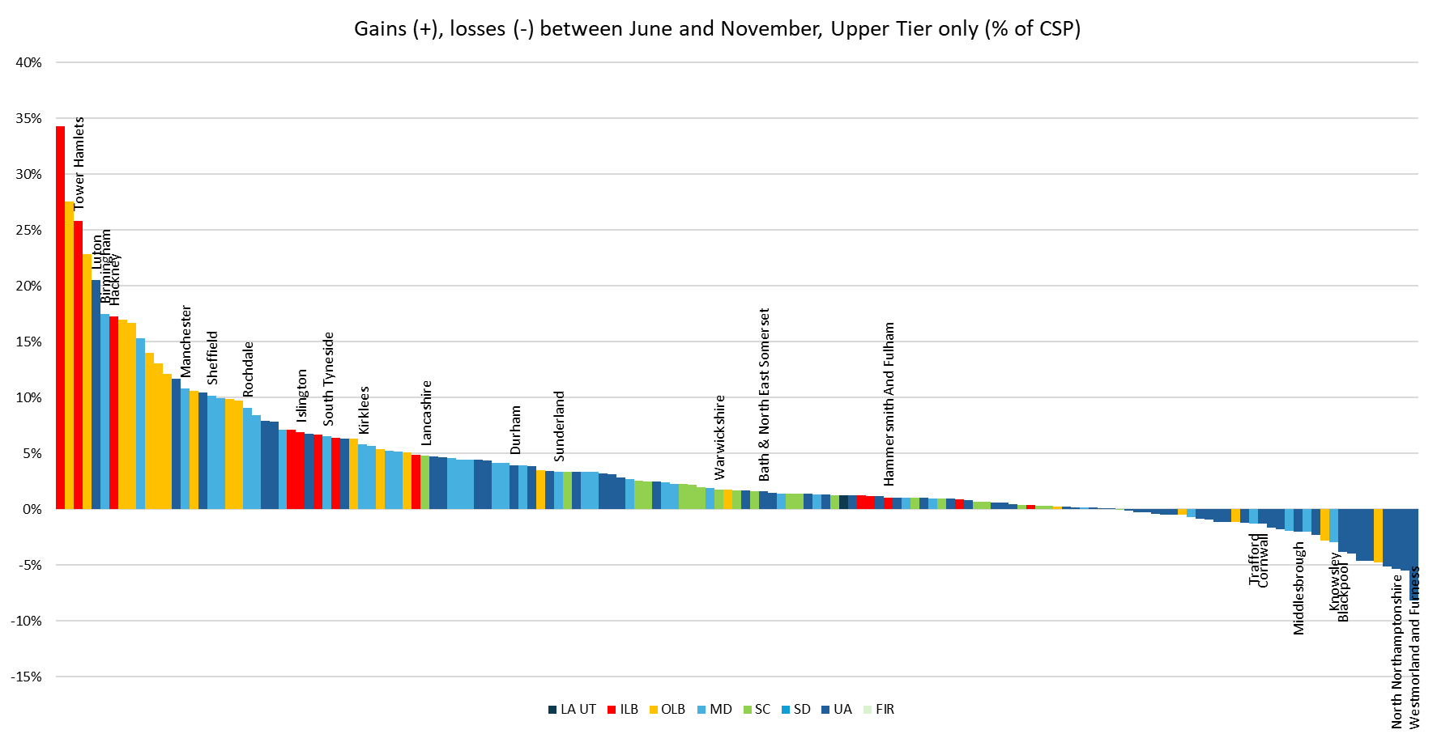
Notes:
Select the same 10 or so

Slide 7
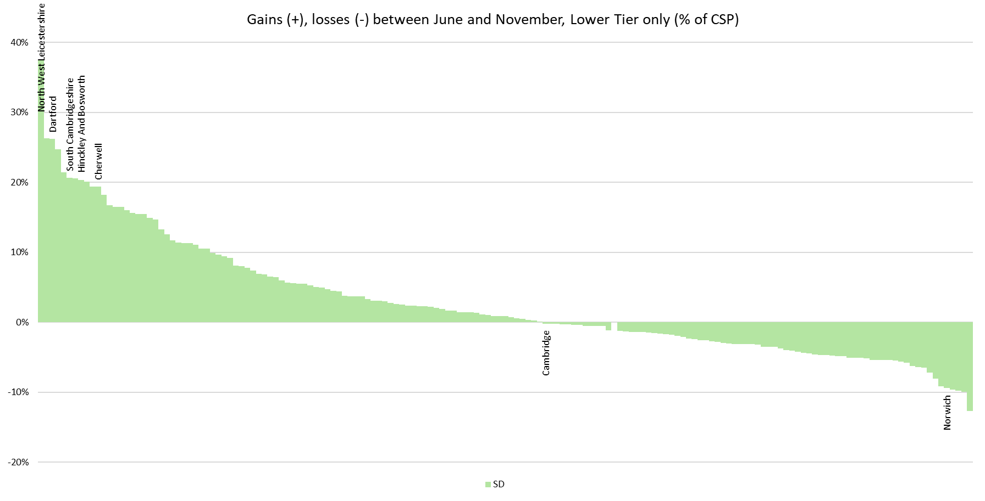
Notes:
Districts. No district numbers available, as far as I am aware.

Slide 8
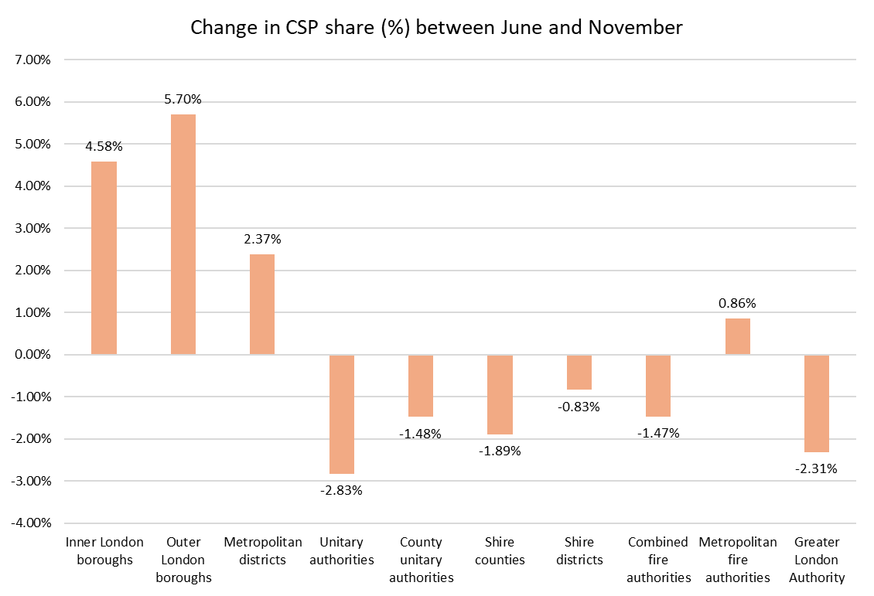
Change in CSP share (%)
This takes into account only the change in funding share and excludes the impact of higher quantum
Increase in CSP share in London is significant (+4.58% in inner London, +5.7% in outer London)
Smaller increase in CSP share in Mets (+2.37%)
Reductions in every other class (except Met Fire)
Reductions in particularly large in county unitaries and shire counties
Some specific circumstances in unitary authorities

Slide 9
Main changes in the Policy Statement
Using 2022-based sub-national population projections (not mid-2024 population estimates)
Using 2025 IMD and new IDACI (in Children’s RNF)
Removing “remoteness” from all ACAs, except ASC
Reducing weighting for non-resident population in Foundation Formula (no change in data)
Cap on distance in the Home-to-School Transport (HTST) RNF is increased from 20 to 50 miles
Continuing Recovery Grant payments (to UT and LT authorities) in 2026-27
Changes to quantum (since SR25) and to taxbase forecasts

Slide 10
Quantum
Forecasting in Summer based on Core Spending Power projections in SR25 (plus rolled-in BRRS income)
Uncertainty about the council tax assumptions within SR25 (we assumed growth in grant funding of £2.3bn by 28-29, more likely £3.3bn by 28-29)
Rolled-in BR income also higher (by around £900m). We assumed £1.495bn (post-levy retained rates for 50% scheme). Ministers decided to roll-in BR pooling and pilot gains, plus above-baseline cap compensation funding (£2.4bn in total)
Overall, an additional ~£1.9bn in funding within Core Spending Power by 28-29
Plus update to assumptions about taxbase growth
Some uncertainty in the week beginning 24 November with unclear signals about the funding that was within the quantum and decisions ministers had taken post-SR25
There is still some uncertainty and MHCLG will not fully outline quantum until the provisional settlement

Slide 11
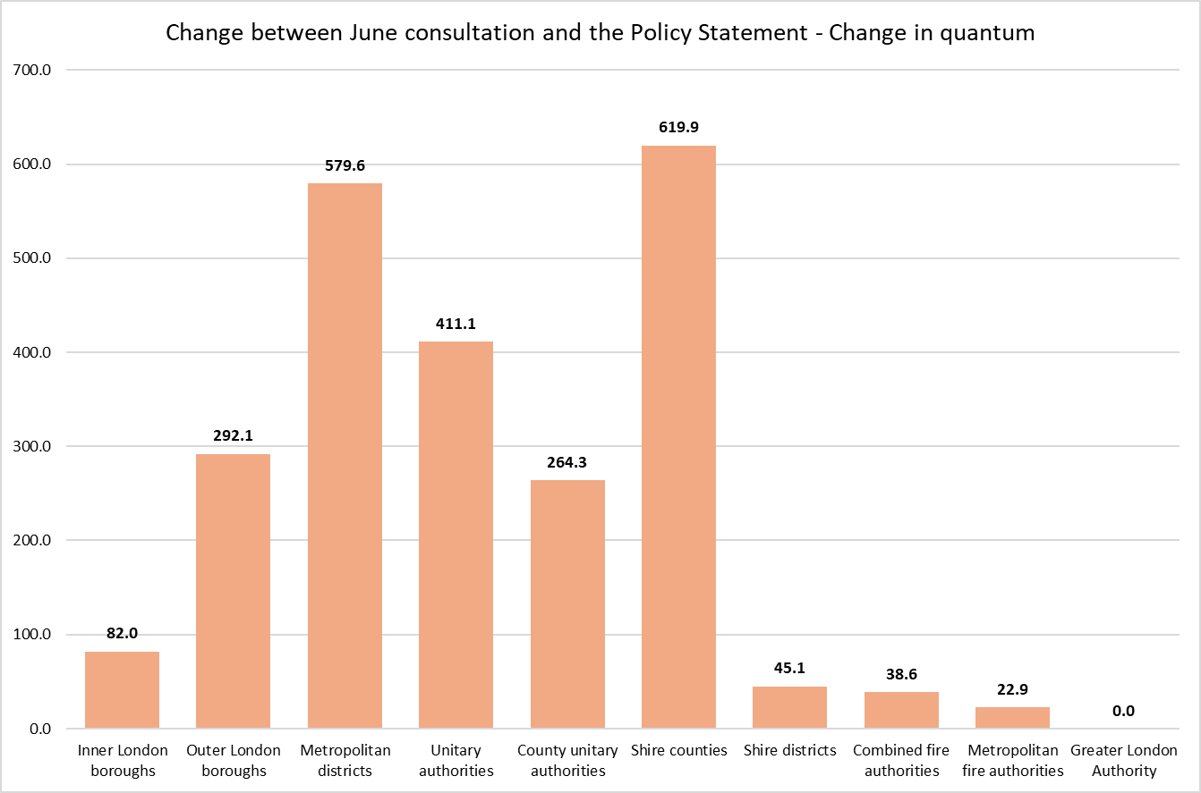
Change in quantum
By 2028-29, there is an additional £2.355bn within Core Spending Power (CSP) compared to our June assumptions
Forecasts not constrained by the SR25 CSP projections
Rolled-in BRRS up from £1.495bn to £2.4bn (now including rolled-in pooling/ pilot/ and cap comp)
£3.4bn in additional grant funding (ASC funding £900m, children’s funding £870m, transitional support £1.375bn, and other funding £300m)
Plus full indexation of BFL £3.5bn
Largest cash increase for shire counties (including funding for ASC etc)

Slide 12
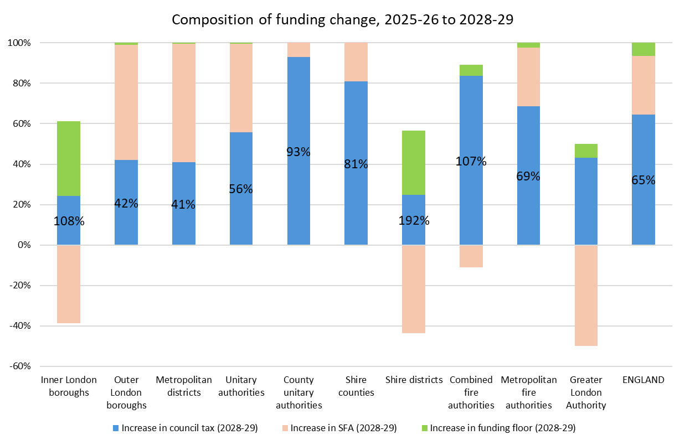
CSP increase funded by council tax
Overall, 65% of increase in CSP (including funding floor) is from council tax increases
For county unitaries, 93% of CSP increase is from council tax, for shire counties 81%
Outer London and Metropolitan authorities fund only ~40% of CSP increase from council tax
Funding composition for inner London and shire districts is skewed by the scale of funding floor still received in 2028-29

Slide 13
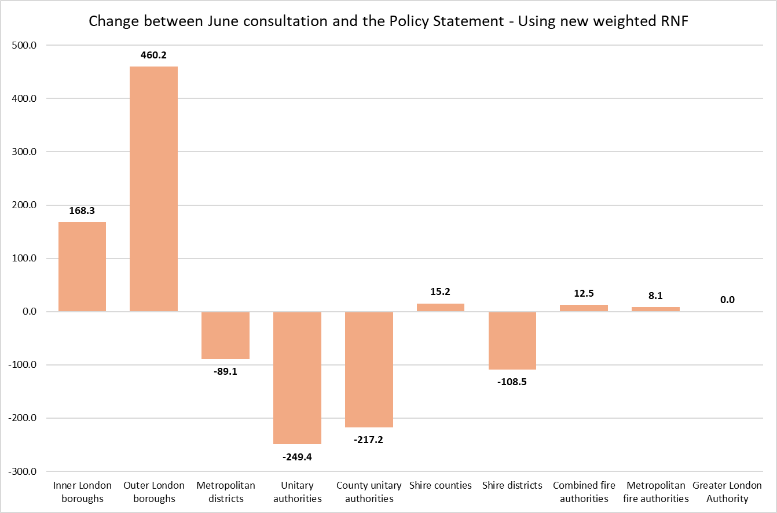
Revised weighted RNF
Updated weightings, with higher share for County Foundation Formula
Results in small cash gain for shire counties (even with other underlying reductions in RNF)
Substantial reductions for county unitaries – reduced RNF share, with no offsetting increase in weighting
Losses primarily driven by removal of remoteness
Massive gains in London, esp outer London (IMD and IDACI)
Surprising reductions in some unitaries with high levels of deprivation (Blackpool, Knowsley, Middlesbrough)

Slide 14
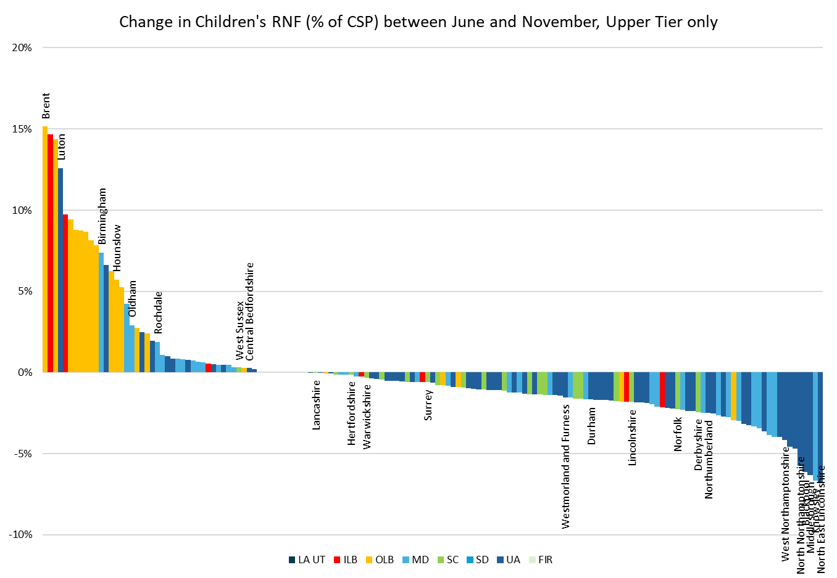
Children’s RNF
Applying new IDACI to the Children’s RNF
Very significant gains is almost all inner and outer London borough, as well as some Mets (Birmingham, Oldham, Rochdale) – an increase worth 15% of CSP for Brent
Losses worth more than 5% of CSP in North Northants, West Northants, and then some very high-need unitaries (Blackpool, Middlesbrough, NE Lincolnshire, plus Knowsley)

Slide 15
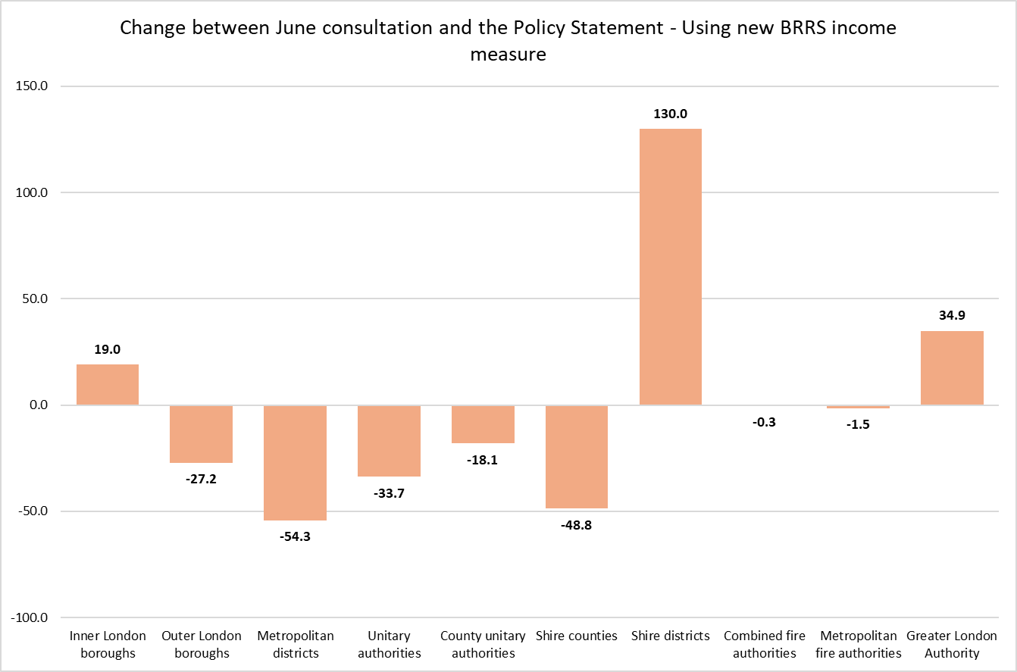
BRRS income
Perplexing decision to allocate full BR pooling gains to district councils
Huge gain to shire district council in pools – and these are protected at 95% for 3 years
Alternative measures available (e.g. notional split of pooling gains between tiers)
Not a huge issue in itself but important at the margins – and also about equity

Slide 16
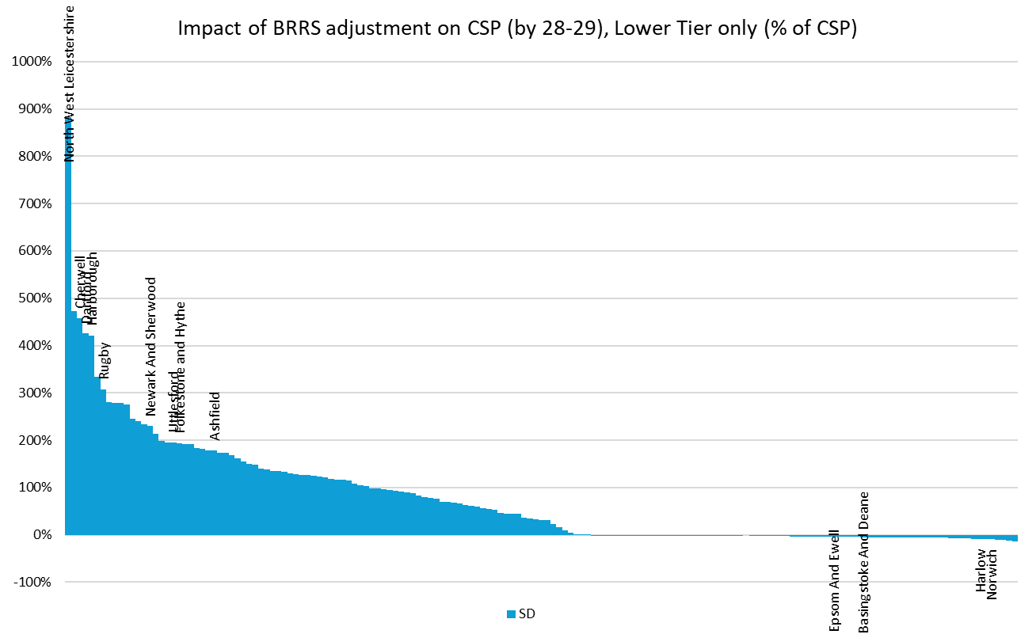
BRRS – shire district councils
BRRS income adjustment will benefit any shire district council with (a) high BR growth in 25-26 and (b) in a BR pool in 25-26
Notes:
Show impact on all shire districts.

Slide 17
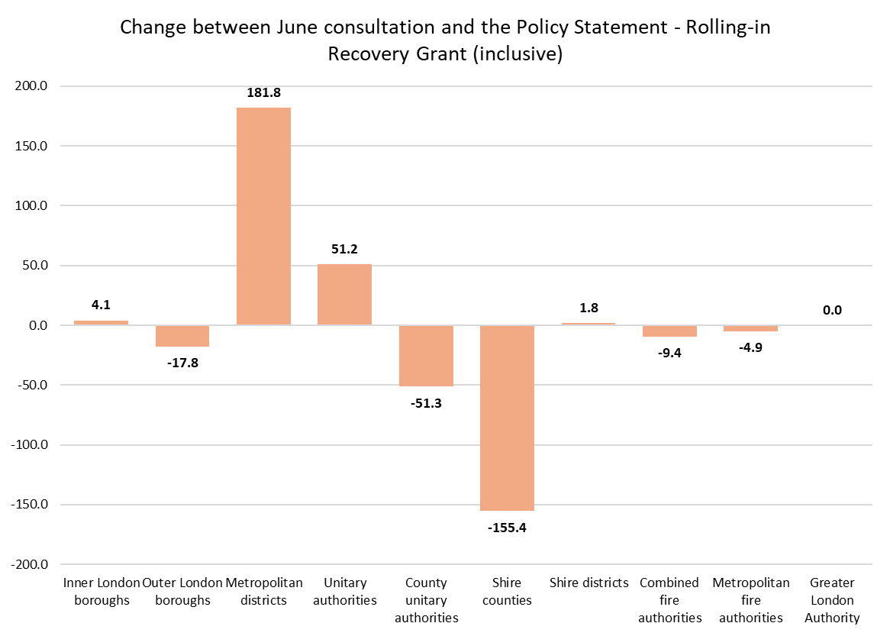
Recovery Grant
Decision to continue Recovery Grant over next 3 years based on 2025-26 distribution (i.e. 2019 IMD)
£600m in total remains outside SFA rather than being rolled-in and redistributed
Gains for Mets (only £181m compared to £341m in payments in 2025-26), and some gains for unitaries (some received large amounts)
But gains for individual authorities are very significant (e.g. Birmingham)
Losses in shire counties and county untaries (smaller losses for London too)

Slide 18
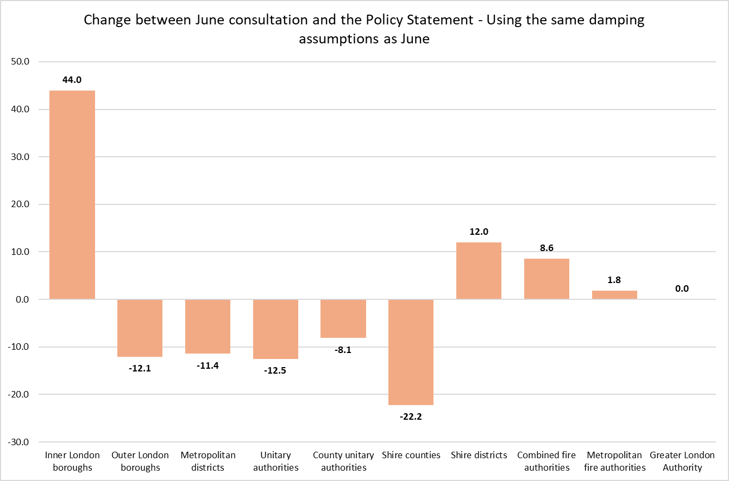
Transitional support – funding floors
Floors are more generous – real-terms protection for Recovery Grant recipients and fire authorities; 95% protection rather than 93% for those most-above funding targets
But relatively little movement in overall funding if we apply the June funding floor proposals
Overall cost of the funding floors has increased, even if impact of reverting to the June proposals makes little difference to overall cost
Cost of floors has increased because (a)there are more and higher floors, and (b) higher damping payments for districts’ BRRS income

Slide 19
Transitional support – funding floors
Cost of floors is significant and growing (reaches £779m by 2028-29)
Around £250m for shire district councils by 2028-29
Relatively low payments for Recovery Grant authorities
Funding floor payments to Inner London boroughs £405m in 2028-29, of which £124m to the City
No funding floor payments for shire counties or county unitaries
 | 2026-27 | 2027-28 | 2028-29
Upper tier with Recovery Grant | 47.7 | 54.5 | 59.3
Fire authorities | 1.0 | 7.2 | 14.6
Upper tier (no Recovery Grant, <15% above target) | 10.9 | 35.4 | 57.5
Lower tier less than 15% above target | 21.3 | 64.8 | 110.0
Upper tier more than 15% above target with low council tax | 56.9 | 206.6 | 356.2
Lower tier more than 15% above target | 21.7 | 85.0 | 148.6
Greater London Authority | 0.0 | 0.0 | 33.6
TOTAL | 159.5 | 453.6 | 779.8

Slide 20
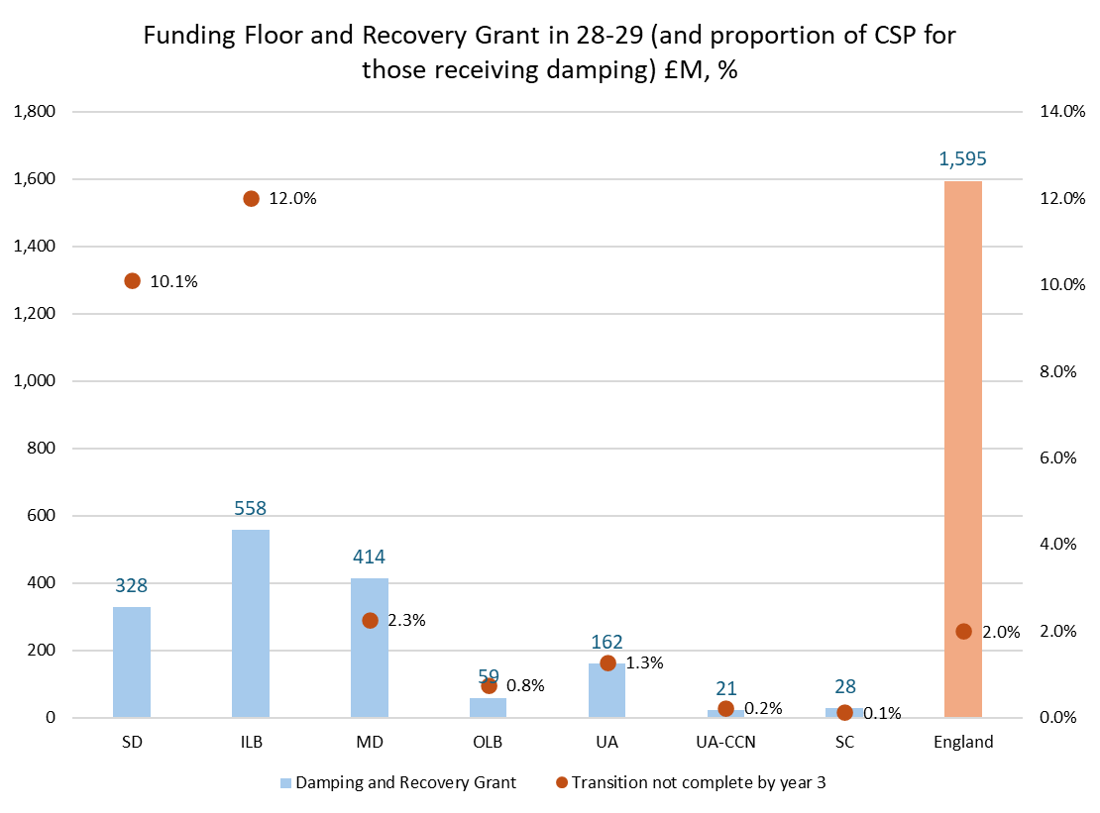
Cliff edge going into 2029-30
Very significant cliff-edge going into 2029-30 (new SR and possibly a new government)
Particularly significant for shire districts and inner London boroughs (10.1% and 12.0% above funding target in 2028-29)
Much lower cliff-edge for Mets (only 2.3% of CSP)
Potentially, this is a risk for these authorities – but more likely that it makes it even harder for a future funding review to bring these authorities “down” to their funding targets
This is a really important point of principle – ministers do not want to damping and do not want to repeat frozen damping of 2013-14 – but this does just that.

Slide 21
Model accuracy
Some values given to authorities for the 3-year increase in CSP (£M and %)
16 authorities shown in chart, not a representative selection
We have compared these to our model
Forecasts for shire counties and county unitaries are close
Larger variances for some London boroughs and Mets
Possible uncertainty around quantum
Bear in mind when using forecasts in budget planning

Slide 22
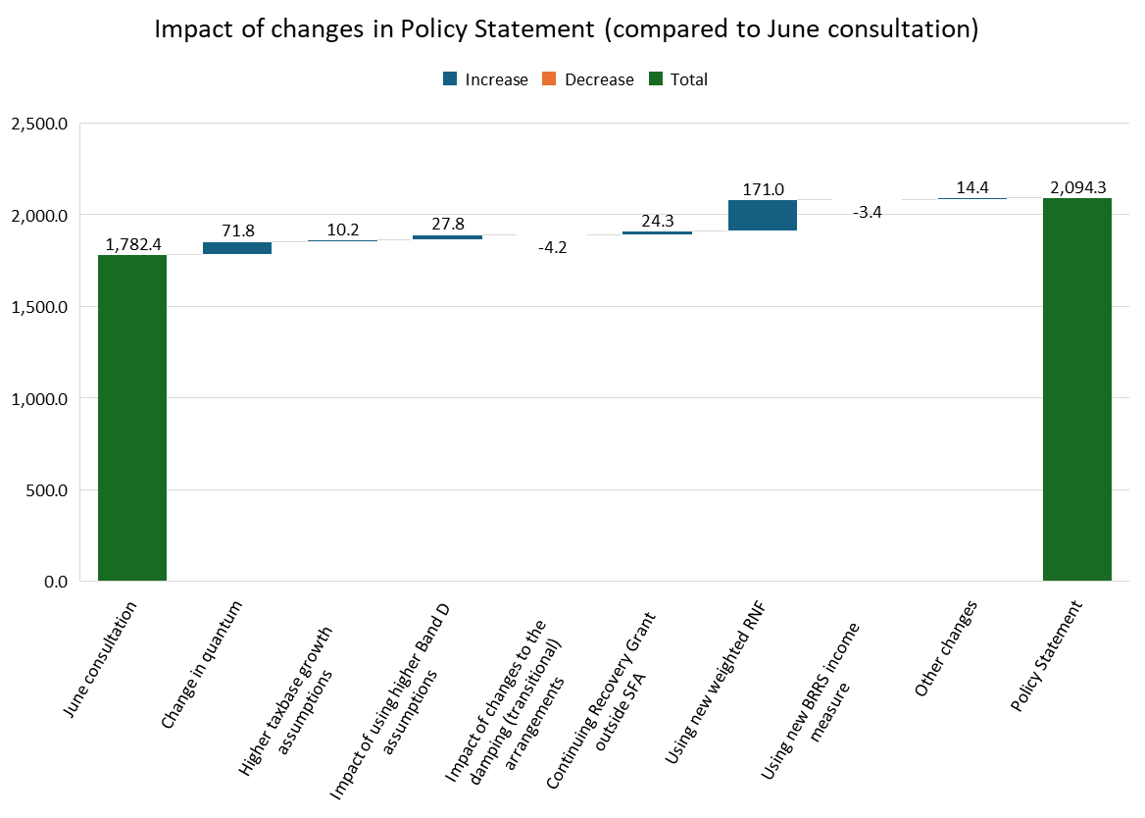
Change compared to June – Birmingham
Comparison of 2028-29 in the June and latest MTFP models
Gaining on everything
Particularly on new weighted RNF (+£171m)
£24m gain on Recovery Grant (compared to £39m actually received in 2025-26)
£311m increase in CSP (+17.5%), and reduced share of CSP (from 2.2% to 2.5%)

Slide 23
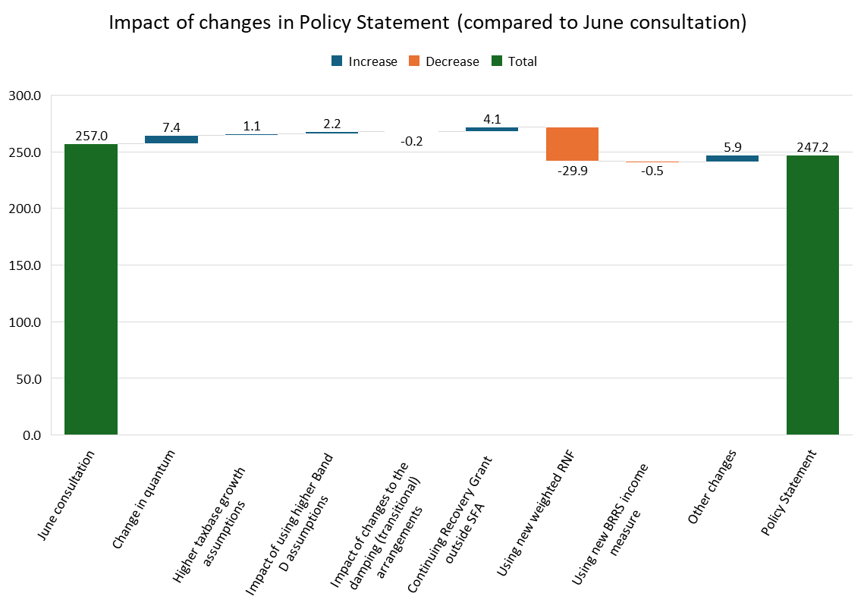
Change compared to June – Blackpool
Comparison of 2028-29 in the June and latest MTFP models
Gaining on quantum and Recovery Grant
But losing very heavily indeed on weighted RNF – and particularly Children’s RNF
Blackpool has highest IMD score (43.5)
£10m reduction in CSP (-3.8%), and reduced share of CSP (from 0.318% to 0.295%)

Slide 24
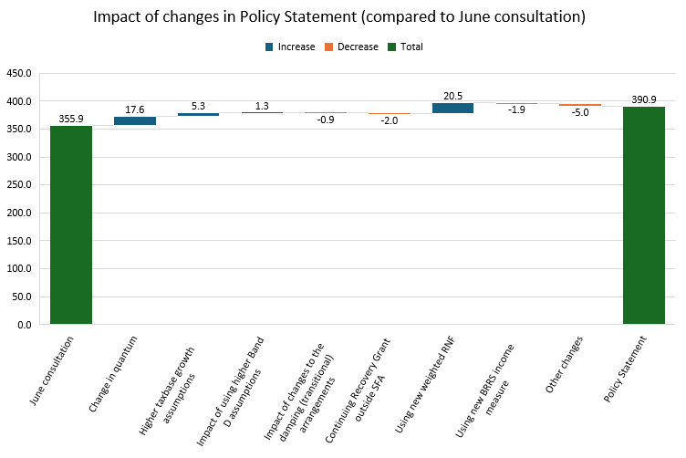
Change compared to June – Hounslow
Comparison of 2028-29 in the June and latest MTFP models
Substantial gains in June proposals and further gains in November
Gains from weighted RNF and from quantum, marginally offset by smaller reductions in other changes

Slide 25
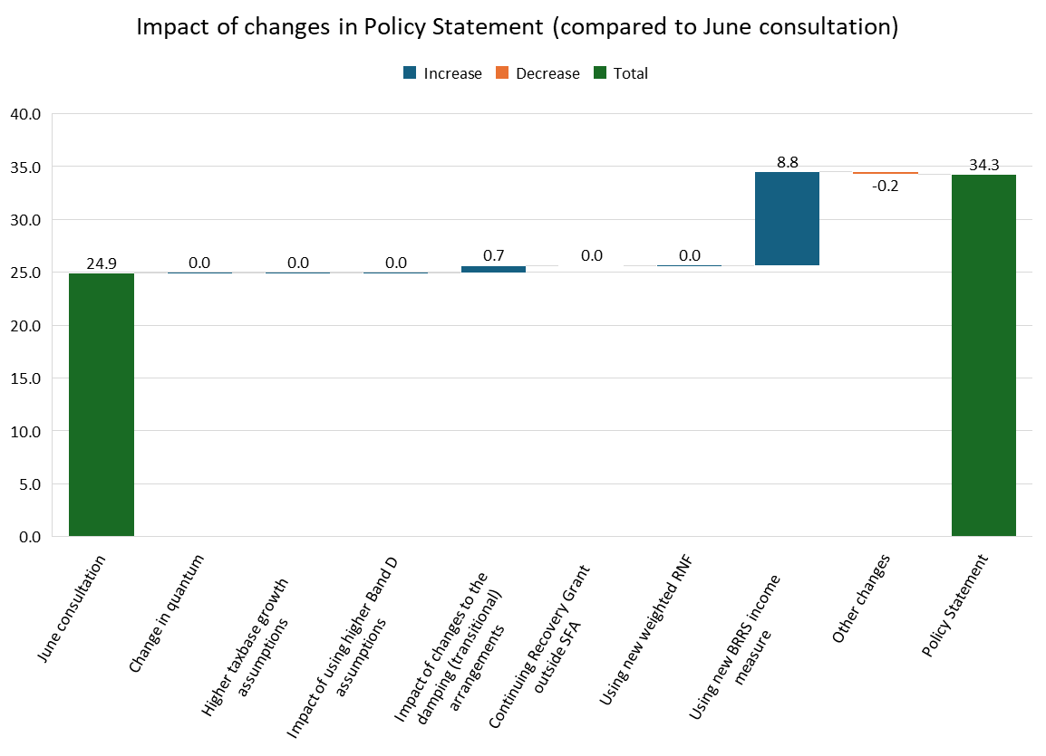
Change compared to June – North West Leicestershire
Comparison of 2028-29 in the June and latest MTFP models
Huge benefit from the way BR pooling gains have been rolled in
Represents a 37% increase CSP compared to June
£9.3m increase in CSP (+37.5%), but reduced share of CSP (from 0.031% to 0.041%)

Slide 26
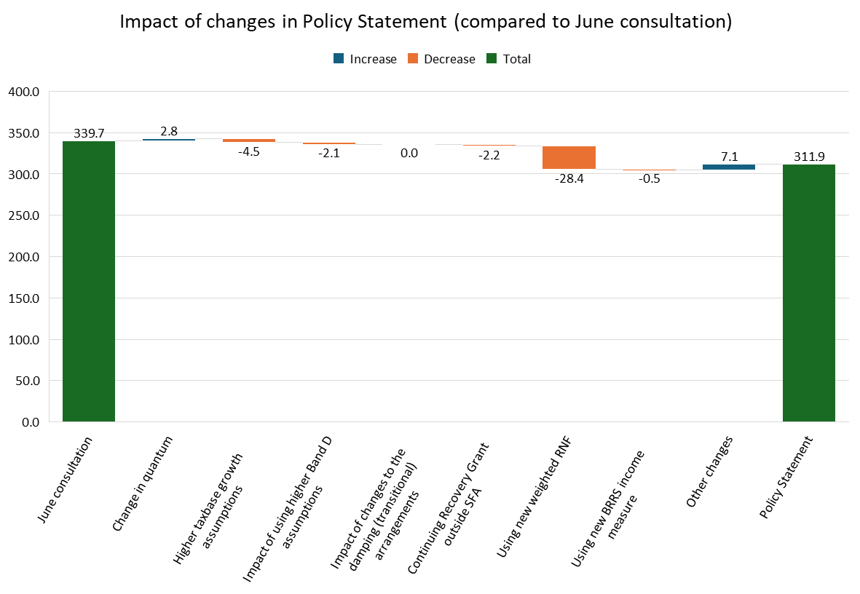
Change compared to June – Westmorland and Furness
Comparison of 2028-29 in the June and latest MTFP models
Losing from every change, particularly new weighted RNF
Impact of remoteness
Reduction of £28m compared to June
£28m reduction in CSP (-8.2%), but reduced share of CSP (from 0.42% to 0.37%)

Slide 27
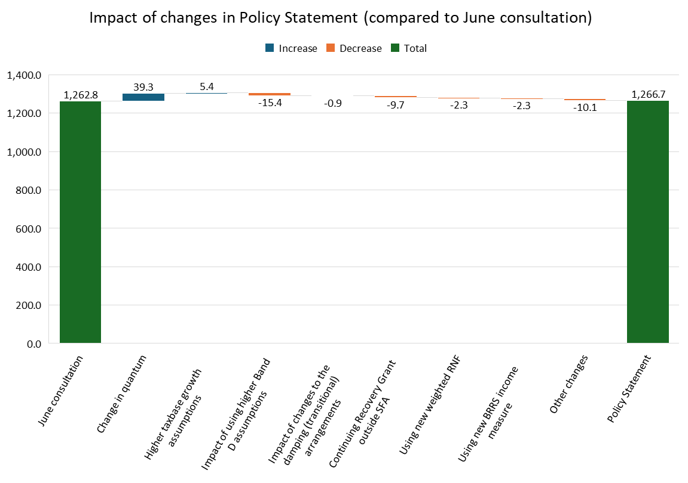
Change compared to June – Hertfordshire
Comparison of 2028-29 in the June and latest MTFP models
Gain from quantum – more than offset by other changes
Small increase compared to June of £4m
£4m increase in CSP (+0.3%), but reduced share of CSP (from 1.562% to 1.511%)

Slide 28
Next steps?
Provisional settlement – 17 December?
Our on-the-day briefing and analysis of variances between the settlement and our model
Update the model when we can
Potential for further lobbying?
ACA remoteness
Use of IDACI within the Children’s RNF
Recovery Grant
Transition (cost and calculation)

