Slide 1

Spending Review 2025 Financial accounts – first look
Adrian Jenkins/ Dan Bates
June 2025

Slide 2
Overview
Spending Review 2025 was published on 11 June 2025: https://www.gov.uk/government/collections/spending-review-2025
Overall real-terms growth in funding, but increases are front-loaded
Next spending review will be in 2027 – and there will be pressure to top-up funding allocations in 2028-29
Funding settlement still looks very tight for the public sector as a whole (HMT has attempted to make the increases look more generous)
Bulk of the increase in DEL will go to the NHS (60%) and many departments (8) will see their DEL cut
Funding for Defence increases to 2.5% of GDP (2.6% including security services), but increase largely funded from capital
Funding for schools is very tight (real-terms freeze if you strip-out cost of expanding free school meals)
In this context, local government’s settlement is better than the average – but only if you include council tax increases

Slide 3
Summary for local government
Local government’s Core Spending Power (CSP) will increase 3.1% real terms between 2023-24 and 2028-29
A tough settlement: it does not give the sector the funding it needs, and will result in much smaller increases in funding than the sector has received in recent years
Better settlement than many other parts of the public sector are getting, even if increases in resources are largely the result of council tax rather than more grant funding
Still uncertainty about the grant funding within CSP, and wider funding package (an additional £5bn in grant funding)
But increases in CSP are lower than the sector has received in recent years – and lower than increases in spending pressures
Average CSP increases were 6.9% (cash) between 2019-20 and 2025-26 – and these will fall to around 4.5% over the next 3 years
Further destabilisation to local authority finances from the funding reforms in 2026-27

Slide 4
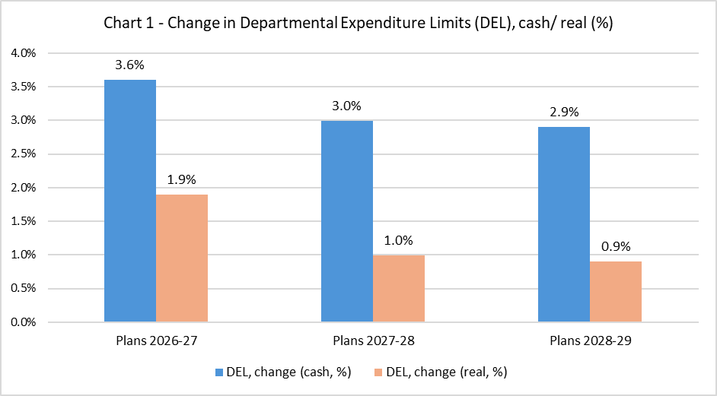
Departmental Expenditure Limits (DEL)
Spending Review 2025 gives us the first insight into the government’s spending priorities
Very tight settlement for the public sector as a whole
Average real-terms growth of only 1.2% over next 3 years
Front-loaded growth (real-terms growth falls from 1.9% in 2026-27 to 0.9% in 2028-29)
Next spending review is in 2027, and will update 2028-29
Further top-up in funding in 2028-29?

Slide 5
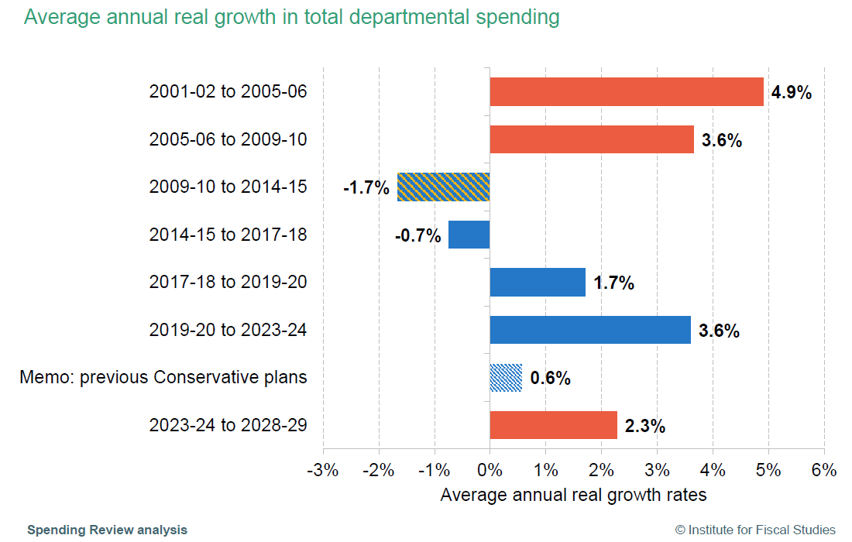
Historical context
Spending increased relatively rapidly in the last SR (19-20 to 23-24) +3.6%
Increasing more slowly in this SR period (+2.3%)
Note that growth was lower in the Phase 2 (25-26 to 28-29), at only 1.5% average growth in real terms
Gradual tightening of public spending over the decade
Increases are much higher than Conservative government’s pre-election spending plans

Slide 6
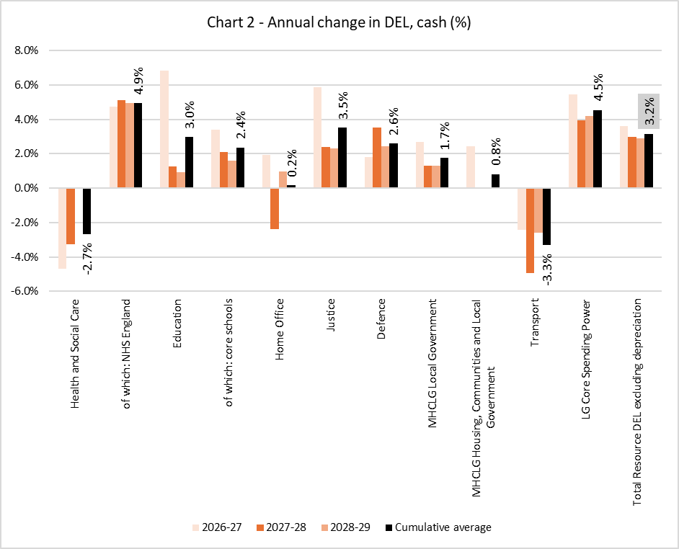
Departmental Expenditure Limits (DEL)
Average cash increase in DEL is 3.2%
NHS is the clear winner in SR25 – consistent annual increases in funding (averaging 4.9% cash), and receives £30.5bn (60% of the net increase in DEL)
Cuts in the non-NHS element of the DHSC DEL
Growth in Education and Schools but only small real-terms growth
Cash-flat for Home Office (real terms cuts) and resources for Police depend on precept increases
Increases in funding for Defence are largely in capital investment rather than revenue spending
Local government CSP increases by 4.5% on average – but depends on council tax increases

Slide 7
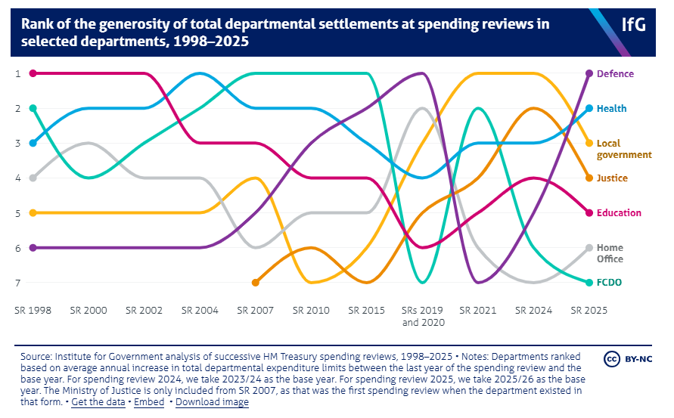
The winners and losers!

Slide 8
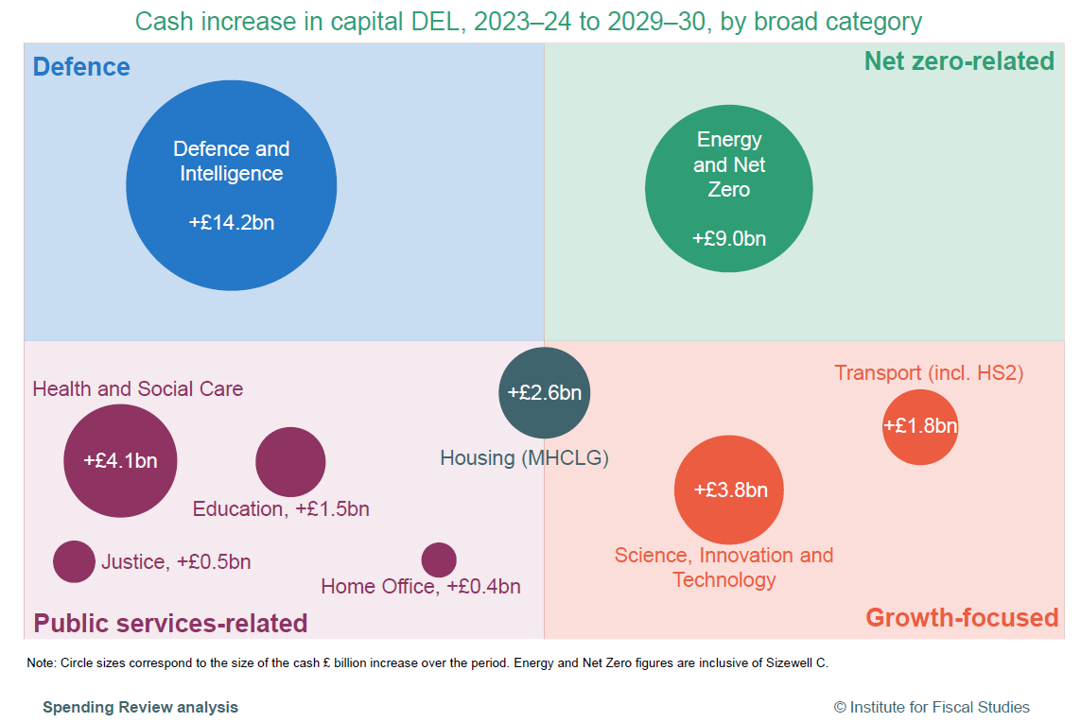
Capital DEL
Largest increase in capital spending is in Defence (2.5% GDP target). Spending is increasingly capital intensive.
Large amounts also on Energy and Net Zero.
Smaller amounts on Housing and Transport
Less of a growth focus than might have been expected?

Slide 9
Local government Core Spending Power (CSP)
CSP increases by £9.5bn by 2028-29(Table 5.3)
Assume increase in council tax (average increase 6.2%), generating £7.5bn by 2028-29
Implies additional grant funding of £2.3bn, with £1.4bn in 2026-27, £388m in 2027-28 and £533m in 2028-29
Increase in CSP (and grant funding) is front-loaded
Real-terms growth depends on growth in council tax revenues (76% of increase in CSP is from council tax)
Summary – local government will have real-terms growth in CSP and this is better than for most other parts of the public sector
We will set this in wider CSP timeline later
£bn | 2025-26 | 2026-27 | 2027-28 | 2028-29 | Cumulative change
Council tax | 38,312 | 40,678 | 43,190 | 45,858 | 7,546
Grant funding (incl SFA) | 31,094 | 32,522 | 32,910 | 33,442 | 2,348
Core Spending Power | 69,406 | 73,200 | 76,100 | 79,300 | 9,894
CSP increase (cash, £bn) |  | 3,794 | 2,900 | 3,200 | 9,894
CSP increase (cash, %) |  | 5.5% | 4.0% | 4.2% | 4.5%
Real terms growth in CSP (%) |  | 3.8% | 2.1% | 2.4% | 2.7%
Increase in grant funding (incl SFA) |  | 1,428 | 388 | 533 | 2,348
Proportion of CSP increase from council tax |  | 62% | 87% | 83% | 76%
The SR25 (and an email from MHCLG) refers to a £3.4bn grant increase within CSP. This is the “Phase 2” increase in funding, which refers to the period 2025-26 to 2028-29. That is, it includes increases in grant funding in the current year.
The IFS estimate that council tax will fund “over 80%” of the increase in CSP. Similar to our analysis, possibly with different assumptions for council tax growth.

Slide 10
Local government Core Spending Power (CSP)
CSP increases by £9.5bn by 2028-29(Table 5.3)
Assume increase in council tax (average increase 6.2%), generating £7.5bn by 2028-29
Implies additional grant funding of £2.3bn, with £1.4bn in 2026-27, £388m in 2027-28 and £533m in 2028-29
Increase in CSP (and grant funding) is front-loaded
Real-terms growth depends on growth in council tax revenues (76% of increase in CSP is from council tax)
Summary – local government will have real-terms growth in CSP and this is better than for most other parts of the public sector
We will set this in wider CSP timeline later
£bn | 2025-26 | 2026-27 | 2027-28 | 2028-29 | Cumulative change
Council tax | 38,312 | 40,678 | 43,190 | 45,858 | 7,546
Grant funding (incl SFA) | 31,094 | 32,522 | 32,910 | 33,442 | 2,348
Core Spending Power | 69,406 | 73,200 | 76,100 | 79,300 | 9,894
CSP increase (cash, £bn) |  | 3,794 | 2,900 | 3,200 | 9,894
CSP increase (cash, %) |  | 5.5% | 4.0% | 4.2% | 4.5%
Real terms growth in CSP (%) |  | 3.8% | 2.1% | 2.4% | 2.7%
Increase in grant funding (incl SFA) |  | 1,428 | 388 | 533 | 2,348
Proportion of CSP increase from council tax |  | 62% | 87% | 83% | 76%
There is uncertainty about the increase in grant within CSP. £3.4bn over 4 years (25-26 to 28-29), but increase in grant was £1.9bn in 25-26.
The SR25 (and an email from MHCLG) refers to a £3.4bn grant increase within CSP. This is the “Phase 2” increase in funding, which refers to the period 2025-26 to 2028-29. That is, it includes increases in grant funding in the current year.
The IFS estimate that council tax will fund “over 80%” of the increase in CSP. Similar to our analysis, possibly with different assumptions for council tax growth.

Slide 11
Implications for local government funding
Increase in CSP is higher than increase in the average increase in DEL (CSP = 4.5% average, Total DEL = 3.2% average)
But growth is reliant on council tax increases, and is front-loaded
Reliance on council tax growth puts pressure on individual authorities to agree above-inflation increases in Band D
Distribution of the growth in council tax revenues puts more pressure on equalisation (or delivers unequal increases in CSP)
Potentially more funding towards the later years (“This is the floor not the ceiling for the settlement”) – funding top-up of some kind is possible, especially for social care
We still need to clarify: (a) the grant funding within CSP, (b) the grant funding outside CSP, and (c) additional funding for transitional support outside CSP
Also uncertainty about other major revenues streams, including retained business rates income

Slide 12
Council tax
No change in the main thresholds: maximum 3% core increase, and 2% ASC Precept
Specific thresholds for shire districts, fire authorities and police are not specified (we assume they remain at £5 for districts/ fire, and £14 for police)
Assumptions used by government within CSP are based on the average increase in council tax yield in recent years is 6.2% (with most councils applying the maximum increase, and taxbase growth of around 1.3%)
Increases in spending power in local government and police are largely reliant on growth in council tax yield (but how reliant?)

Slide 13
Adult social care funding
SR 25 promises an additional £4bn by year 3
“The SR allows for an increase of over £4 billion of funding available for adult social care in 2028-29, compared to 2025-26. This includes an increase to the NHS’s minimum contribution to adult social care via the Better Care Fund, in line with DHSC’s SR settlement.”
ASC precept will generate about £1.8bn by 2028-29 (it generates an additional ~£600m of additional income each year).
So, that suggests there will be a further £2.2bn in funding, either from the NHS contribution or specific grants.
The NHS contribution in 2025-26 is about £5.6bn: https://www.england.nhs.uk/ourwork/part-rel/transformation-fund/better-care-fund/grants-and-funding/
An increase in line with the uplift in NHS funding overall (about 5% cash per year) would generate an increase in contribution of ~£260m per year, about £840m by year 3.
If that is the case, then there would need to be £1.4bn in social care grant within CSP. This will consume the bulk of any increase in grant funding within CSP.
Increased funding will have to go towards “fair pay agreement” for social care staff. Will cost of any reforms following Casey Review be funded?

Slide 14
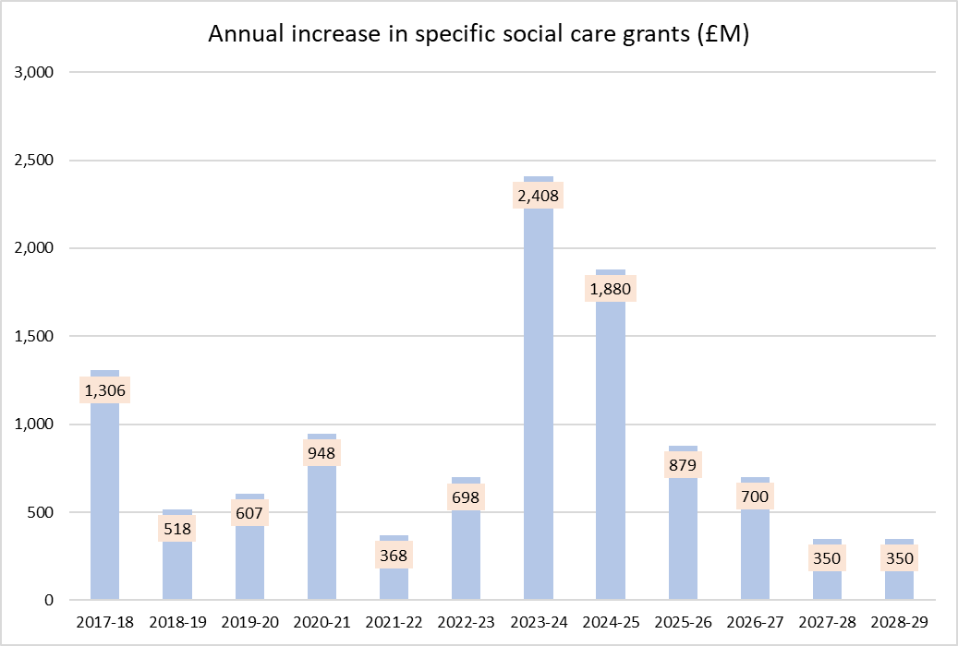
Adult social care grants
Increases in social care grants since 2017-18 have been very significant (average £1bn increase every year)
If there is indeed £1.4bn for ASC grants within CSP, then they are potentially phased as: £700m in 26-27, £350m in 27-28 and £350m in 28-29
£700m is comparable to most recent years (except the very large increases in 23-24 and 24-25); £350m per year would be towards the lower end
Our wider analysis of social care funding indicates that overall social care resources would be increasing at only 4.8% per year – compared an average of 10.3% since 2020-21
Lower increases will place more pressure on social care services
Forecast grant increases for illustration only

Slide 15
What is included in the grants within CSP?
Not clear what is included within the additional grant funding within CSP.
Our initial calculations suggested an additional £2.3bn over 3 years
£1.4bn in additional funding for adult social care (see previous slide)
Indexation of Settlement Funding Assessment (SFA). SFA has been indexed in every year since 2020-21, and this would cost around £340m per year (£1.0bn over 3 years)
Funding for transitional support. Some funding will be held back for damping – but the amount is unknown and could be funded from outside CSP (most of the funding would be in year 1)
Children’s Social Care Transformation Fund (£500m). Some is potentially within CSP.
Can all these funding streams be included within the grant uplifts in CSP?
Choices about what is funded – and what is not – has significant distributional consequences (districts/ fire, funding reforms, new burdens/ ongoing pressures)

Slide 16
MTPF model update
Update model early next week
Changes in assumptions to reflect SR25. These are modelling assumptions only (you can still change them in the MTFP model if you wish).
Additional social care grant. £1.4bn over 3 years (£700m, £350m, £350m)
Children’s Transformation Fund. Part of the £500m in 2025-26 (say, 50%)
Remainder for transitional support (£700m)
No increase in SFA or cap compensation

Slide 17
Wider local government grant funding
MHCLG email: Spending Review provides £5bn in new grant funding for local government
£3.4bn additional grant funding within CSP (see previous slides for discussion about definition)
£760m to reform the current SEND system
An increase in the NHS’s contribution to adult social care via the Better Care Fund (BCF) (amount not known, but could be around £860m)
£500m from the Transformation Fund for children’s services (helping more children stay with their families and preventing children going into the care) [This is on top of the £523m Children’s Social Care Prevention grant in the LGFS.]
£100m to prevent homelessness
£100m to support adults with complex needs
There is still more to find out here because total potential grants exceed £5bn

Slide 18
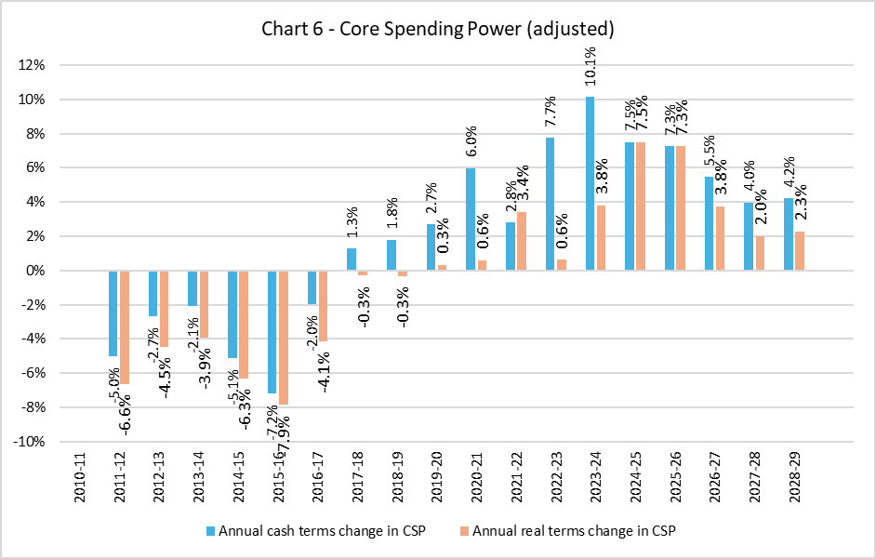
Core Spending Power (CSP)
Average change in CSP is 2.7% (real) over 3 years, and 4.5% (cash)
Contrast to recent spending rounds, where CSP increases have been higher in cash terms
CSP growth has exceeded inflation (compared to both CPI and GDP Deflator) in every year since 2020-21
Increases in CSP will be lower over the next 3 years than they have been in the past 5 years
CSP has increased (on average) by 6.9% per year since 2019-20 (3.8% in real terms)

Slide 19
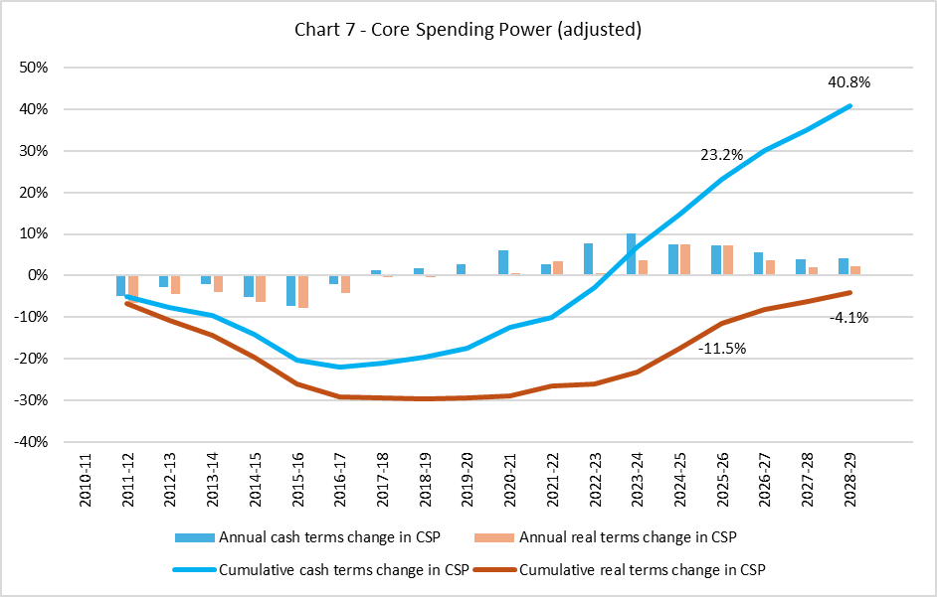
Core Spending Power (CSP) since 2010-11
CSP will be +40.8% higher in 2028-29 than it was in 2010-11 (compared to +23.2% in 2025-26)
In real-terms, CSP will still be marginally below its 2010-11 level (-4.1%)

Slide 20
Funding for police and fire
Funding for police services will increase by 2.3% per year in real terms
Much better than for the Home Office overall, where funding is effectively flat in cash terms over the period
This is a slightly smaller average increase than for local government
Increases in funding for police services will be largely fund from an increase in the police precept
There is no specific mention of funding for fire but will be funded from within the local government finance settlement
Precept increases likely to be the higher of 2.99% or £5, but not confirmed

Slide 21
Local government funding reforms
Funding reforms in 2026-27 will be much more difficult to deliver with limited increases in overall funding
Do the limited increases in funding in this spending review indicate that MHCLG will have to scale-back its ambition for redistribution in the funding reforms next year? Or will they have to extend the period over which reforms are implemented?
Reliance on council tax increases for future CSP growth will put even more pressure on implementing council tax equalisation
Transitional support funding is within CSP – but the cost is likely to be considerable (scaling-back gains?)
The government is still committed to “simplify[ing] the local government funding landscape, by consolidating as much revenue funding as possible from across government departments into the LGFS”. They are also committed to multi-year settlements.

Slide 22
Simplifying local government funding
The government is still committed to “simplify[ing] the local government funding landscape, by consolidating as much revenue funding as possible from across government departments into the LGFS”. They are also committed to multi-year settlements.
Simplification could have a wider scope than previously expected. MHCLG is looking to consolidate 300 budgets lines with 12.7bn value, monitored by different departments. Expecting to consolidate much of this spending into two pillars, with more flexibility to move money around.
Ministers also want LGR/ unitarisation achieve something similar (i.e. move money up and down the two-tier system). Not about taking money out of the system but is more about new unitary councils to make the right choices for your area.
Reform consultation – “only weeks away”. Want to get a provisional settlement in late November, but new governments always want that!

Slide 23
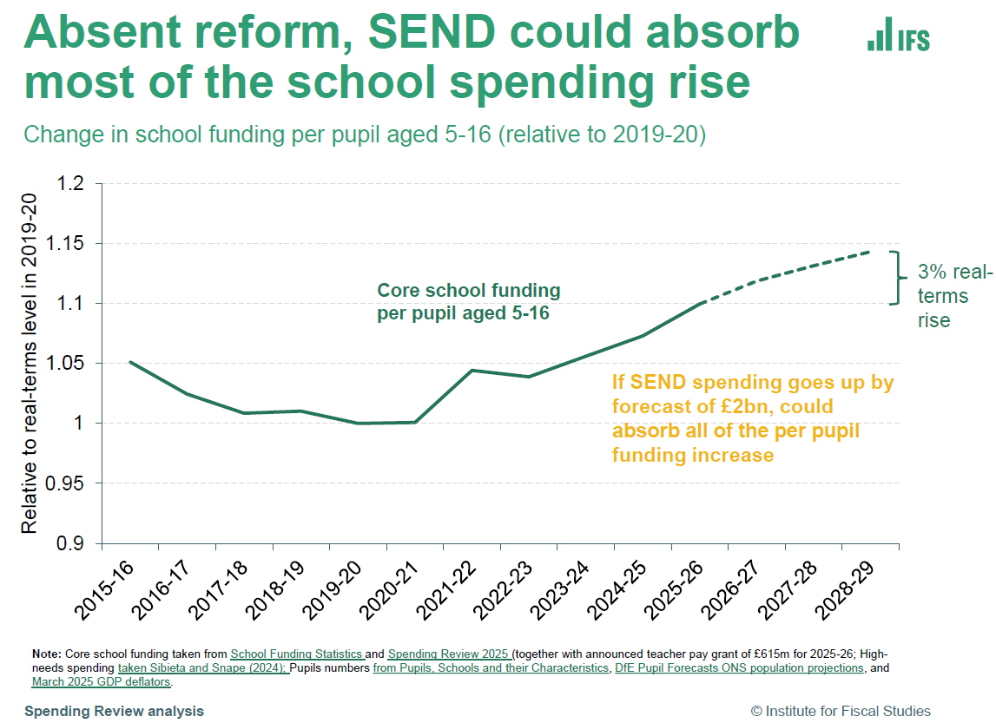
SEND funding
Disappointing that there was no announcement about SEND deficits in the spending review
“a looming challenge”
Will now be addressed in the funding reform consultation paper this month, and/ or in a White Paper in the Autumn
Negotiations are still ongoing between HMT, DfE and MHCLG
IFS analysis shows that, without action, the increase in SEND deficit could wipe-out all the increase in schools funding
Ministers realise they cannot leave councils with a “cliff edge”

Slide 24
Devolution – Integrated Settlements
Integrated settlements will be expanded from GM and WM to include North East, West Yorkshire, South Yorkshire, Liverpool City Region and London
Inclusion of all but London was announced in the English Devolution White Paper
Principles and monitoring set out in a new paper: https://www.gov.uk/government/publications/integrated-settlement-policy-document/integrated-settlement-policy-document
Integrated settlements will include funding falling under “themes” where MSAs have functional responsibilities (e.g. economic development, transport, adult skills).
Will not include any funding streams that “directly underpin local statutory and/or core responsibilities” or funding for national transport schemes
Quantum for integrated settlements will be determined on a formulaic basis (MSAs no worse off), and budgets transferred to MHCLG (Budget Cover Transfer, BCT), and paid to MSAs by s31 grant. Grant funding is without conditions, except in exceptional circumstances. MSAs will be able to move up to 10% of CDEL funding within each theme to RDEL, and 100% of RDEL funding within each theme to CDEL.
English Devolution Accountability Framework, to ensure MSAs are delivering value for money. MSAs will be held to account for delivery of the outcomes associated with the functional responsibilities
Funding will not be subject to departmental savings exercises during the course of an SR period (and MSAs will be responsible for fluctuating expenditure, at their risk)

Slide 25
Transport and infrastructure
Additional capital investment for transport schemes, some national (Transpennine route upgrade, East-West Corridor between Oxford and Cambridge), and some via local authorities and mayors:
Providing £15.6 billion in total by 2031-32 for the elected mayors of some of England’s largest city regions via the Transport for City Regions (TCR) settlements.
Investing £2.3 billion in the Local Transport Grant over Phase 2 for local transport improvements including bus lanes, cycleways and congestion improvement measures in places outside of those areas receiving TCR settlements.
Guidance for MSAs on Local Growth Plans: https://www.gov.uk/government/publications/local-growth-plans-england/guidance-for-mayoral-strategic-authorities-on-developing-local-growth-plans

Slide 26
Other funding issues
Public Health grant – cuts in the non-NHS element of the DHSC DEL suggests there will be no additional funding for public health
Household Support Fund (HSF) - will be replaced by the Crisis and Resilience Fund. Funding of £1bn (£742m in the HSF in 2025-26). But includes funding for Discretionary Housing Payments
Extended Producer Responsibility (EPR) – income streams continue in 2026-27 (guarantee ends in 2025-26)
Housing and homelessness – £100m from the Transformation Fund for early interventions in homelessness

Slide 27
Local government financial sustainability
Although local government CSP increases are higher than the average increase in DEL across the public sector, this is still a very challenging settlement for the sector
Increases in resources will be substantially lower than they have been recent years
Spending pressures will continue to grow more rapidly than resources
Funding reforms will create very severe funding pressures in some authorities (we need to know more about transitional support)
Non-CSP funding will be very important (particularly for SEND deficits)
Exceptional Financial Support (EFS) is likely to become more widely used within local government over the coming years – combined with pressure to increase council tax

Slide 28
First Balance Sheet Analysis for 2024/25
13 June 2025

Slide 29
How many have published 24/25 accounts?
Only 16 sets of accounts published so far (10 upper tier and 11 districts).
This is lower than expected. Two (not very scientific) surveys in April/May suggested that between 10 and 15% might publish by end of May.

Slide 30
Net Assets – Upper Tier
Aggregate balances for the 10 upper tier authorities which have published so far.
URR reduced significantly (9%) for the third year running.
Total usable reserves reduced by 3%.
Dedicated Schools Grant deficits have more than doubled.
Balance Sheets have shrunk.
Current Resources have reduced significantly (9%).

Slide 31
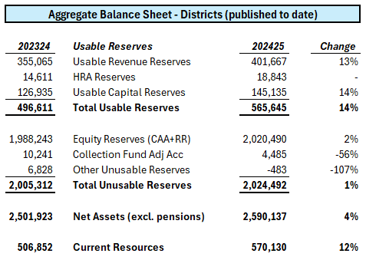
Net Assets - Districts
Aggregate balances for the 11 districts which have published so far.
URR increased significantly (13%).
Total usable reserves increased by 14%.
Collection Fund surpluses reducing..
Balance Sheets have grown.
Current Resources have increased significantly (12%).

Slide 32
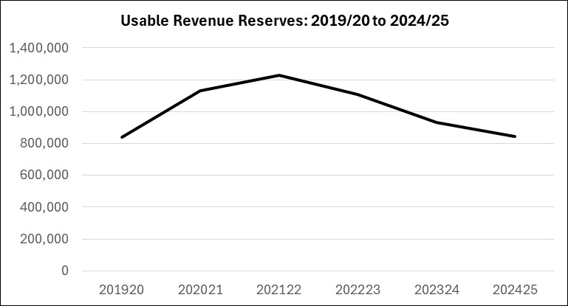
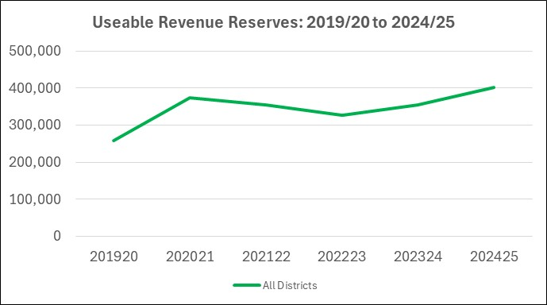
Usable Revenue Reserves
Upper Tier
Based on 10 which have published.
Decreased by 12% in cash terms.
Greater decrease as % of CSP
Third consecutive year where URR decreased significantly.
Districts
Based on 11 which have published.
Increased by 13% in cash terms.
Smaller decrease as % of CSP.

Slide 33
Usable Revenue Reserves
2.1%
6.3%
3.1%
7.6%
9.7%
7.7%
0.9%
3.1%
0.3%
5.1%
4.9%
5.8%
Upper Tier Usable Revenue Reserves depleted in the years where CSP increases were the highest.
Indication that demand/cost pressures growing faster than funding.
Average cash CSP increases between 2019/20 and 2025/26 were 6.9%, they will drop to 4.5% over the next three years.

Slide 34
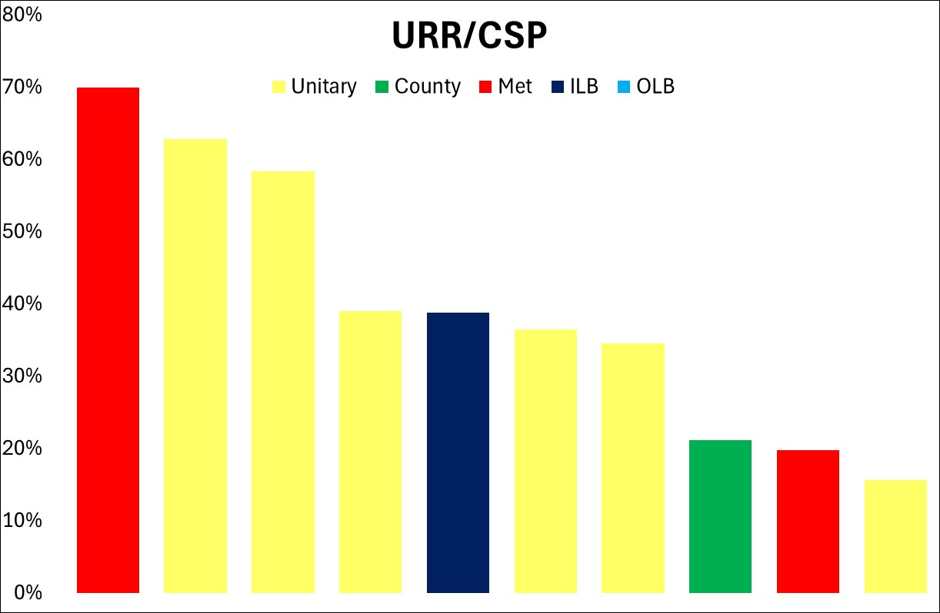
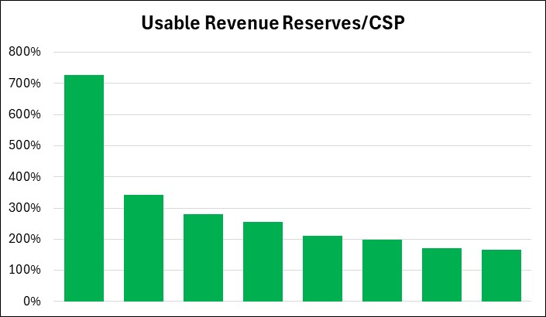
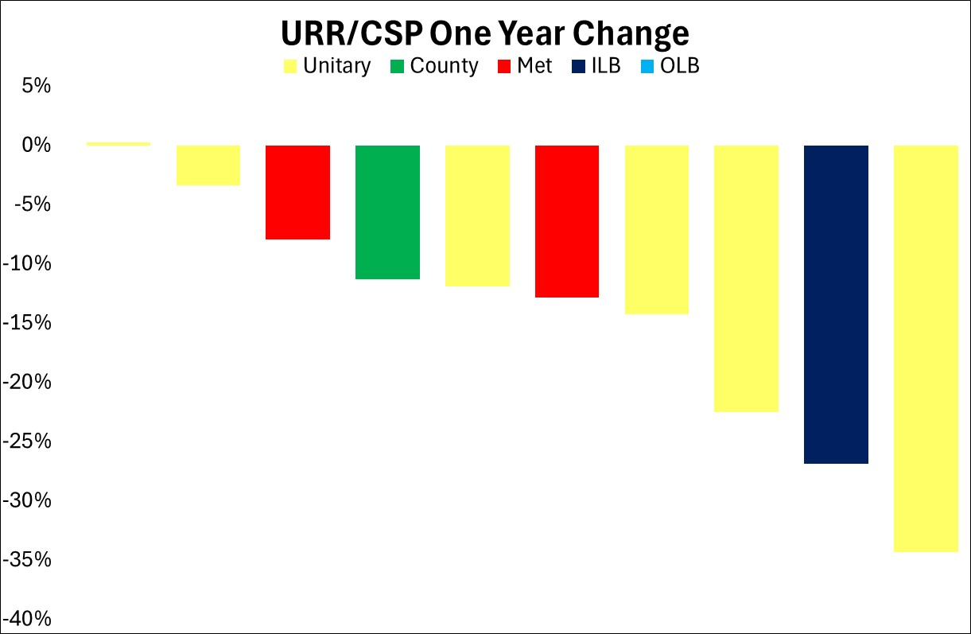
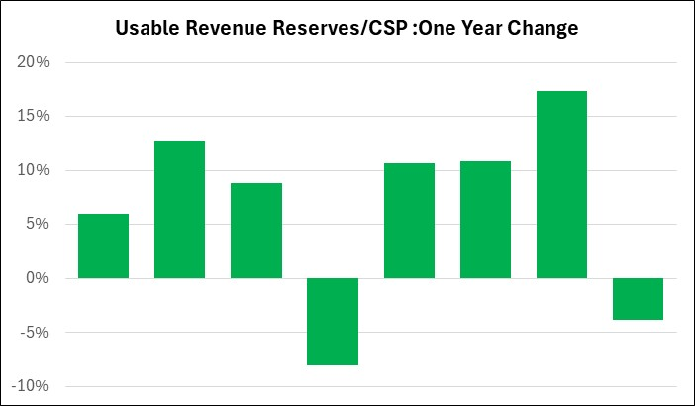
Usable Revenue Reserves
Upper Tier
Districts

Slide 35
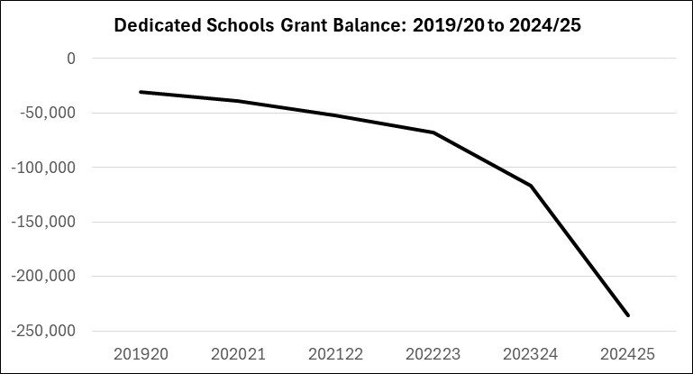
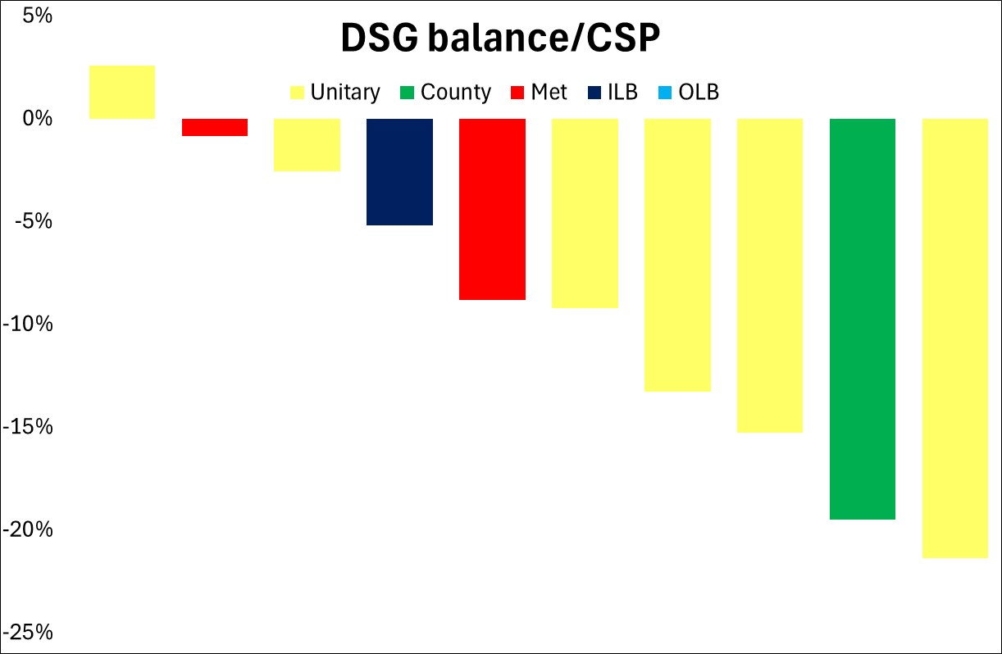
Dedicated Schools Grant Deficits
Dedicated School Grant deficits have accelerated for a second consecutive year for the eight authorities which have published.
They have more than doubled in aggregate.
This now appears to be a real threat to the financial health of most upper tier authorities.
But no real mention of the problem in the Spending Review:
To be resolved as part of the upcoming Funding Review?
Does Government really understand the magnitude of the issue?

Slide 36
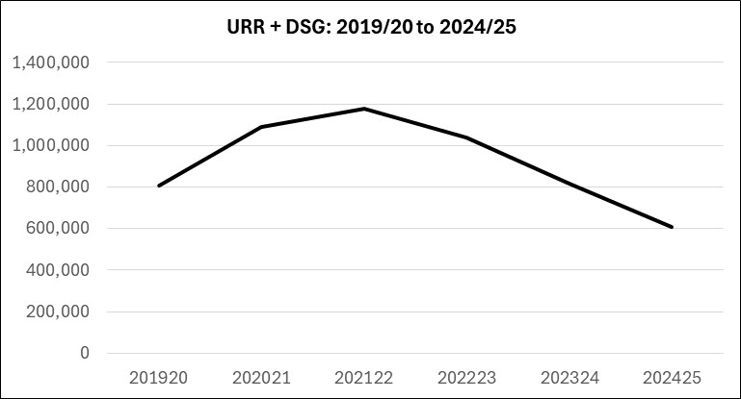
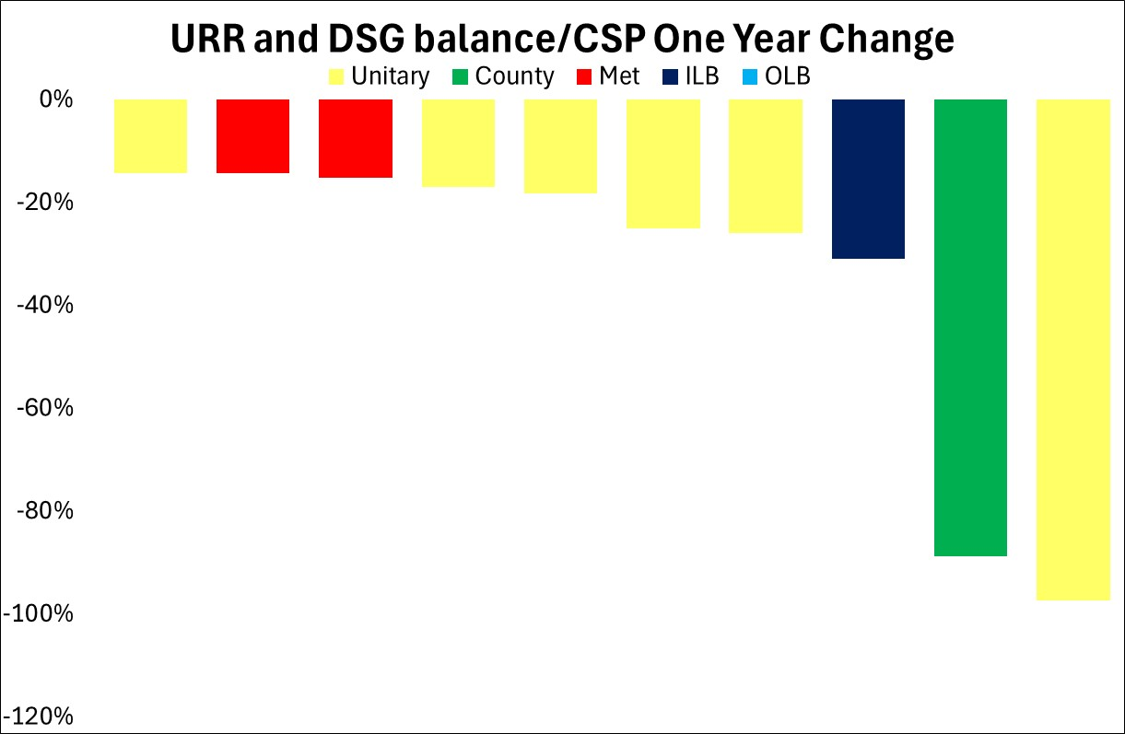
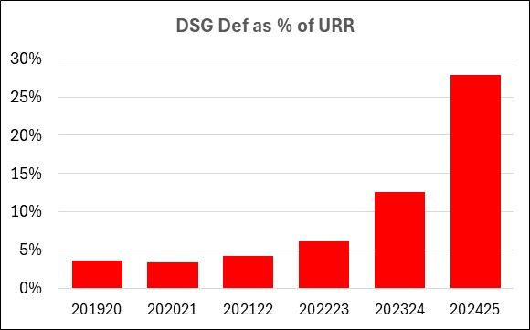
Dedicated Schools Grant Deficits
When adding DSG deficits to URR balances we see a much steeper decline in financial health.
For the 10 authorities, DSG deficits are almost a third of the size of the total usable revenue reserves.
In 2023/24, there were 3 authorities where DSG deficits > URR – suspect this number will increase

Slide 37
Debt and Borrowing – Upper Tier
Need to borrow has increased by 7%.
All this increase funded by external borrowing and some internal borrowing has switched to external.
Significant increase in short term borrowing (64%) and interest payable (24%).
External borrowing increasing due to:
Increased capital expenditure.
To fund DSG deficits.
Exceptional Financia Support.
Replace internal borrowing as reserves deplete.

Slide 38
Debt and Borrowing – Districts
Need to borrow has increased by 6%.
Mainly funded by internal borrowing which increased by 20% as external borrowing reduced slightly.
Opposite picture to upper tier. Increasing reserves amongst published districts translates to higher internal borrowing and lower exposure to interest rate volatility.

Slide 39
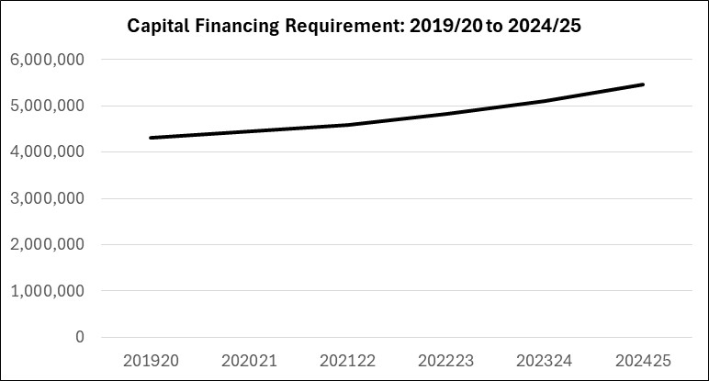
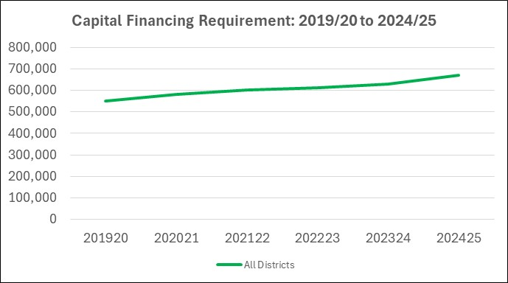
Capital Financing Requirement
Upper Tier
Based on 10 which have published.
Increase in CFR of 7% in 2024/25.
Graph in cash terms, in real terms, CFRs are stable with no real increase.
Districts
Based on 11 which have published.
Increase in CFR of 8%

Slide 40
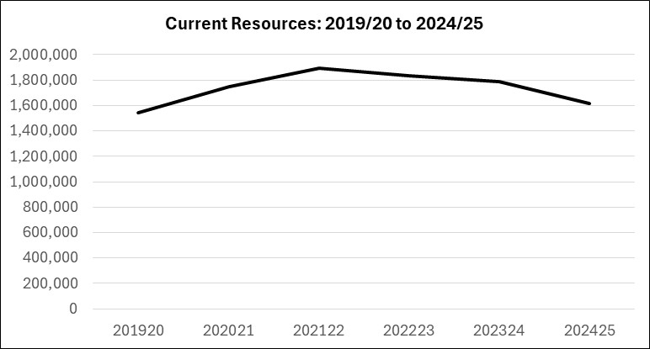
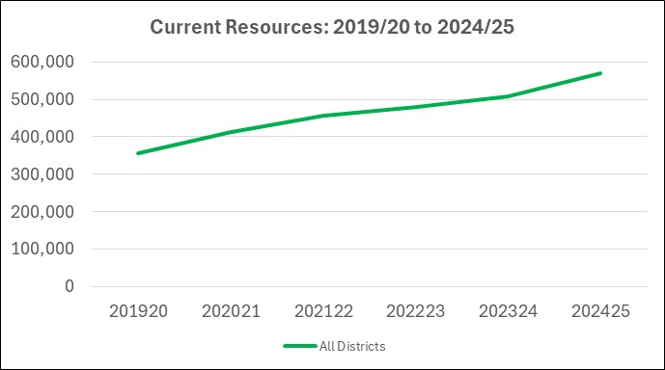
Current Resources
Upper Tier
Based on 10 which have published.
Reducing (in cash terms) for third consecutive year.
Shows the impact of falling URR and increasing DSG deficits.
Suspect usable capital reserves are ‘propping up’ current resources.
Districts
Based on 11 which have published.
Increased steadily over the last five years.
No DSG deficit and significant business rate gains.

Slide 41
Early conclusions
These are very early conclusions based just on 10 upper tier authorities and 11 districts which have released accounts.
Continuing signs of stress amongst upper tier authorities. Less so across districts.
Upper tier balance sheets have reduced in money terms by 4% (double figures percentage decrease as a proportion of CSP).
Trend of falling usable revenue reserves looks set to continue in 2024/25 – they have reduced by 9% across the 10 authorities which have published.
DSG deficits have more than doubled.
Taken together, current resources have reduced and this appears to have had an impact on borrowing, with external borrowing increasing quite significantly and debt interest cost rising.
Most districts have seen URR and current resources increase and this is reflected in CFR increases mainly being funded via internal borrowing.

