Slide 1

Provisional local government finance settlement 2025-26
Adrian Jenkins/ Dan Bates
19 December 2024

Slide 2
Agenda
Adrian (Pixel) – review of the provisional local government finance settlement 2025-26
Dan – analysis of the settlement
Adrian (Pixel) – funding reform consultation paper
We are recording this webinar and it will be available on our website tomorrow:
Slides will also be on the website tomorrow
Discussion and questions from 3pm to 3.30pm

Slide 3
Provisional settlement 2025-26
The Government published the provisional local government finance settlement for 2025-26 on 18 December 2024:
https://questions-statements.parliament.uk/written-statements/detail/2024-12-18/hcws342
https://www.gov.uk/government/collections/provisional-local-government-finance-settlement-england-2025-to-2026#core-spending-power-of-local-authorities-2025-to-2026-
https://www.gov.uk/government/consultations/consultation-provisional-local-government-finance-settlement-2025-to-2026/consultation-provisional-local-government-finance-settlement-2025-to-26
There will be a four-week consultation period, closing on 15 January 2025.
https://www.gov.uk/government/consultations/consultation-provisional-local-government-finance-settlement-2025-to-2026/consultation-provisional-local-government-finance-settlement-2025-to-26

Slide 4
Overview
Real-terms increase in Core Spending Power (6.0% in cash terms, 3.6% real terms)
Run of “good” settlements since 2020-21 – but have not matched increases in budget pressures
Change of course with new government – much greater focus on deprivation, and ability to generate council tax income
Measures used in 2025-26 are fairly aggressive
New grants: Recovery Grant, Children’s Social Care Prevention Grant
Deleted grants: Rural Services Delivery Grant, Services Grant
Reduced grants: Minimum Funding Guarantee
Net effect is a clear shift in resources towards high-deprivation authorities, with most shire districts getting no increase in CSP
Ministers have to be careful about how they justify the changes: partly about compensating for larger cuts in CSP in deprived areas since 2010-11; partly about anticipating changes in funding reforms in 2025

Slide 5
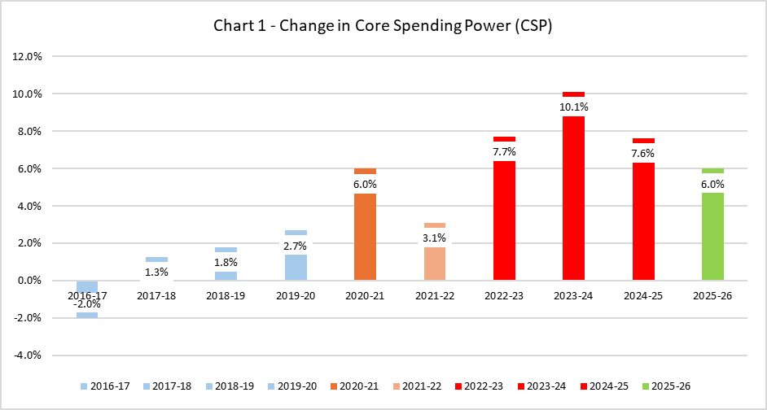
Core Spending Power (CSP)
Core Spending Power (CSP) increase of 6.0% in 2025-26
Additional £200m announced for social care in the settlement
3.5% real terms increase in CSP
Growth is lower (in cash terms) than previous 3 years, continues run of “good” settlements since 2020-21

Slide 6
Core Spending Power overview
 | 2023-24 | 2024-25 | Change in 2024-25 | Change in 2024-25 | Provisional settlement 2025-26 | Change in 2025-26 | Change in 2025-26
 | £m | £m | £m | % | £m | £m | %
Settlement Funding Assessment | 15,671 | 16,563 | 892 | 5.69% | 16,841 | 278 | 1.68%
Compensation for under-indexing the business rates multiplier | 2,205 | 2,581 | 377 | 17.08% | 2,696 | 115 | 4.44%
Council Tax | 33,984 | 36,154 | 2,169 | 6.38% | 38,312 | 2,158 | 5.97%
Improved Better Care Fund | 2,140 | 2,140 | 0 | 0.00% | 2,640 | 500 | 23.36%
Social Care Support Grant | 3,852 | 5,044 | 1,192 | 30.95% | 5,924 | 880 | 17.45%
ASC Market Sustainability and Improvement Fund | 562 | 1050 | 283 | 50.36% | 1,050 | 0 | 0.00%
Discharge Fund | 300 | 500 |  |  |  | -500 | -100.00%
Children's Services Preventative Grant |  |  |  |  | 250 | 250
3% Funding Guarantee (estimate) | 133 | 269 | 136 | 101.93% | 121 | -147 | -54.78%
Services Grant | 483 | 87 | -396 | -81.90% | 0 | -87 | -100.00%
Domestic Abuse Safe Accommodation Grant | 127 | 130 | 2 | 1.88% | 160 | 30 | 23.32%
Recovery Grant |  |  |  |  | 600 | 600
New Homes Bonus | 292 | 291 | -1 | -0.41% | 290 | -1 | -0.27%
Rural Services Delivery Grant | 95 | 110 | 15 | 15.79% | 0 | -110 | -100.00%
Adjustment for rolled in grants (Workforce Fund) | 365
Adjustment for rolled in grants (Fire Pension grant) | 115
Adjustment for rolled in grants (other) | 57 | 64
Core Spending Power | 60,382 | 64,982 | 4,601 | 7.62% | 68,884 | 3,902 | 6.00%

Slide 7
Core Spending Power (CSP)
55% of CSP increase from council tax – but redistribution has given higher CSP increases to more-deprived authorities
“Progressive” distribution of resources
Large grant increases in metropolitan districts (and higher-need unitaries)
Much lower in CCN unitaries
Grant cuts in shire districts and in met/ combined fire authorities
 | Gov’t funding increase (£M) | Gov’t funding increase (%) | Council tax increase (£M) | Council tax increase (%) | CSP increase (£M) | CSP increase (%)
Shire districts | -46.4 | -4.75% | 60.3 | 4.08% | 8.0 | 0.32%
Outer London boroughs | 117.3 | 4.71% | 183.5 | 5.94% | 322.7 | 5.78%
Metropolitan districts | 706.9 | 9.50% | 366.1 | 6.06% | 1,130.4 | 8.37%
Unitary authorities (non-CCN) | 337.4 | 7.58% | 325.8 | 6.08% | 693.2 | 7.05%
Unitary authorities (CCN) | 83.2 | 3.23% | 284.3 | 6.12% | 371.5 | 5.14%
Inner London boroughs | 120.4 | 4.79% | 84.1 | 5.95% | 221.7 | 5.64%
Combined fire authorities | -17.2 | -3.31% | 55.7 | 6.69% | 38.5 | 2.85%
Shire counties | 298.1 | 5.12% | 704.4 | 6.11% | 1,019.6 | 5.86%
Metropolitan fire authorities | -2.0 | -0.63% | 19.4 | 7.14% | 17.5 | 3.00%
Greater London Authority | 25.7 | 1.61% | 74.7 | 5.01% | 78.9 | 2.53%
England | 1,623.4 | 5.66% | 2,158.3 | 5.97% | 3,901.9 | 6.00%

Slide 8
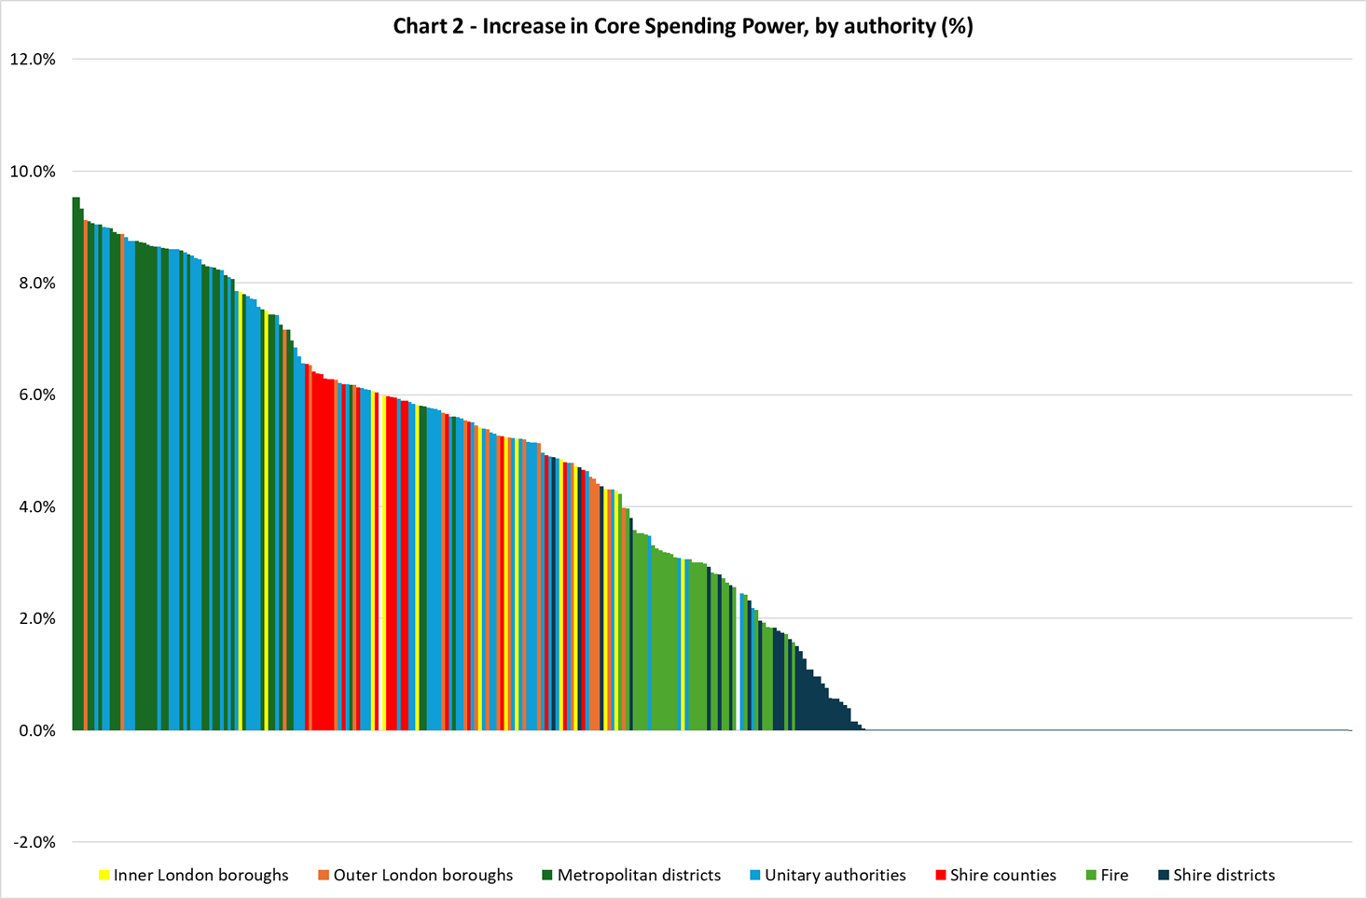
Largest CSP increases in Mets and high-need unitaries/ OLBs
Shire counties and other lower-need authorities
Met and combined fire authorities getting higher CSP increases then shire districts (£5 precept)
Most shire districts receiving no CSP increase, except the most deprived districts (e.g. Great Yarmouth)

Slide 9
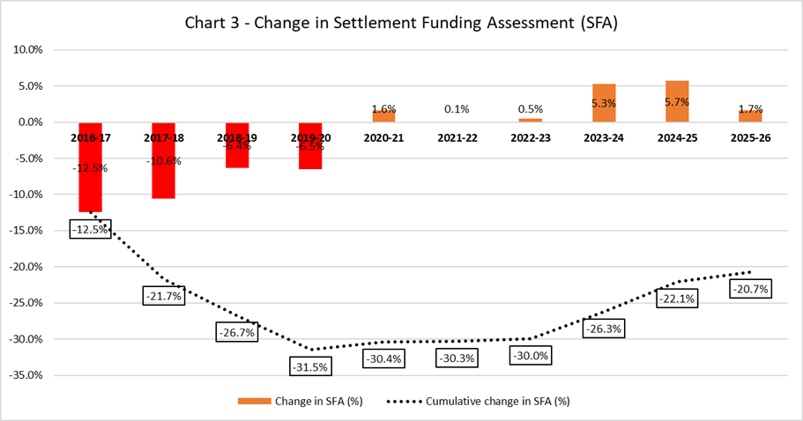
Settlement Funding Assessment (SFA)
SFA has increased by £278m (1.7%) in 2025-26
Baseline Funding Level (BFL) (in respect of the 1.67% increase in the standard multiplier) and Revenue Support Grant (RSG) (1.67%, linked to the September CPI).
Grants worth around £67m will be rolled into SFA in 2025-26, and paid via RSG
Top-ups and tariffs will also be uprated using the “weighted average index” for each authority
No change in the treatment of Negative RSG (that is, no authority’s RSG will be less than zero)

Slide 10
Council tax Band D
Core principle of a maximum increase of 2.99% in Band D. This applies to unitaries, county councils, and London boroughs.
Continuation of the adult social care precept, allowing an additional 2% of Band D.
Shire district councils will be able to increase Band D by the higher of 2.99% or £5. We estimate that only 22 shire districts will benefit from the £5 threshold.
Fire authorities will be able to increase their Band D by £5. Every fire authority will benefit from the £5 threshold. This was a major part of fire authorities’ “funding ask” from government.
Police and Crime Commissioners will be able to increase their precept by a maximum of £14 in 2024-25. The maximum increase in precept was £13 in 2024-25, £15 in both 2023-24 and 2021-22, £10 in 2020-21, and preceded by £24 in 2019-20 and £12 in 2018-19.
There will be no council tax referendum thresholds for either mayoral combined authorities or town and parish councils. As ever, there is the threat of introducing thresholds in future years if these councils agree excessive increases.
The Greater London Authority (GLA) will be able to increase Band D by 3% for its own functions.

Slide 11
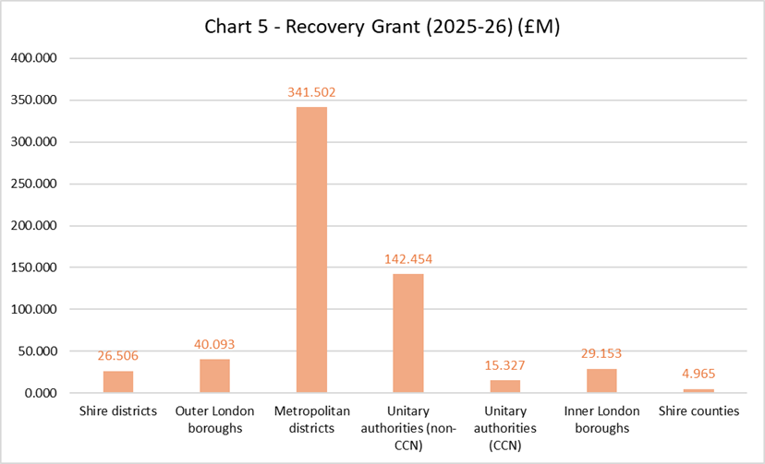
Recovery Grant
£600m in 2025-26, over half going to metropolitan districts
Jim McMahon MP: purpose of the grant is to “to get councils back on their feet”
Partly about giving additional funding to those councils who have had the largest cuts in funding since 2010-11 – and also about anticipating the changes in funding in 2026-27
Some very large cash amounts: Birmingham £39m, Leeds £20m, Liverpool £20m, Manchester £19m
The large payments are at or near the authority’s 3% CSP cap
Shire districts received a surprisingly large allocation, largely absorbed by the MFG

Slide 12
Recovery Grant methodology
Methodology was largely as we had anticipated:
“Needs” assessment based on each authority’s overall 2019 Index of Multiple Deprivation score, multiplied by the authority’s 2023 mid-year population (we used 2021 Census);
“Resources” assessment based on each authority’s share of the national taxbase; and
Weighting (or tier split) in two-tier areas to split the Needs and Resources assessments.
“Needs” weighting based on expenditure: county 83%, district 17%, fire 0%
“Resources” weighting based on Band D elements: county 89%, district 11%, fire 0%
Maximum allocation 3% of CSP (£10,000 de minimis)
For LGR authorities created since 2019, IMD scores have been calculated based on lower layer super-output areas
Assume that the targeted deprivation funding will be rolled into SFA (or its successor) in 2026-27, and distributed using a new funding formula
 | MTFP model | ACTUAL, prov settlement | Variance
Shire districts | 7.608 | 26.506 | 18.898
Outer London boroughs | 46.798 | 40.093 | -6.706
Metropolitan districts | 324.719 | 341.502 | 16.782
Unitary authorities (non-CCN) | 139.639 | 142.454 | 2.815
Unitary authorities (CCN) | 19.356 | 15.327 | -4.029
Inner London boroughs | 31.689 | 29.153 | -2.536
Combined fire authorities | 2.007 | 0.000 | -2.007
Shire counties | 21.469 | 4.965 | -16.504
Metropolitan fire authorities | 6.715 | 0.000 | -6.715
Greater London Authority | 0.000 | 0.000 | 0.000
England | 600.000 | 600.000 | 0.000

Slide 13
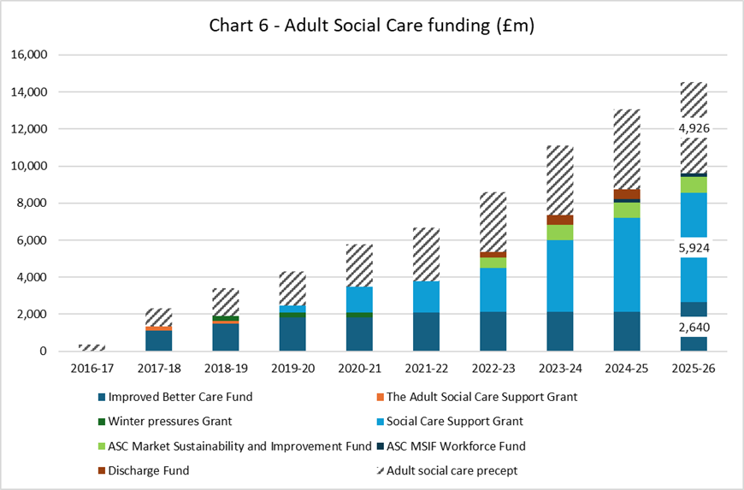
Adult social care funding
Continued increase in funding for social care through both grant increases and ASC precept
£880m increase in Social Care Grant - £600m in Autumn Budget, £80m transfer in Policy Statement, and further £200m in provisional settlement
Does this set the level for increases in future years in SR? Clearly still a major priority for the government and within DH
Discharge Grant (£500m) rolled into the renamed Local Authority Better Care Fund (was the iBCF)
No other changes in grant funding
SCG distribution: uses Adult RNF and partial equalisation of ASC precept (£240m out of ~£590m)

Slide 14
Children’s Social Care Prevention Grant
New grant announced in Autumn Budget, will increase from £250m to £283m in the final settlement
Distribution formula uses the research commissioned by MHCLG and DfE, undertaken by LG Futures and academic partners:
https://www.gov.uk/government/publications/explanatory-note-on-childrens-social-care-prevention-grant-methodology/2f355cbf-3e5a-43e1-a2ff-2fb30daa52b7
Cannot replicate the formula from the information published – there will need to be more transparency in the funding reform process next year
Includes an assessment of ability to raise council tax (a new and controversial feature)
Distribution is more “progressive” than the current (2013-14) RNF updated for population – is this the underlying formula or later judgement-based adjustments?
 | Pixel estimates based on current RNF (£M) | Provisional settlement (£M) | Difference (£M)
Outer London boroughs | 36.325 | 22.636 | -13.689
Metropolitan districts | 63.264 | 87.884 | 24.620
Unitary authorities (non-CCN) | 43.491 | 51.014 | 7.524
Unitary authorities (CCN) | 20.864 | 17.633 | -3.232
Inner London boroughs | 23.993 | 17.799 | -6.194
Shire counties | 62.063 | 53.033 | -9.030
England | 250.000 | 250.000 | 0.000

Slide 15
Other elements of settlement
New Homes Bonus – continued for a final year, overall cost roughly the same (£291m), and no change in methodology
Services Grant – abolished in 2025-26 (£87m)
Rural Services Delivery Grant (RSDG) – abolished in 2025-26 (£110m)
Island premium (Isle of Wight, Isles of Scilly) – transferred from Services Grant to SFA
Minimum Funding Guarantee, now the Funding Floor – threshold reduced from 4% to 0%, and includes Band D uplift – so effectively puts most shire districts (132) on the floor (no change in CSP). Cost reduces from £267m in 2024-25 to £121m in 2025-26
Levy Account - £100m (for third successive year) – same distribution, same values expected as current year
Public Health grant – allocations will be announced “soon”. Cash-flat assumption for now, potentially indexed.
Extended Producer Responsibility (EPR) – authorities informed of individual allocations, but DEFRA will not publish full formula or national distribution of funding – do you want to share information about allocations?

Slide 16
Rolled-in grants
Electoral Integrity Programme New Burdens grant (worth £4.6 million)
Tenant Satisfaction Measures New Burdens grant (£3.9 million)
Transparency Code New Burdens grant (£3.6 million)
Domestic Abuse Safe Accommodation Grant (£160.0m in 2025-26, which reflects an uplift of £30 million for 2025-26) has been included within CSP but will be paid separately to RSG.

Slide 17
Employers’ National Insurance Contributions (ENICS)
Increase in ENICS rates in the Autumn Budget
Treasury has made £515m available for local government to cover their assessment of the sector’s direct costs (will not fund indirect ENICS costs in third-party suppliers): “directly employed staff across the public sector”
LGA estimate that additional direct costs of £637m and indirect costs of £1.1bn
Distribution of funding to local authorities will use Net Current Expenditure (NCE) for 2023-24
Allocations not published because some authorities have yet to submit data for 2023-24
We will provide estimates in updated MTFP model (by tomorrow)
Reports to us from authorities suggest the funding allocations will not fully fund additional costs; shortfall on direct costs will depend on the proportion of ENICS in direct/ third-party suppliers
LGA analysis suggests £515m will fund between 50% and 33% of total additional cost pressure

Slide 18


Analysis of Provisional Local Government Finance Settlement for 2025/26
19 December 2024
INFORMATION MANAGEMENT FINANCIAL RESILIENCE EXPERTISE ON DEMAND

Slide 19
Headline figures
Increase in Core Spending Power of 6% or £3.90bn.
Additional Council Tax of £2.16bn and Government funding £1.74bn.
Council tax referendum criteria pretty much as expected.
New recovery grant of £600m.
Rural Services Delivery Grant scrapped.
Additional £1.13bn of social care grants.
And funding floor of £121m used entirely for districts.
Reasonably redistributive settlement.

Slide 20
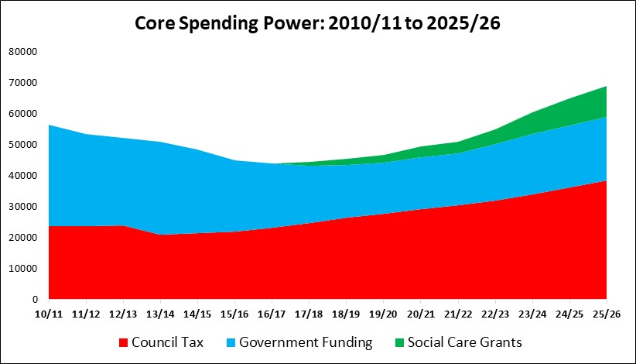
Headline figures
Council tax gearing the largest CSP element at 55% (same as last year).
But for districts council tax gearing jumped from 60% to 62%.

Slide 21
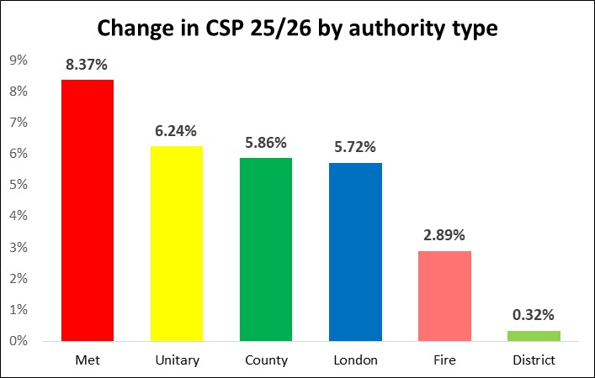
Authority type change in CSP
Mets with the highest increase.
Districts with the lowest.
Impact of Recovery Grant and repurposing of RSDG and services grant + lower floor.

Slide 22
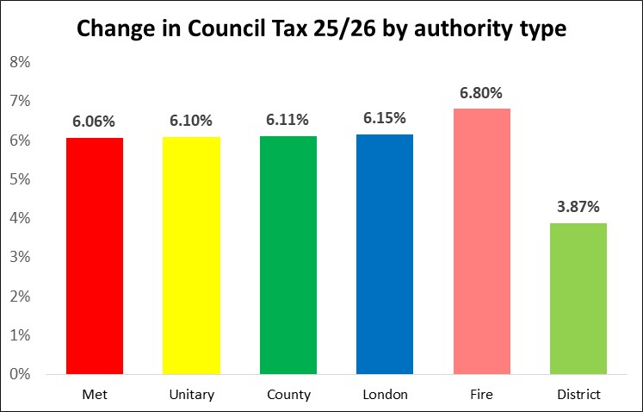
Authority type change in Council Tax
Roughly equal changes in council tax.
Fire is higher due to £5 limit.
Districts lower due to £5 limit.

Slide 23
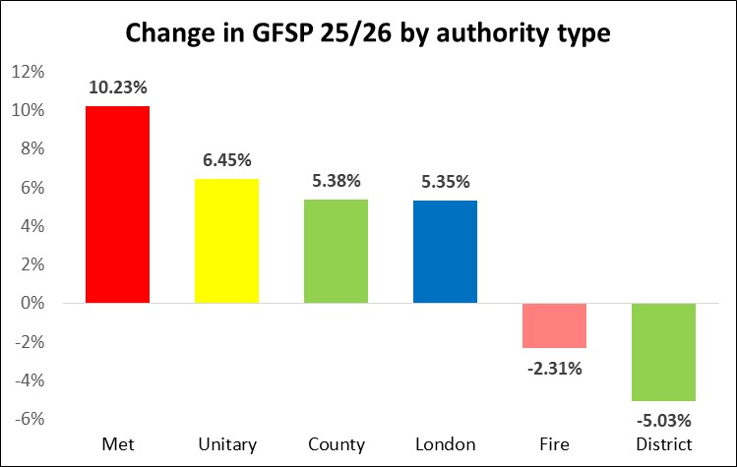
Authority type change in Government Funded CSP
The provisional settlement has made some fairly significant redistributions in funding using:
Recovery Grant.
Repurposing RSDG.
Repurposing Service Grant.
Making floor 0%.

Slide 24
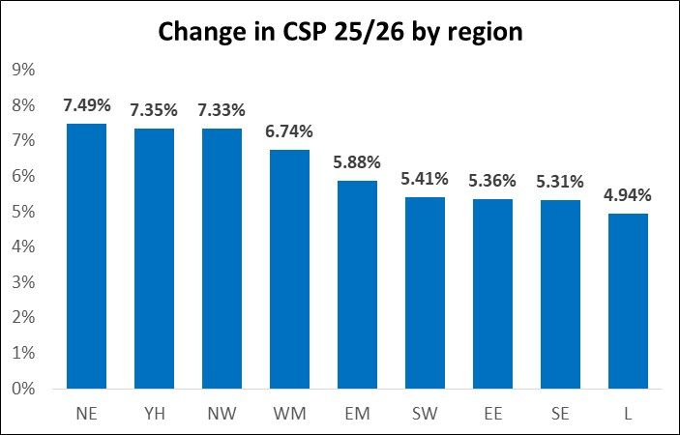
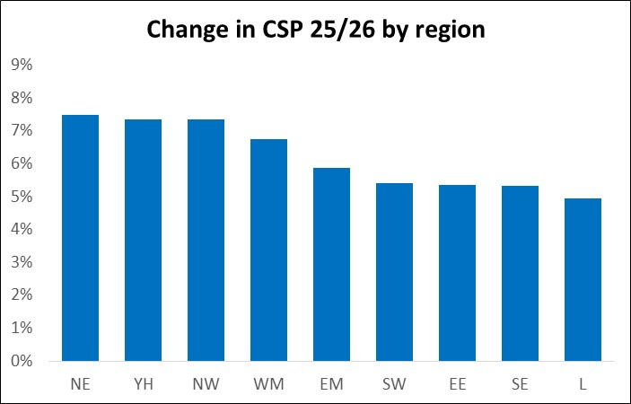

Regional change in CSP
Northen regions have fared significantly better than south with London seeing lowest CSP increase.
Deprivation weighting higher (but with some London adjustment?)

Slide 25
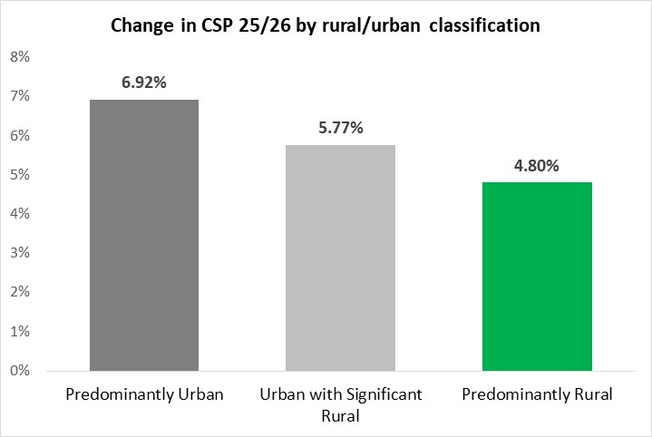
Rural/Urban classification change in CSP
Rural authorities have lost out due to repurposing of RSDG but also receiving lower share of Recovery Grant.

Slide 26
Initial Conclusions
Provisional settlement has been far more redistributive than the last few Gove settlements.
Partly due to more Social Care grants which are deprivation weighted.
But also the introduction of the Recovery Grant and repurposing of RSDG and Services Grant.
Northern authorities, urban authorities and Mets particularly have gained.
Southern authorities, rural areas, fire authorities and districts have lost out relatively.
Lets look more closely at how this redistribution has occurred.

Slide 27
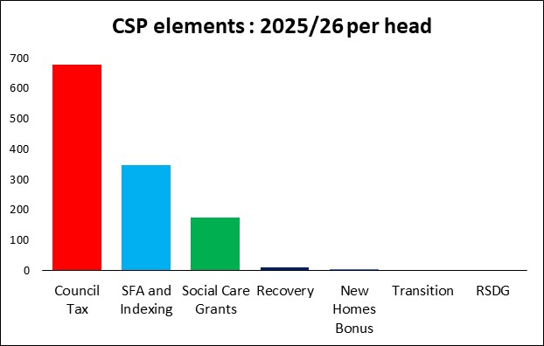
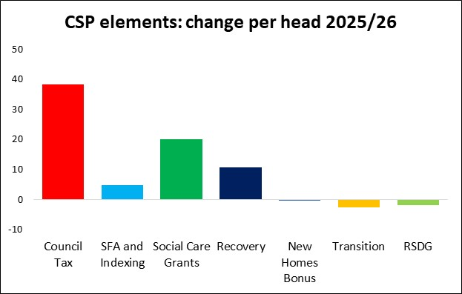
CSP components: 2025/26
Council tax largest CSP element both in absolute and change terms.
Interestingly, northern taxbases have grown more than southern in 2025/26.
The other significant changes though are extra social care grants, the new recovery grants and, although small in aggregate, scrapping RSDG and reducing funding guarantee have had a big impact for some authorities.

Slide 28
Upper Tier: Winners and Losers
High needs (but also high taxbase growth) areas amongst those which have gained relatively.
Very rural areas amongst those which have lost out relatively.

Slide 29
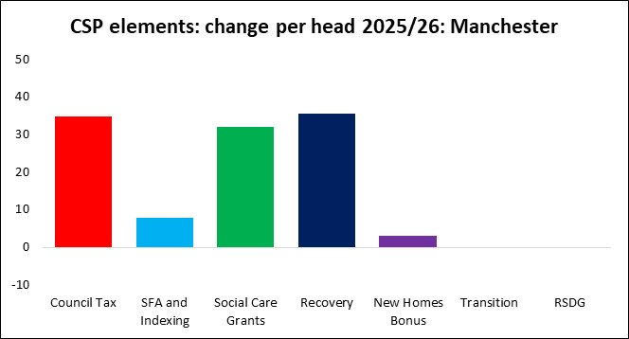
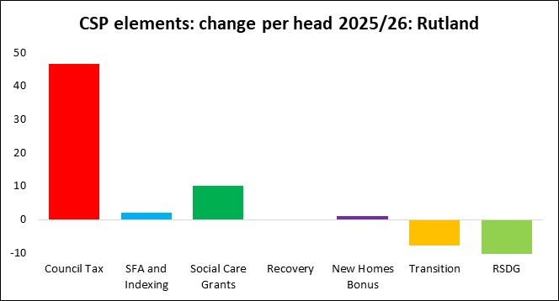
Manchester
Reasonably strong taxbase growth coupled with extra social care grants and significant recovery grant.
Rutland
Strong Council Tax
Loss of RSDG is significant.
Zero Recovery Grant.
Low needs = lower share of extra social care grants.
Loss of funding guarantee as floor drops to 0%.

Slide 30
Districts: Winners and Losers
Only a handful of the 164 districts, with very high needs, or a very good NHB year have received an increase in CSP.
80% of districts with no CSP increase.

Slide 31
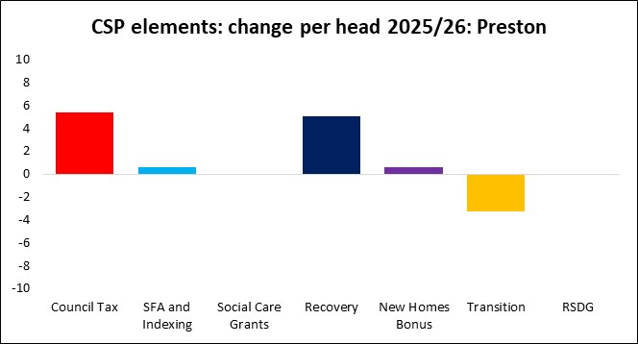
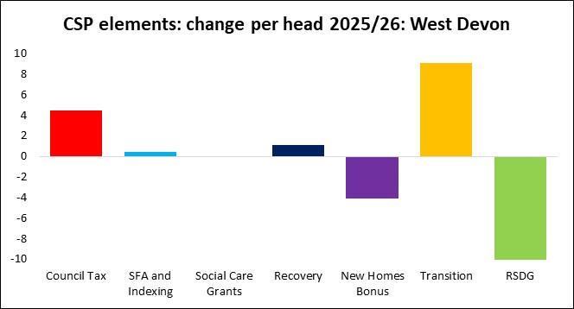
Preston
Biggest district gainer.
Good taxbase growth = strong NHB.
High needs resulting in good level of recovery grant.
West Devon
Sluggish taxbase growth means poor extra council tax and loss of NHB.
But loss of RSDG significant which (unusually for a district) has resulted in more funding guarantee.

Slide 32
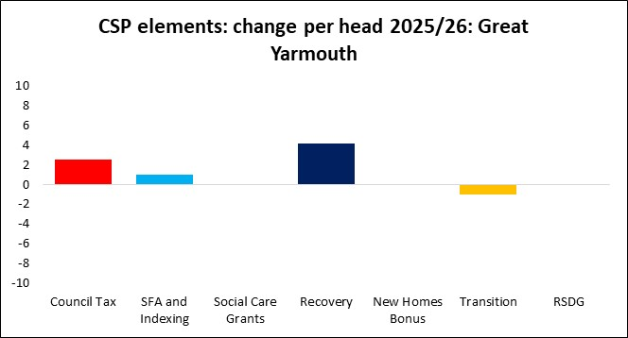
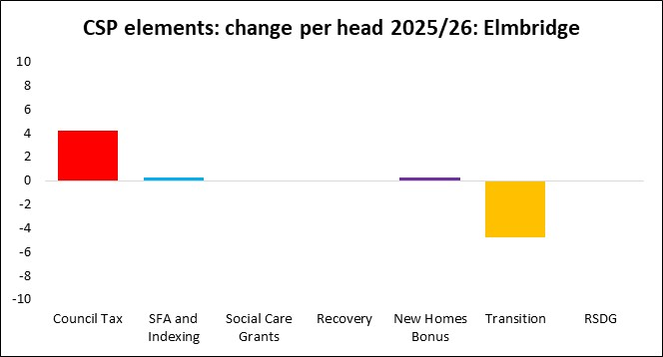
Great Yarmouth
Second biggest district gainer.
Recovery grant pushing CSP beyond the 0% floor.
Elmbridge
Reasonably strong taxbase has allowed Government to reduced funding guarantee by almost equal and opposite amount.
Same picture across most of SE.

Slide 33
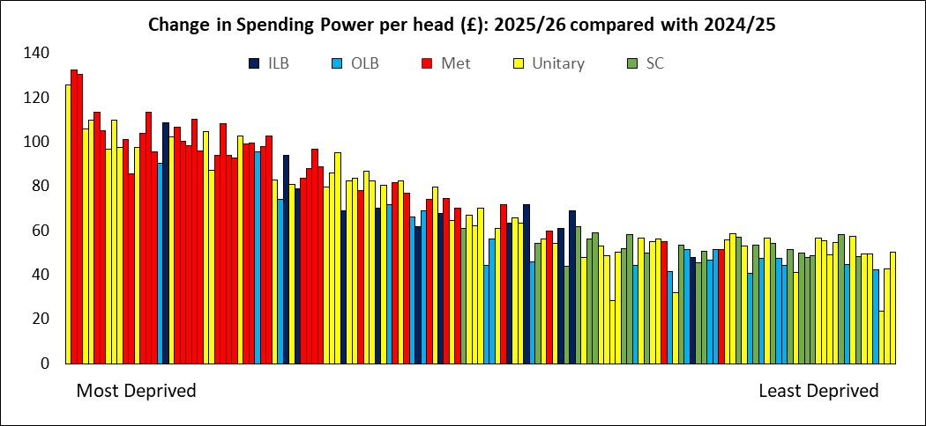
Upper Tier Redistributional Impact

Slide 34
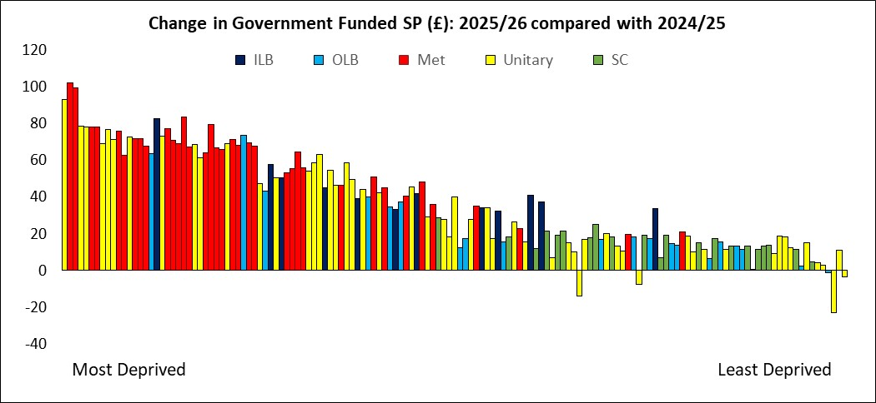
Upper Tier Redistributional Impact

Slide 35
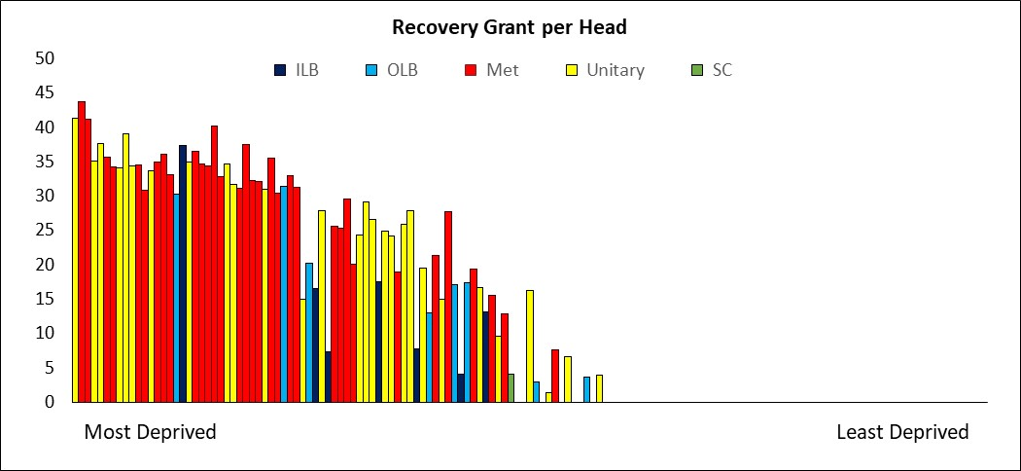
Upper Tier Recovery Grant

Slide 36
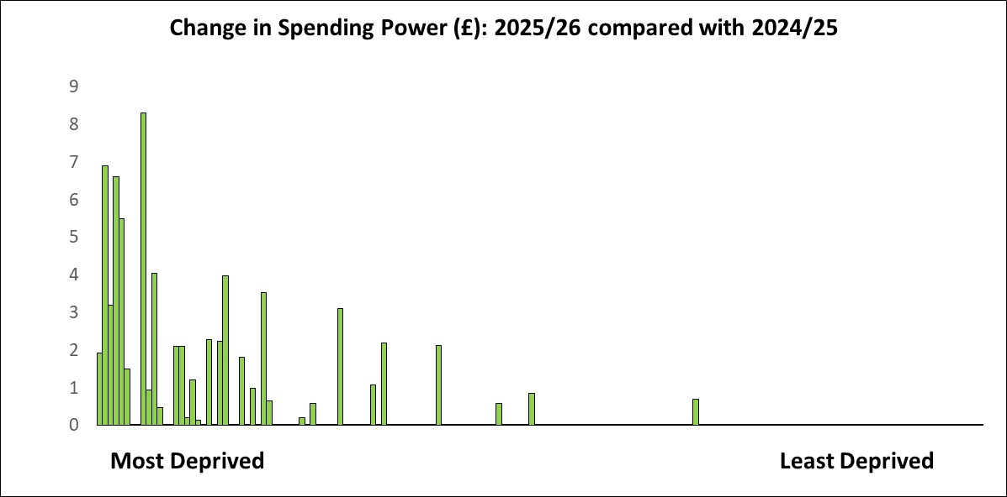
Districts Change in Core Spending Power

Slide 37
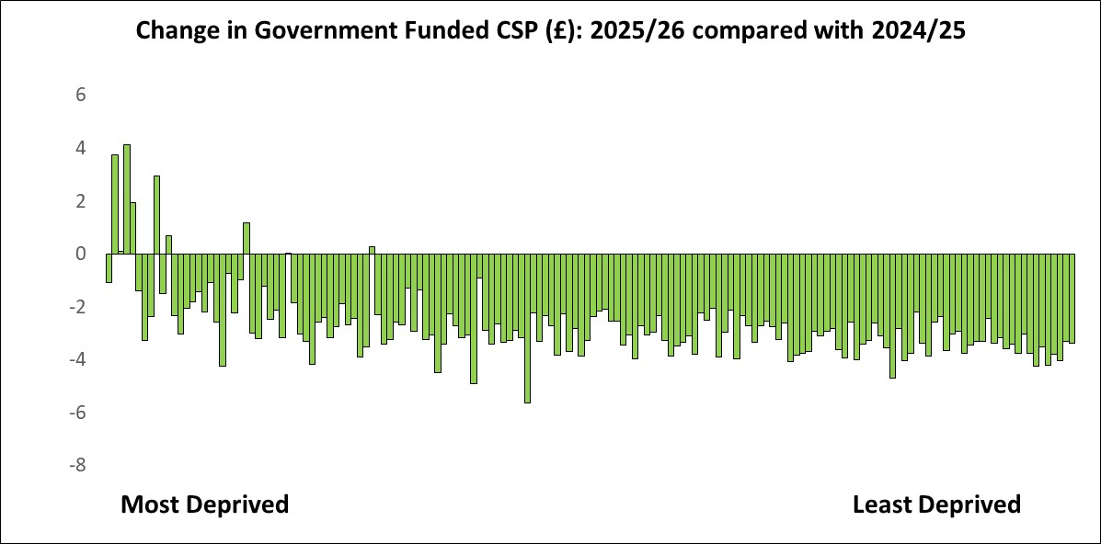
Districts Change in Government Funded Core Spending Power

Slide 38
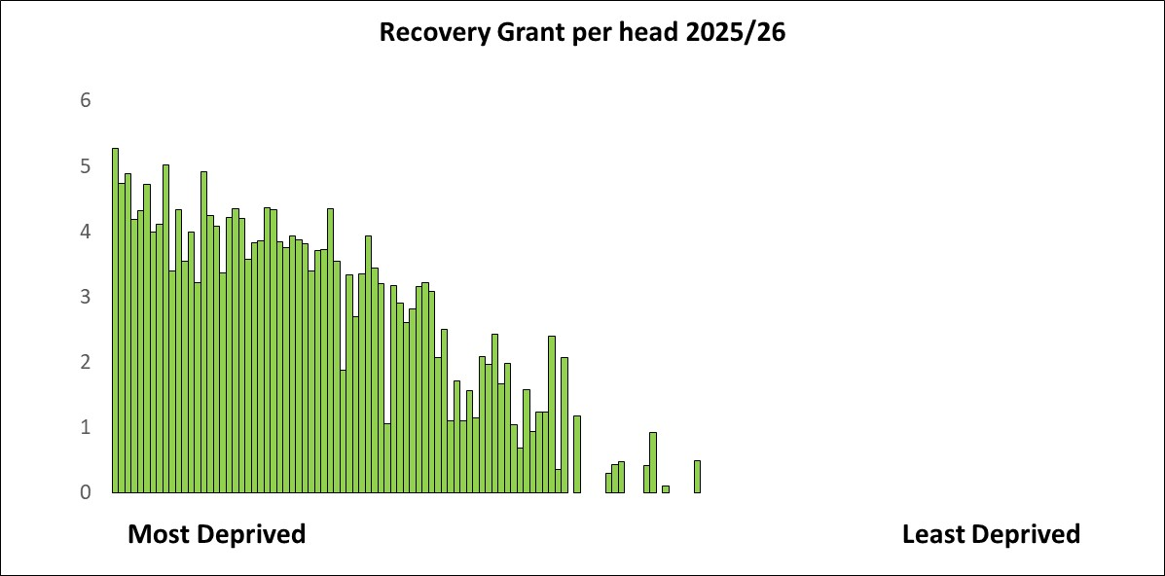
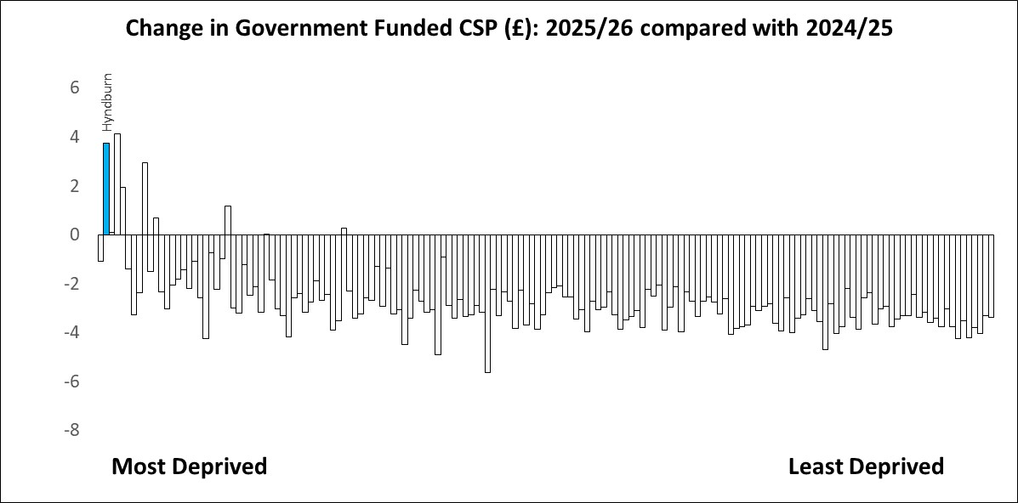
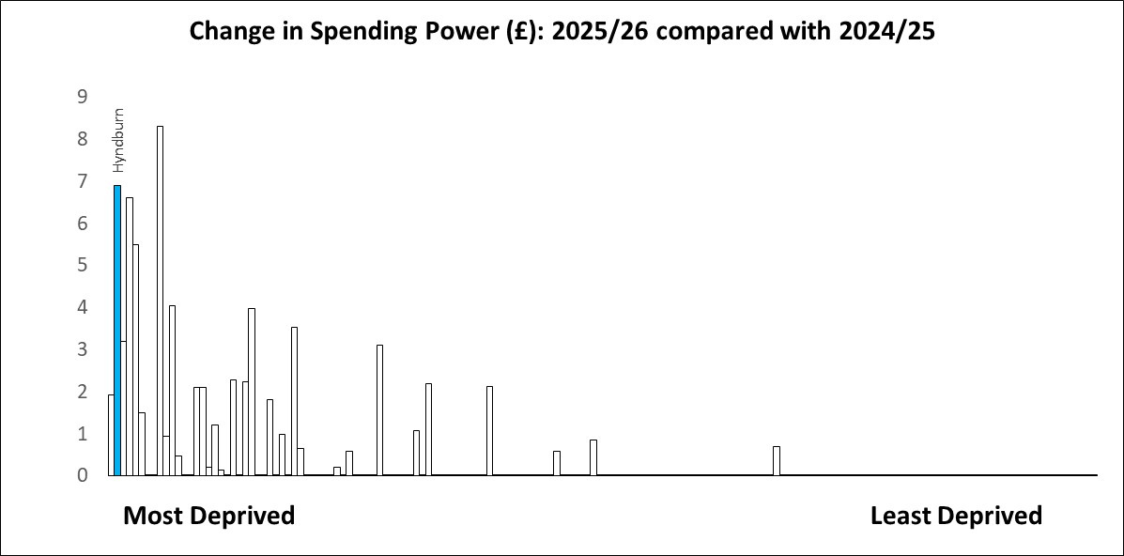
Districts Recovery Grant per head

Slide 39
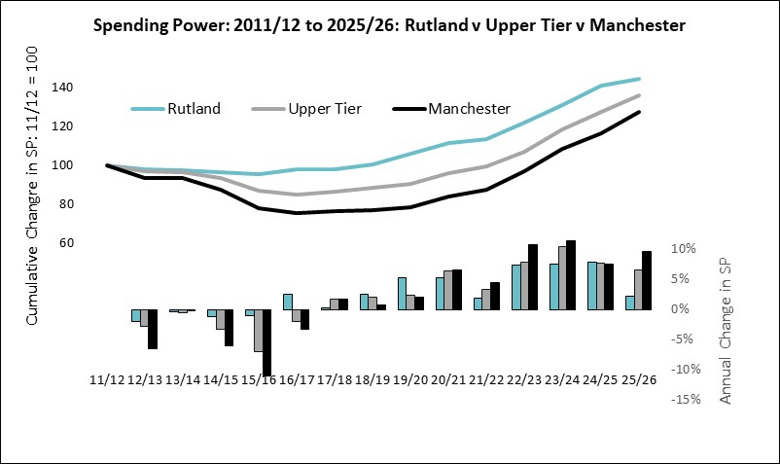
Finally … looking forward
This settlement sets out this Government’s position on local government funding.
Manchester catching back up the average and the average catching up Rutland
But …
There is still a disparity when compared to the last Labour Government’s distribution
Will funding review seek to close the gap further … ??

Slide 40

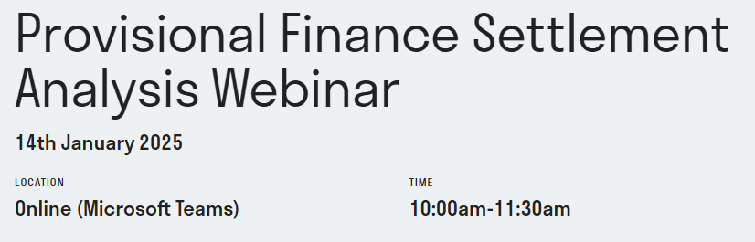
Thank you for listening
Wishing you a happy and (restful!) festive period!
And if you want to come back to yet more analysis of the settlement, we are running a free Webinar in mid January.
Provisional Finance Settlement Analysis Webinar - LG Improve

Slide 41
Funding reforms in 2025
Consultation on funding reforms launched:
https://www.gov.uk/government/consultations/local-authority-funding-reform-objectives-and-principles
Using the same principles as the previous government in the 2018 Consultation
Government wants to present its funding reforms as a continuation of the previous government’s (“the previous government recognised that the existing system is unfair”)
Looking to “re-test” the evidence now that it is over six years old and significant changes since then (COVID)
Scope will include SFA, BRRS (reset) and NHB – and we assume will be extended to specific grants (ASC, PH) but it is not explicit on this
Question about how far to incorporate Strategic Authorities in the settlement (where they receive some settlement funding)
Comprehensive consultation, doesn’t depart much from the previous government’s approach, but doesn’t give much away
Consultation ends on 12 February 2025

Slide 42
Business Rates baseline reset
There will be a full baseline reset in 2026-27, with further regular resets after that
No further detail on the mechanics of how the reset will be implemented (spot, EBRA?, financial year?)
BR income from reset will be “allocated based on the updated assessment” – good news!!
Intention to incorporate Strategic Authorities in some way where there are “enhanced arrangements”
Consult on the reset early next year (they are keen!)
Reset will also incorporate changes to the multiplier announced in the Autumn Budget
Intention to make the system simpler (e.g. remove s31 grants)
Ezs/ Investment Zones etc, will be exempt from the reset (not sure about renewables)
Impact of the reset likely to be included in the transitional arrangements

Slide 43
Needs assessment
“population of a local authority remains the most important driver of demand for the bulk of non-social care services”
“exercise judgement in determining the drivers of demand” – “strong argument that local authorities with high levels of deprivation see more demand for their services”
Separate formulas for Adults, Children’s and probably highways maintenance, fire and rescue
Not sure about separate formulas for capital financing, flood defence, concessionary fares, home-to-school transport
Fixed costs – likely to be ditched
Costs in urban and rural areas – suggestion these will be covered in the ACA

Slide 44
Council tax equalisation
Suggestion that council tax bills are higher in more deprived places (not checked this and will be interested to see the evidence)
Growing reliance on council tax income and business rates growth has “most disadvantaged more deprived places”
Use taxbase and assumed level of council tax (i.e. notional rather than actual council tax to equalise)
“We are inviting views on what our assumptions should be used regarding Council Tax Level, and other factors influencing Council Tax resource, such as the use of Discounts, Exemptions, and Premia, the Council Tax Collection Rate, and the split of Council Tax resource between tiers of local government.”
Will not include sales, fees and charges – and we assume that means parking income as well

Slide 45
New Homes Bonus
Suggestion that the “incentive is blunted by the interactions with the remainder of the settlement”
Benefit to shire districts mostly
Consult in first half of 2025
Should there be an incentive within the settlement to enable and encourage housebuilding?

Slide 46
Transitional support
Stability and sustainability – introduce funding changes over several years
Worrying that the example applies changes in funding over 3 years – but this is not indicative of policy
“Blending in”
Choice of baseline (Core Spending Power plus??)
Future dynamism in allocations balanced with multi-year certainty

Slide 47

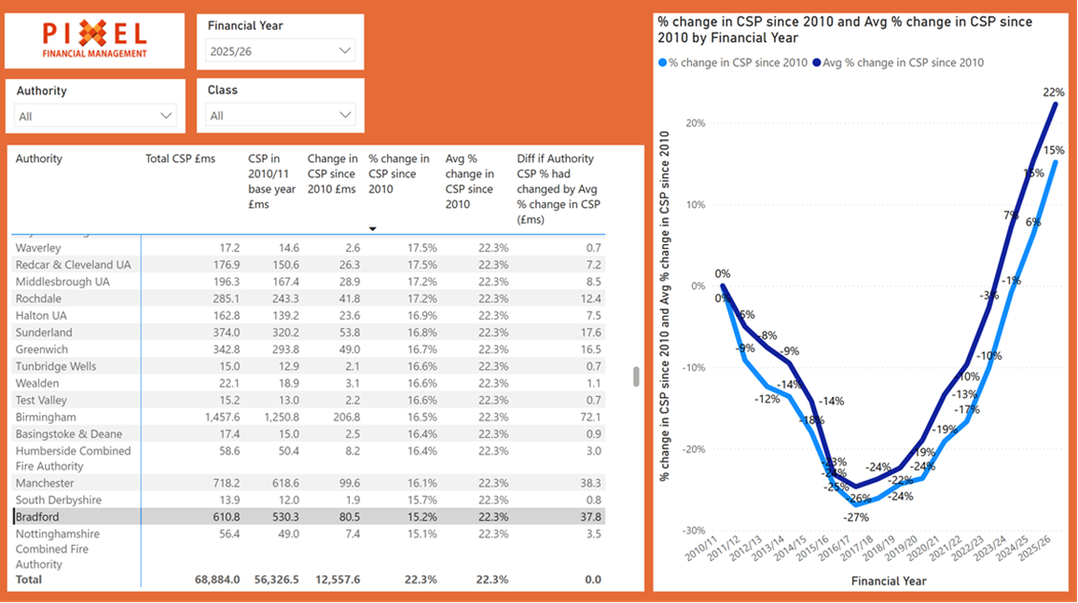
Pixel Benchmarking Service
Website for our benchmarking service is now available: https://pixelfinancial.co.uk/benchmarking
Data has been updated for the 2025-26 settlement
Arranging meetings in the new year for authorities wanting to join the service
Webinar on the new service is available on the website: https://pixelfinancial.co.uk/events/pixel-financial-benchmarking-webinar-2024-11-21

Slide 48
Technical problems…
Not all the emails got through last night – re-sent this morning
Briefing note is on the website as a backup: https://pixelfinancial.co.uk/subscribers
Will be verifying and checking email addresses in the New Year, and moving to a different email system
Please let me know if you are not getting emails

