Slide 1

Local government funding reforms/ CTR1 analysis
Adrian Jenkins/ Dan Bates
25 March 2025

Slide 2
Funding reforms are definitely happening in 2026-27
Consultation paper on funding reform published in December 2024: https://www.gov.uk/government/consultations/local-authority-funding-reform-objectives-and-principles/local-authority-funding-reform-objectives-and-principles
Builds on the December 2018 consultation paper: https://www.gov.uk/government/consultations/review-of-local-authorities-relative-needs-and-resources
Future funding reforms already in place based on 2018 (business rates baseline reset, council tax equalisation, new social care formulas, Foundation Formula, Area Cost Adjustment)
Labour government is seeking to show that their reforms build on the previous government’s – and to indicate cross-party support:
“This government agrees with the previous government that we should use the best available evidence to assess differences in the need for local government services – including deprivation – and resources available to local authorities. Whilst our proposed objective is in line with the 2018 Consultation, we are seeking to re-test it given this was six years ago and there have been significant changes since then”
But a new government will have different priorities, and will take different decisions
Significant scope for (justifiable) judgement even where a reformed system looks similar to what might have been envisaged in 2018

Slide 3
Process and progress
Funding Strategy Reform meetings with key stakeholders, including representative bodies, local authorities and third parties (including Institute for Fiscal Studies, IFS)
Papers and process is confidential, nothing has been circulated beyond the group
Next stage is a full consultation paper in late June or July, after the spending review (in June) – no numbers published until June/ July!!
Spending review will provide quantum for the settlement, and potential funding for transitional support
Process is loading a huge amount (too much?) onto the Summer consultation
Very little time or scope for “course correction” after this
Business rates: technical consultation on the baseline reset in late March, and then a wider consultation on strategic direction of the rate retention system (“quote”)
New Homes Bonus: consultation paper at some point
Children’s Services formula: papers have been published but cannot recreate the modelling
Adult social care formula: published informally but no commitment to implement
Concern that process is falling behind, and that the depth of technical papers is insufficient

Slide 4
Direction of travel is becoming clearer
Angela Rayner comments at Convention of the North: https://www.gov.uk/government/speeches/deputy-prime-minister-speech-at-convention-of-the-north
“This government is only giving the North what it’s owed, and what it deserves. For too long, our outdated system of council funding has been stacked against the north. The days of Ministers expecting the North to go cap in hand ends now. That’s why with Jim McMahon, our Minister for English Devolution and Local Government, we are making simpler and clearer structures and will fix the foundations of local government. He is already beginning to replace the funding formula to give the North nearly £840 million more this year. That brings the North’s total increase to just over 8 per cent - the biggest rise of all regions in England, by a good distance.”
“All councils are facing pressures, but it’s particularly hard for those that bore the brunt of austerity. And this year’s settlement marks a clear direction of travel for the rest of the Parliament. ”
SIGOMA report: https://sigoma.gov.uk/fairfunding Key “asks”: deprivation as a key factor in new formulas; regular resets; limit transitional support to 3 years; commit to full council tax equalisation
Objective: to reset funding shares to somewhere closer to those in 2010-11, before austerity
There are also constraints on how far ministers can deliver this objective:
Evidence and data – there is a limit to how far ministers can depart from evidence but current process makes it difficult for authorities/ bodies to challenge (examples: indicators and weightings in Foundation Formula, research for Children’s and Adult RNFs)
Financial sustainability – what is the financial impact on those authorities “losing” from the reforms? How is MHCLG going to measure and assess ability to absorb loss of funding share (scale of loss, and pace of change)?
Local government reorganisation – two rounds of LGR in 2027-28 and 2028-29, and question whether counties losing significantly will think LGR compounds financial pressures

Slide 5
2018 proposals help more-deprived authorities
Pixel modelled 2018 proposals (in Fair Funding model) and has kept model up-to-date since then
Our modelling of the 2018 consultation paper showed funding would have shifted towards more-deprived authorities
Clear gains in metropolitan authorities (and similar unitary authorities)
Substantial losses in county areas in South-East (council tax equalisation) and inner London (removal of urban-based factors)
Gains in many county areas outside the South-East
If government was simply to revive the 2018 proposals it would deliver an acceptable outcome (percentage replacement of losses since 2010-11?)
Metropolitan authorities would have gained from council tax equalisation – but largely lost share of “needs” assessments. Challenging to present this outcome politically

Slide 6
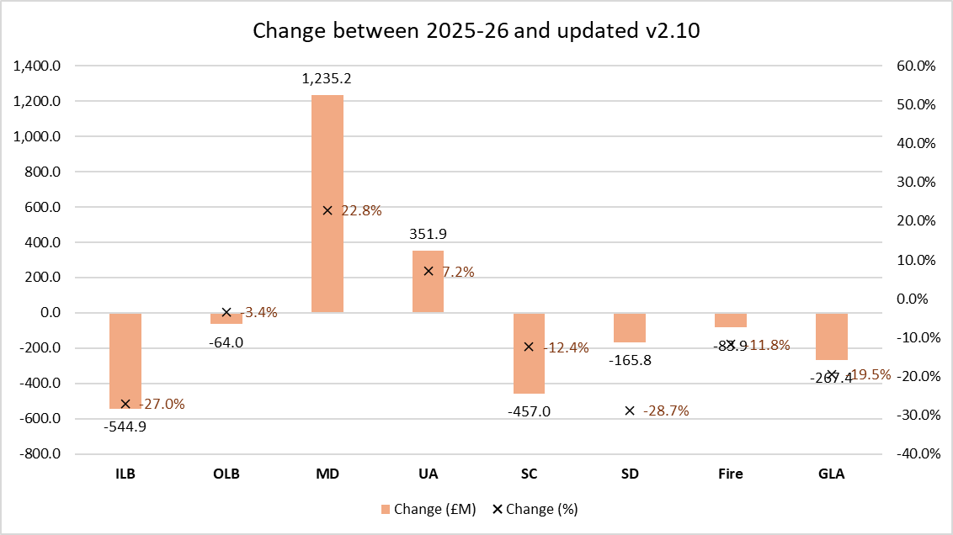
Updated funding forecast for 2026-27
Default assumptions used in Fair Funding model v2.10
Updated control totals and council tax equalisation
New formulas for children’s RNF, adult RNF and public health
Specific formulas for housing/ homelessness, concessionary fares, and home-to-school transport
Judgement-based weightings for density, non-resident population and deprivation in the Foundation Formula
Shows impact on Settlement Funding Assessment (SFA) based on 2025-26 funding distribution
In MTFP model we will also apply full BR baseline reset, and transitional support (based on 5% floor)
Chart shows change in Settlement Funding Assessment (SFA)

Slide 7
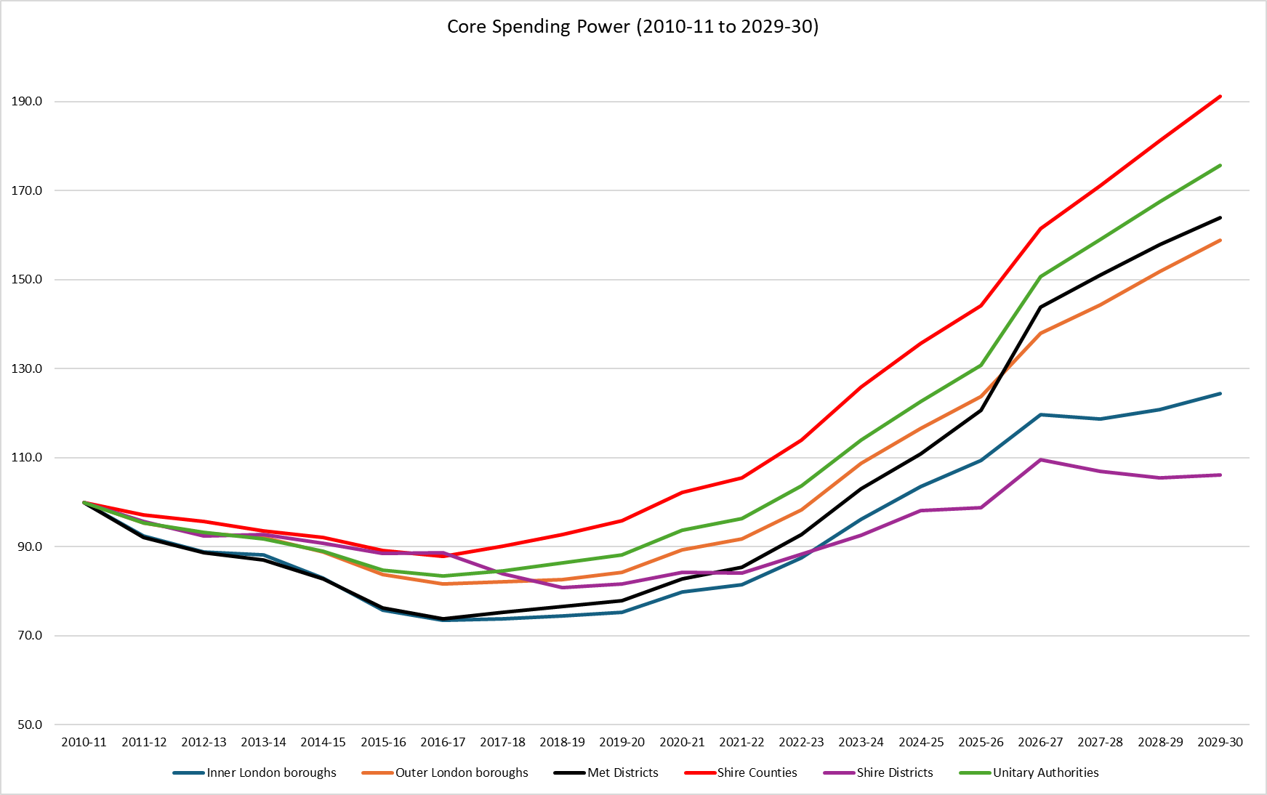
Would funding changes close the funding gap?
Cash-terms change in Core Spending Power, adjusted in previous years for function changes
To 2025-26: shire counties had largest cash-terms increase over period; inner London and (especially) shire districts had the worst
Mets in the middle of the pack – but improving in relative terms in 2025-26
Uplift for all authorities in 2026-27 because of funding streams rolling into CSP (e.g. above baseline BR growth)
Gap between Mets and Shire Counties (and Unitaries) is narrowed but does not close
Inner London and Shire Districts are cut further adrift
Will ministers want to do more to close the funding gap for (deprived) Mets? Will they be concerned about those losing funding share?

Slide 8
Would funding changes close the funding gap?
Cash-terms change in Core Spending Power, adjusted in previous years for function changes
To 2025-26: shire counties had largest cash-terms increase over period; inner London and (especially) shire districts had the worst
Mets in the middle of the pack – but improving in relative terms in 2025-26
Uplift for all authorities in 2026-27 because of funding streams rolling into CSP (e.g. above baseline BR growth)
Gap between Mets and Shire Counties (and Unitaries) is narrowed but does not close
Inner London and Shire Districts are cut further adrift
Will ministers want to do more to close the funding gap for (deprived) Mets? Will they be concerned about those losing funding share?
County councils continue to have highest growth in CSP since 2010

Slide 9
Would funding changes close the funding gap?
Cash-terms change in Core Spending Power, adjusted in previous years for function changes
To 2025-26: shire counties had largest cash-terms increase over period; inner London and (especially) shire districts had the worst
Mets in the middle of the pack – but improving in relative terms in 2025-26
Uplift for all authorities in 2026-27 because of funding streams rolling into CSP (e.g. above baseline BR growth)
Gap between Mets and Shire Counties (and Unitaries) is narrowed but does not close
Inner London and Shire Districts are cut further adrift
Will ministers want to do more to close the funding gap for (deprived) Mets? Will they be concerned about those losing funding share?
Mets narrow the gap but do not close it

Slide 10
Would funding changes close the funding gap?
Cash-terms change in Core Spending Power, adjusted in previous years for function changes
To 2025-26: shire counties had largest cash-terms increase over period; inner London and (especially) shire districts had the worst
Mets in the middle of the pack – but improving in relative terms in 2025-26
Uplift for all authorities in 2026-27 because of funding streams rolling into CSP (e.g. above baseline BR growth)
Gap between Mets and Shire Counties (and Unitaries) is narrowed but does not close
Inner London and Shire Districts are cut further adrift
Will ministers want to do more to close the funding gap for (deprived) Mets? Will they be concerned about those losing funding share?
Inner London and shire districts continue to diverge from other classes

Slide 11
Key changes and decisions in funding reforms
Control totals
Council tax equalisation
Adult social care
Children’s service
Foundation Formula – indicators and weighting
Service specific formulas
Capital financing RNF
Area Cost Adjustment
Public Health grant
Other issues (population estimates, Island Funding)
Business rates baseline reset
Updated funding scenario in next version of the Fair Funding model (v2.10)

Slide 12
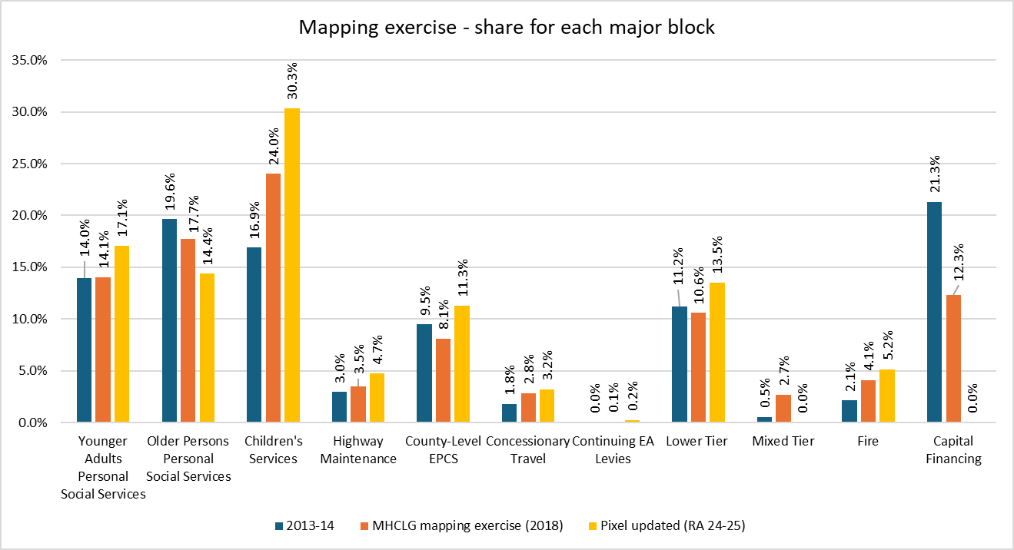
Control totals
Default assumption: use the 2023-24 RA budgeted expenditure to reset the control totals
Followed methodology used in the 2018 consultation paper (not mentioned in 2024 consultation paper, although extremely important)
Total Service Expenditure net of specific grants
Increased share for younger adults and children’s services – but not for older people (social care grants)
Major reduction for capital financing (assuming it is removed)
Other services increase share of expenditure because of reduction in capital financing
Major increase in expenditure share for Fire (from 2.1% to 5.2%)

Slide 13
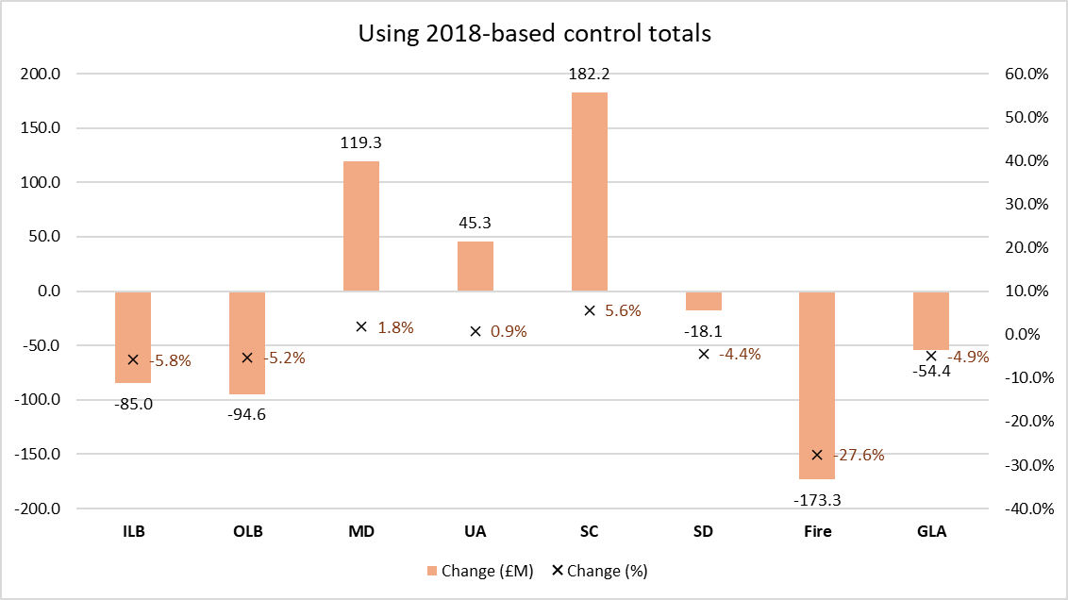
Control totals
Default assumption: use the 2023-24 RA budgeted expenditure to reset the control totals
Updating the control totals reduces funding share for both Mets and Shire Counties
Fire authorities gain (as discussed) as do London boroughs
Impact of removing capital financing?
Major increase in housing/ homelessness?
Reduced share to older people (counties)?
Many interacting factors, difficult to unpick reasons for movements
But there is substantial room for judgement here

Slide 14
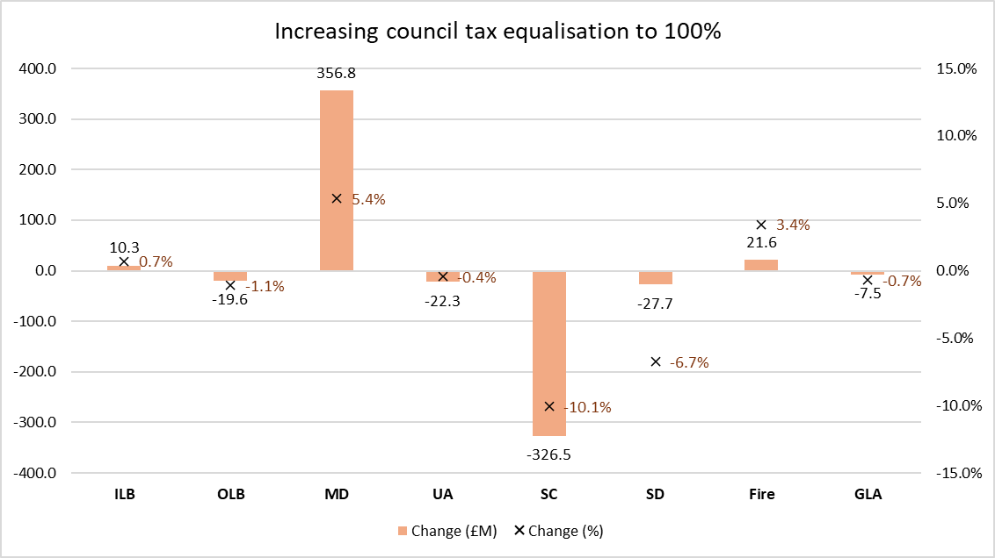
Council tax equalisation
Default assumption: equalise 85% of actual council tax income
Updated in latest version to reflect actual 2025-26 Band D (excluding income from second-home premium)
Chart shows increase in equalisation to 100% (SIGOMA “ask”) increases Mets SFA by £356m (5.4%)
Reduces Shire Counties’ by £326m (-10.1%)
Very significant lever for ministers, and would benefit Met authorities hugely
If ministers want to close the funding gap, then this is how they will be able to do it

Slide 15
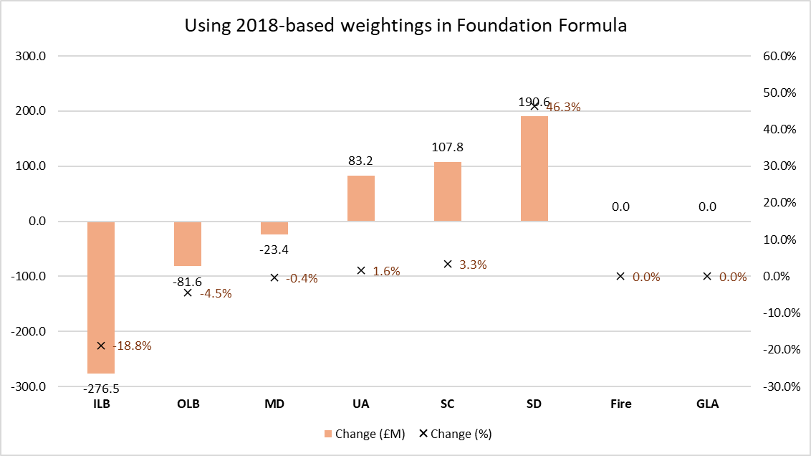
Foundation Formula – non-resident pop, density, deprn
Default assumption: weightings for density, deprivation and non-resident population based on ministerial “judgement”
Deprivation (10%/ 7.5%), non-resident population (5%), and density (5%)
Previously we have used lower weightings for deprivation based on the 2018 consultation paper (5% for deprivation) and 0% for both density and deprivation
Re-introducing indicators for density and non-resident population would massively benefit inner London (and outer London to a lesser degree)
Some benefit to Mets – but not significant

Slide 16
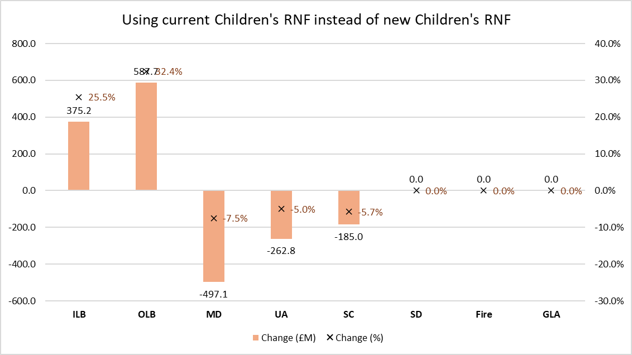
Children’s Services Relative Needs Formula
New formula developed before pandemic – and research paper published on27 February 2025: https://www.gov.uk/government/publications/children-and-young-peoples-services-formula-review
Child-based formula, using sophisticated multi-level modelling
No formula published in the research paper, so not possible to recreate it
But we can reverse-engineer the proposed (“interim”) RNF from the Children’s Social Care Prevention Grant
Significant movement away from London, towards Met authorities; smaller losses for shire counties
 | Share of 2013-14 Children's Services (%) | Share of new interim RNF 26-27 (%) | Change in RNF share (%)
Outer London boroughs | 13.5% | 9.4% | -30.2%
Metropolitan districts | 23.6% | 29.3% | 24.1%
Unitary authorities (non-CCN) | 16.8% | 19.1% | 14.2%
Unitary authorities (CCN) | 9.9% | 9.1% | -8.1%
Inner London boroughs | 8.8% | 6.2% | -29.7%
Shire counties | 27.4% | 26.8% | -2.1%
England | 100.0% | 100.0% | 0.0%

Slide 17
Children’s Services Relative Needs Formula
New formula developed before pandemic – and research paper published on27 February 2025: https://www.gov.uk/government/publications/children-and-young-peoples-services-formula-review
Child-based formula, using sophisticated multi-level modelling
No formula published in the research paper, so not possible to recreate it
But we can reverse-engineer the proposed (“interim”) RNF from the Children’s Social Care Prevention Grant
Significant movement away from London, towards Met authorities; smaller losses for shire counties
 | Share of 2013-14 Children's Services (%) | Share of new interim RNF 26-27 (%) | Change in RNF share (%)
Outer London boroughs | 13.5% | 9.4% | -30.2%
Metropolitan districts | 23.6% | 29.3% | 24.1%
Unitary authorities (non-CCN) | 16.8% | 19.1% | 14.2%
Unitary authorities (CCN) | 9.9% | 9.1% | -8.1%
Inner London boroughs | 8.8% | 6.2% | -29.7%
Shire counties | 27.4% | 26.8% | -2.1%
England | 100.0% | 100.0% | 0.0%

Slide 18
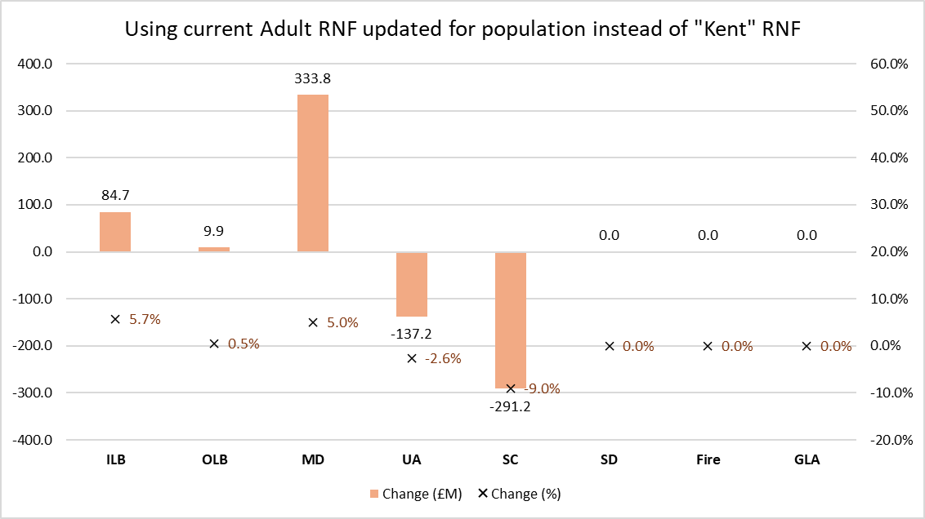
Adult Relative Needs Formula
New formula developed before pandemic – and published informally in 2019 (by University of Kent)
Not published formally by DHSC, and not mentioned in the consultation paper
Growing indications that DHSC will not use this formula in 2026-27 – despite it being based on very robust research/ analysis
Alternative would be to update current formula for latest population estimates
Moving back to the current Adult RNF (updated for population) would significantly benefit Mets at the expense of Shire Counties
If there are going to be increases in social care funding in next SR, then this will be the formula that is used – so has huge importance

Slide 19
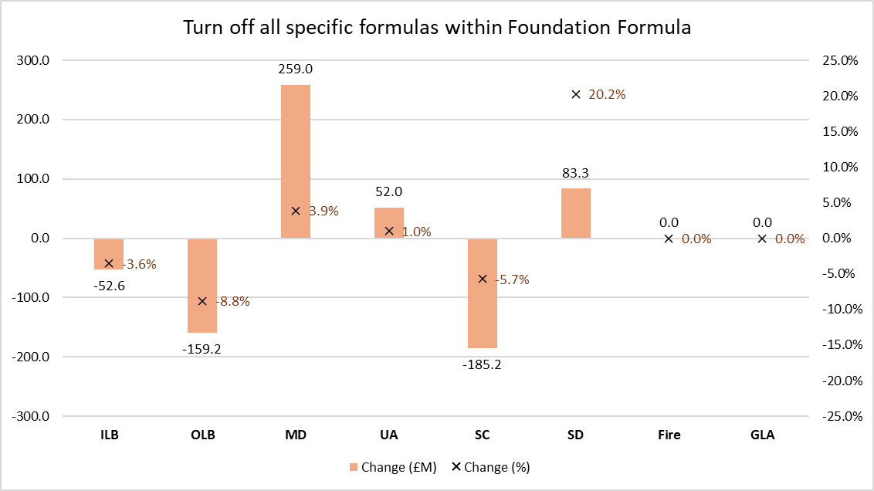
Foundation Formula – specific service formulas
Potential to create new specific service formulas outside Foundation Formula
But criteria for specific formula not yet determined (expenditure size, growth, different distribution?)
Likely candidates: housing/ homelessness, home-to-school transport, concessionary fares
Also, flood defence, coast protection, continuing EA levies (likely to continue)
Default assumption is that there would be new specific formulas for all these specific services
But removing them (and distributing everything via an updated Foundation Formula) would benefit Mets (at the expense of Shire Counties)

Slide 20
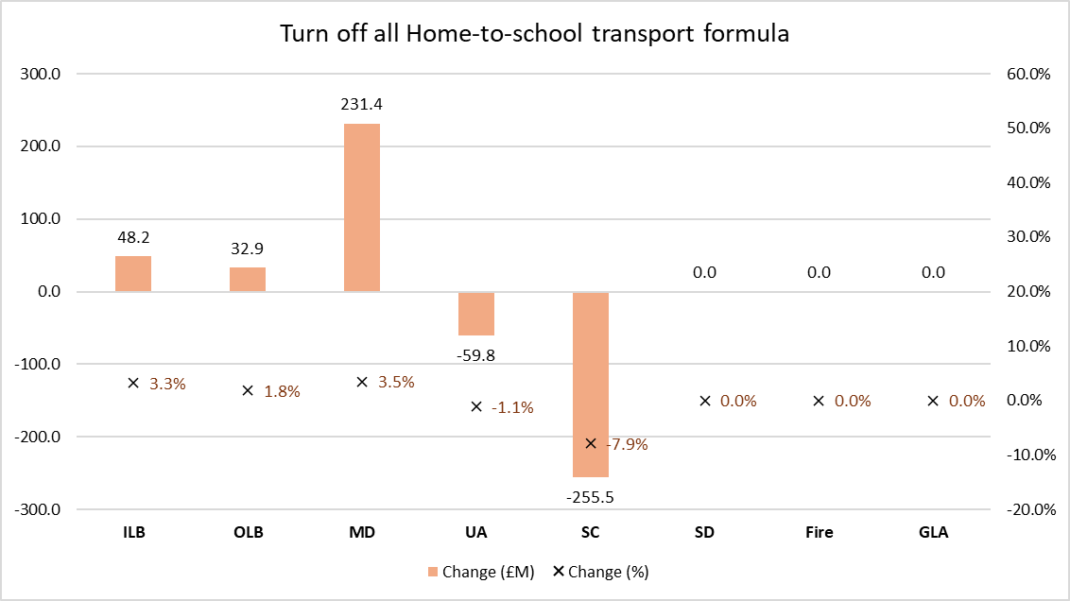
Specific service formulas – home-to-school transport
Massive growth in spending since this issue was reviewed in 2018 (consensus was not to have a specific formula)
Now much changed, and counties are very keen for a specific formula
Around £2.2bn spending currently (and growing quickly)
Formula likely to include a distance measure plus deprivation; no formula has been developed (or published) so we have used expenditure for now
Alternative would be funding via Children’s RNF
Default assumption is that there would be new specific formulas for HTST
Removing it would reduce funding for Shire Counties by £255m (and increase Mets by a similar amount)

Slide 21
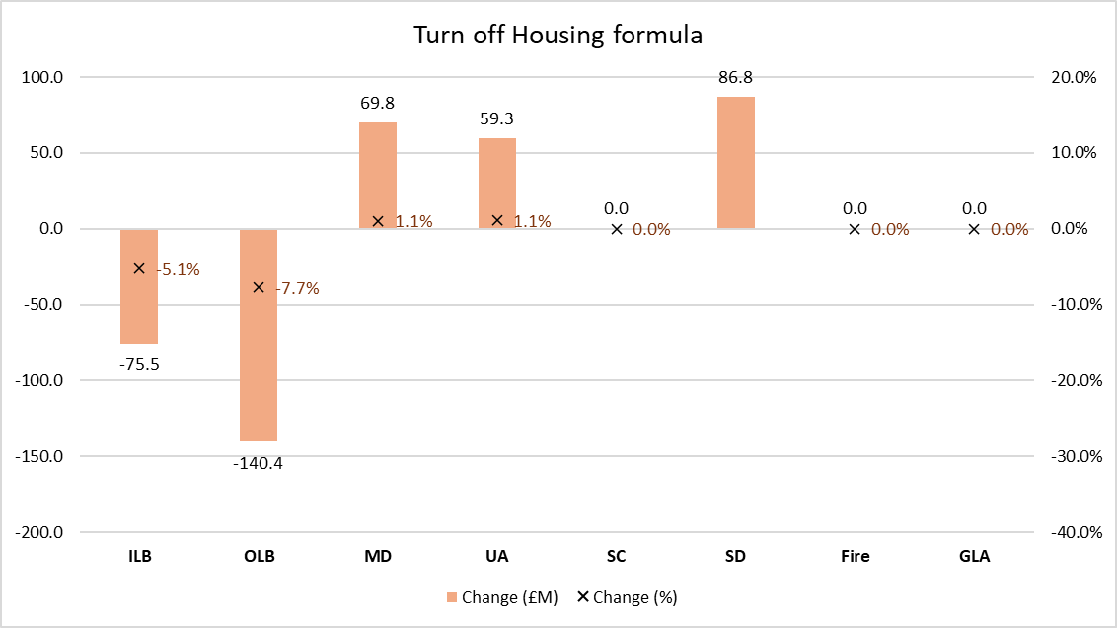
Specific service formulas – housing formula
Again, massive growth in spending since this issue was reviewed in 2018 (consensus was not to have a specific formula)
After grants, net spending is around £900m
Again, no formula but we have the Homelessness Prevention Grant to allocate this formula
Alternative would be funding via District Foundation Formula
Default assumption is that there would be new specific formulas for Housing/ homelessness/ TA
It benefits London and not any other class (although there will be individual gainers) – but this will depend on the formula that is actually used

Slide 22
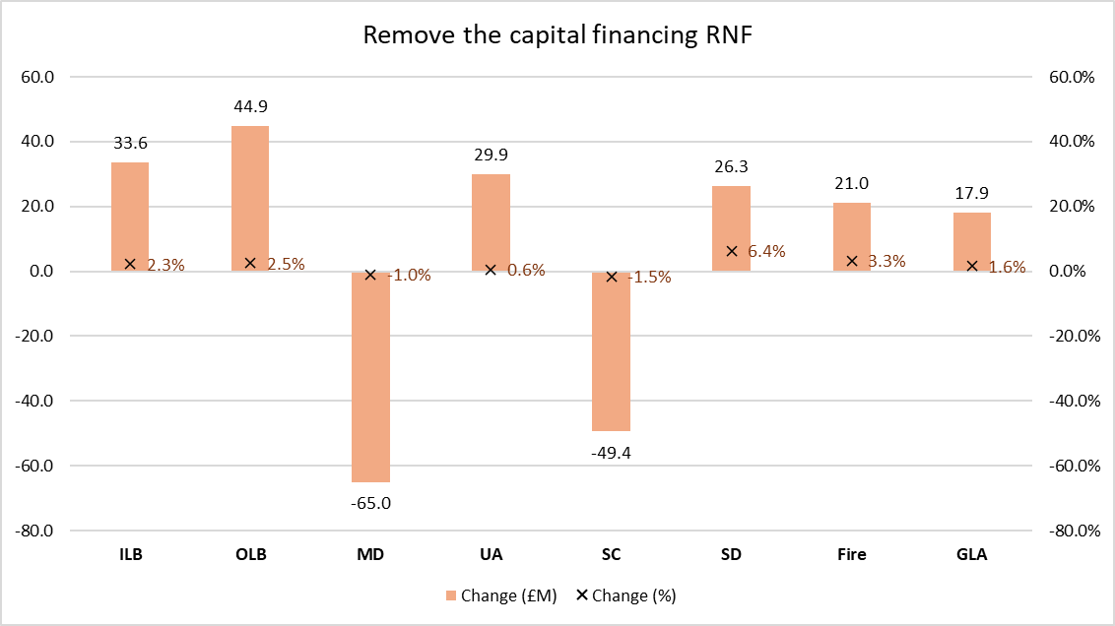
Specific service formulas – capital financing
Consultation paper suggested removing separate formula for capital financing, and funding via relevant Foundation Formula
Argument is that cap fin RNF is for supported borrowing, all of which is pre-2003
Outstanding borrowing is calculated on reducing balance (at 4% MRP)
So, there is still a significant amount outstanding (supported borrowing from 2003 is only depreciated by 62%)
Mets and Shire Counties would lose from removing the cap fin RNF (they have highest relative shares of supported borrowing)
Losses depend on assessment of outstanding supported borrowing (we assume £3bn)

Slide 23
Business Rates Baseline Reset
Full baseline reset in 2026-27 is a certainty
Combination of reset – and redistribution of the BR “surplus” (est £1.5bn) back through the main settlement
Plus the effect of resetting baselines within 100% BR pilots
Massive shift in resources away from Shire Districts – and towards Shire Counties and Mets
Complications with the baseline reset in 2026-27 because it coincides with 2026 Revaluation and creation of new multipliers for RHL properties (there will be 5 in total)
Likely to use VOA post-revaluation data as at 1 April 2026 to create the new baseline
Baseline will be for gross rates, with s31 grants payable for all reliefs
 | Retained BR vs BFL (£M) | Returned surplus (£M) | Gain (+)/ Loss (-)
Class | 2025-26 | 2026-27
ILB | 140.1 | 132.0 | -8.2
OLB | 94.7 | 133.1 | 38.3
MD | 289.2 | 370.2 | 81.0
UA | 212.7 | 229.8 | 17.1
UA - CCN | 221.9 | 125.9 | -96.0
SD | 281.1 | 58.1 | -223.0
SC | 130.4 | 271.5 | 141.2
GLA | 103.8 | 129.5 | 25.6
MF | 5.9 | 17.0 | 11.1
CFA | 18.7 | 28.2 | 9.4
 | 1498.6 | 1495.4 | -3.3

Slide 24
How realistic is our latest funding scenario?
Latest funding scenario in v2.10
Narrows the gap but does not close it
Options for ministers to close the gap further if they want: equalisation at 100%, implement new children’s RNF but not Adult RNF (or Public Health), do not have separate formulas for specific services
But further divergence for inner London and Shire Districts – this is potentially a chronic problem (inner London coming down from its relatively high levels of funding; shire districts not getting any social care funding)
Not all about classes, also about outliers (and bellwethers)
Financial sustainability and LGR
Our view: our default scenario is balanced and delivers the political outcome ministers ought to be happy with
Political rhetoric (and some aspects of consultation) suggest that they might go further than we have modelled
We will develop a range of scenarios within the Fair Funding model – and include them within a refreshed version of the MTFP model next week

Slide 25
Next steps…
Update our Fair Funding model (v2.10) and MTFP model (v5.15) – issue early next week
Further support with funding scenarios if you need it (additional service in Service Plan for 2025-26)
Spring Statement (26 March 2025) – briefing note tomorrow afternoon, focus on potential decisions around quantum of funding for local government
Business rates – reset consultation paper (late March)
Monitor Funding Strategy Group papers (March to June)
Full funding reforms consultation paper (“Summer”) (late June, July)
Business rates – strategic direction consultation paper (early Autumn)
Further consultation (with exemplifications?)? (Autumn?)
Full set of funding reforms announced (provisional settlement, December 2025)

Slide 26


CTR1 Analysis
March 2025
INFORMATION MANAGEMENT FINANCIAL RESILIENCE EXPERTISE ON DEMAND

Slide 27
Council Tax
Largest element of Core Spending Power (56%) by some way.
Responsible for significant variations to Core Spending Power changes since 2010/11.
Only limited equalisation in government funding over the last 15 years but council tax equalisation will return next year.

Slide 28
Council Tax Statistics
Following analysis will look at:
CTB1 data released autumn last year
First look at taxbase growth
New homes
Council Tax Support
Other reliefs and premiums – empty homes, second homes, student exemptions
Final settlement data
Government uses CTB1 data to calculate council tax income
Assumes all councils increase band D to the maximum permitted
Council Tax Requirement
From annual Council Tax Resolution
Actual decisions on band D
Also any decisions on CTS, second homes and updated taxbase stats and estimates of future growth

Slide 29
Council Tax – 2025/26
Final Settlement: £35,556m (based on CTB1)
CTR data: £35,866m
Additional Council Tax: £311m

Slide 30
Council Tax – 2025/26
Final Settlement: £35,556m (based on CTB1)
CTR data: £35,866m
Additional Council Tax: £311m

Slide 31
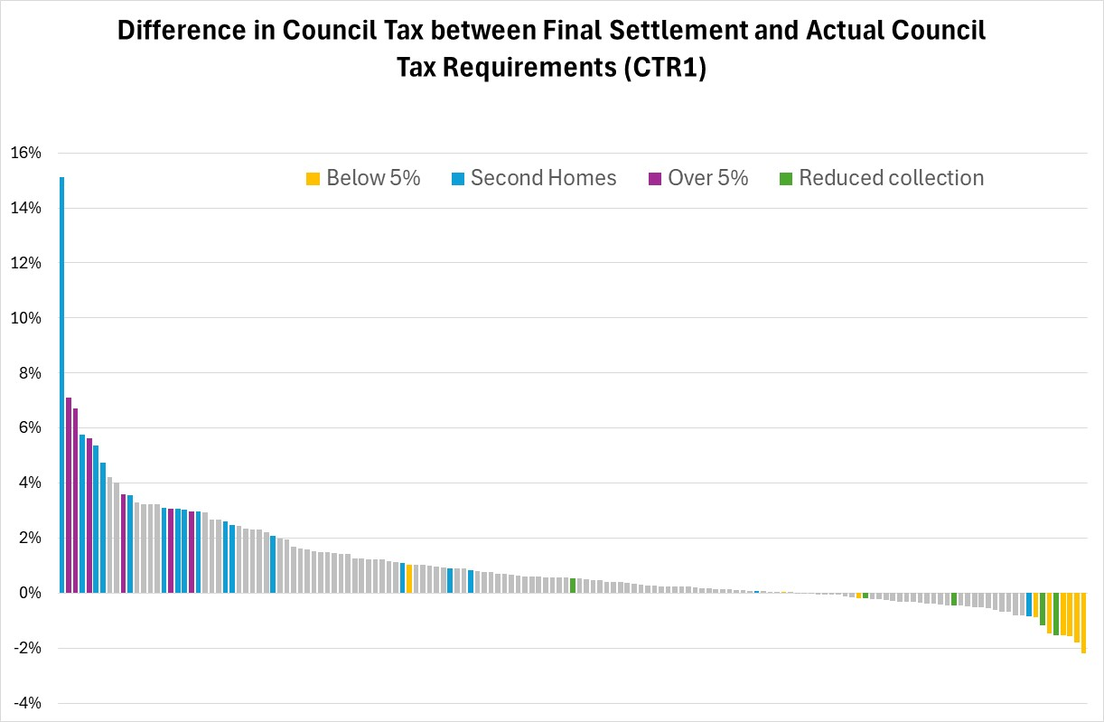
Final Settlement v CTR1
Settlement assumed all authorities opted for maximum council tax.
Main Differences
6 councils permitted to increase council tax above 5% (purple).
Second homes premium (blue).
Some authorities opted for lower increases than 5% (yellow).
Some authorities have reduced estimate collection rates (green).

Slide 32
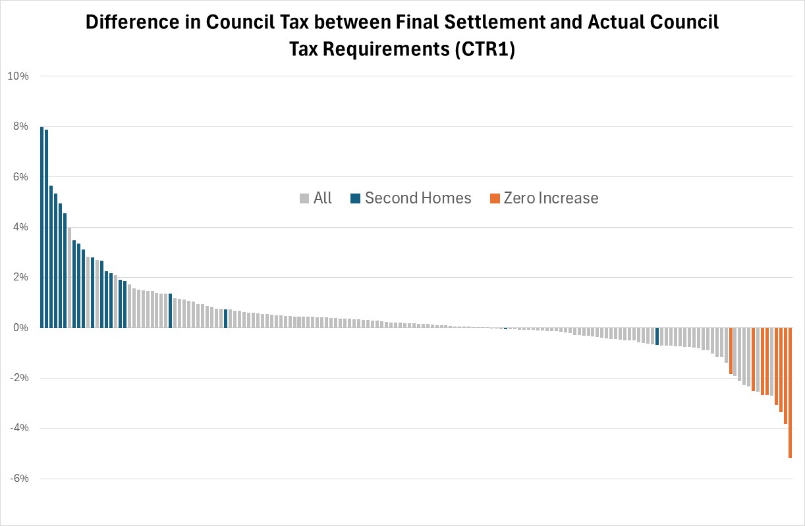
Final Settlement v CTR1
Settlement assumed all authorities opted for maximum council tax.
Main Differences
Second homes premium (shown in blue).
Some authorities opted for zero increase (shown in orange).

Slide 33
Council Tax Levels
Following graphs from Council Tax Requirement data released last week.
Upper Tier authorities permitted to increase council tax by 5% (3%+2% ASC).
Six authorities allowed to increased beyond this 5% threshold.
Only 9 of 151 upper tier authorities went for increases significantly lower than 5%
Districts permitted to increase council tax by higher of 3% or £5.
£5 only relates to 20/164 districts now and 16 of these opted for that.
4 went for lower increases as did 14/144 that opted for lower than 3%.

Slide 34
Change in band D – upper tier
Most upper tier authorities opted for 5% maximum increase.
9 authorities with sub 4.5% increase

Slide 35
Change in band D – upper tier
Six authorities permitted to raise council tax by more than the 5% threshold.

Slide 36
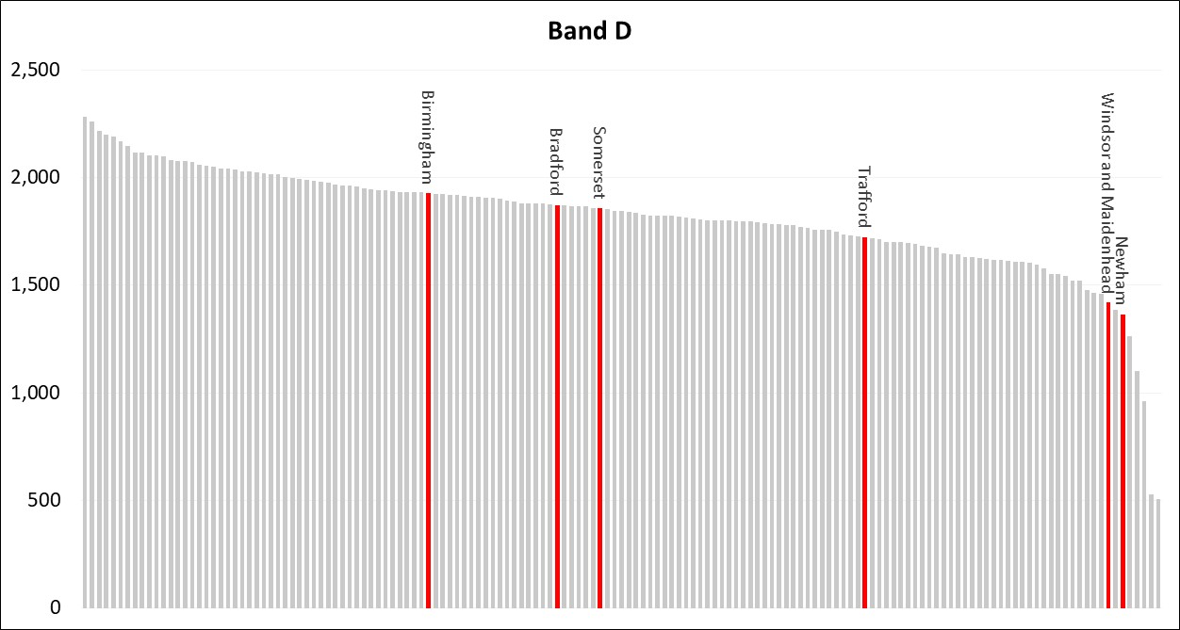
Band D – 2025/26 – upper tier
Band D of upper tier authorities in 25/26 showing those permitted to increase above threshold.
Is there a case for further flexibilities for those with band Ds ‘stranded’ below levels of ‘assumed national council tax’?

Slide 37
Change in band D – districts
Most district authorities increased council tax by 3%.
16 of the 20 authorities permitted to increase CT by £5 have done so.
14 authorities opted for 2% or lower increase including:
£5
<3%

Slide 38
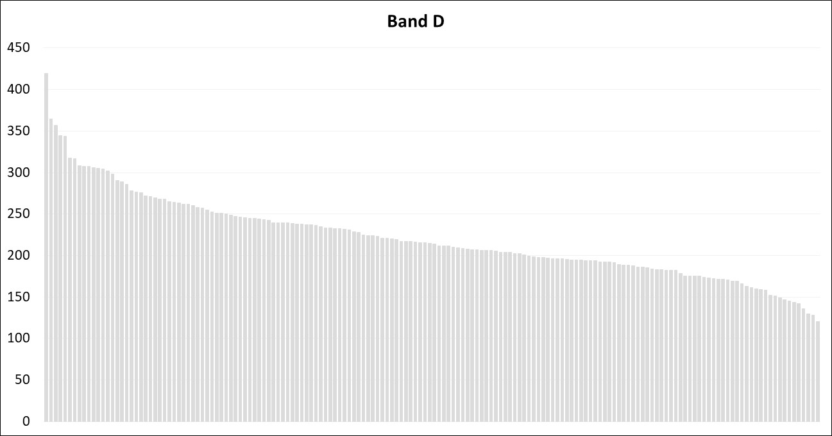
Band D – 2025/26 – districts
Significant disparity in band Ds between districts.
Ipswich: £419.58 (+£12.15 in 25/26)
Breckland: £120.56 (£+5.00 in 25/26)
Case for those below ‘assumed national council tax’ to catch up?

Slide 39
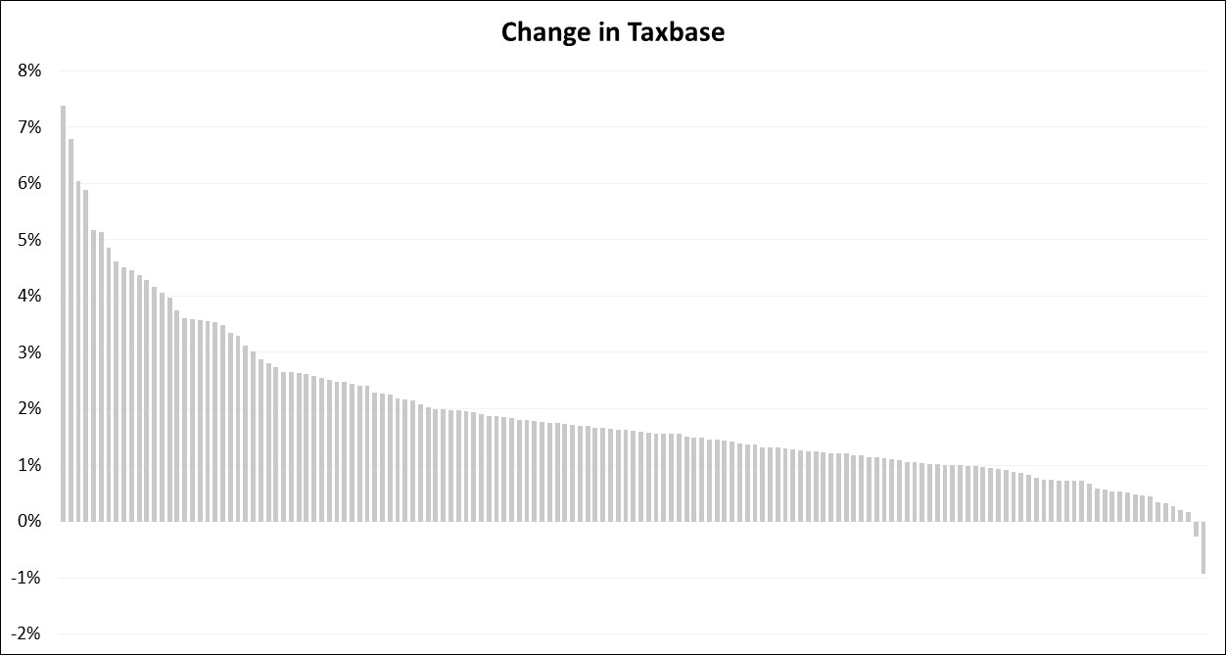
Change in taxbase – upper tier
Significant disparities in taxbase changes in 2025/26.
Reasons
New homes
Council Tax Support
Change in Collection Rates
Second Homes

Slide 40
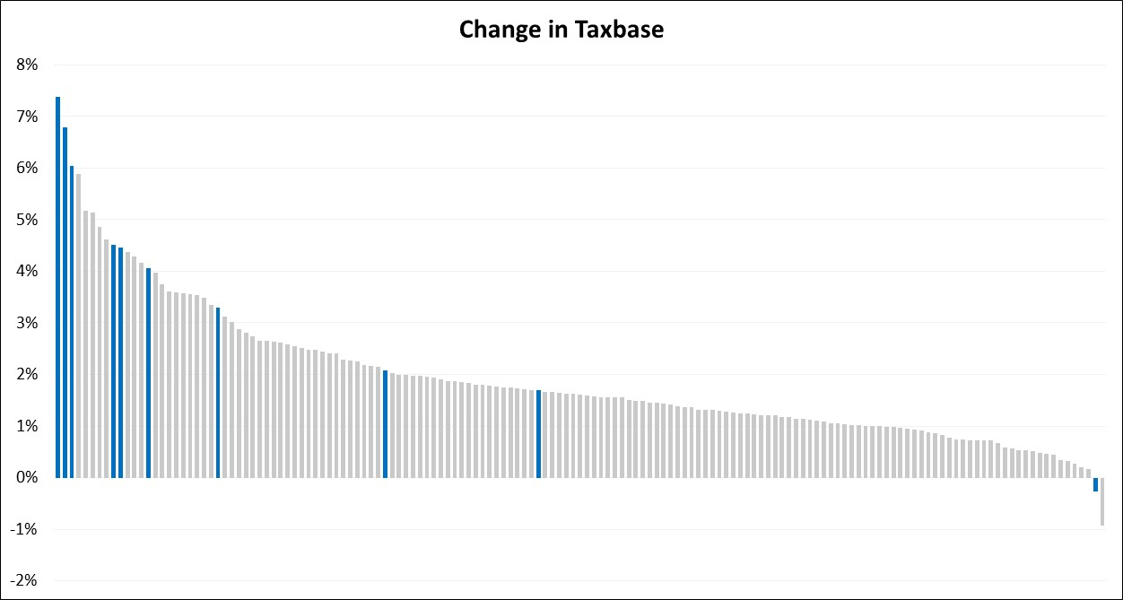
Change in taxbase – upper tier
Impact of second homes
Graph picks out the ten authorities with the highest proportion of second homes (information taken from CTB1).
Significant increases in taxbases of those authorities with high proportion of second homes that opted to charge the premium.

Slide 41
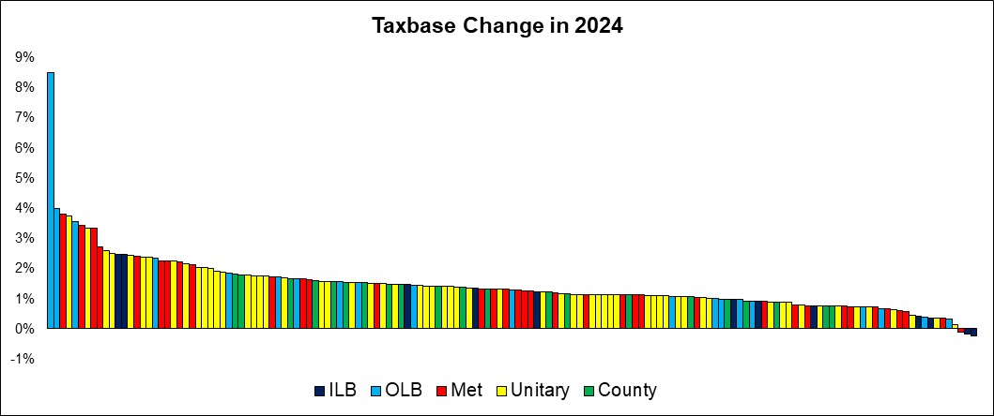
Change in taxbase – upper tier – CTB1
CTB1 data doesn’t show second homes but does show impact of housing growth, Council Tax Support and other discounts/reliefs.
Significant housing growth in some places including Newham, Salford and Liverpool.
But largest increase is Enfield is almost entirely due to changes in Council Tax Support.

Slide 42
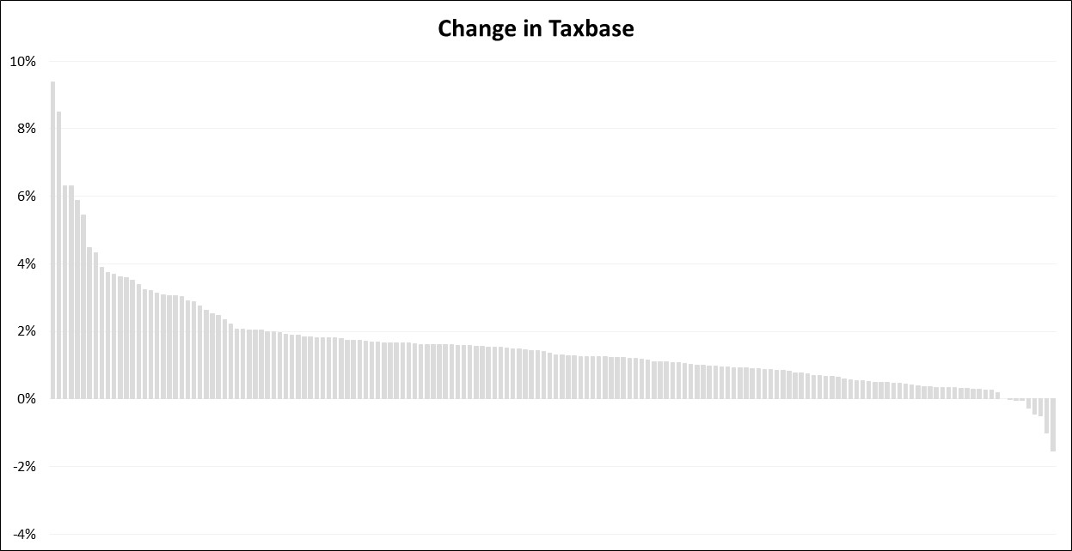
Change in taxbase – district
Significant disparities in taxbase changes in 2025/26.
Highest increase 9%.
Lowest almost 2% decrease.
Reasons
New homes
Council Tax Support
Change in Collection Rates
Second Homes

Slide 43
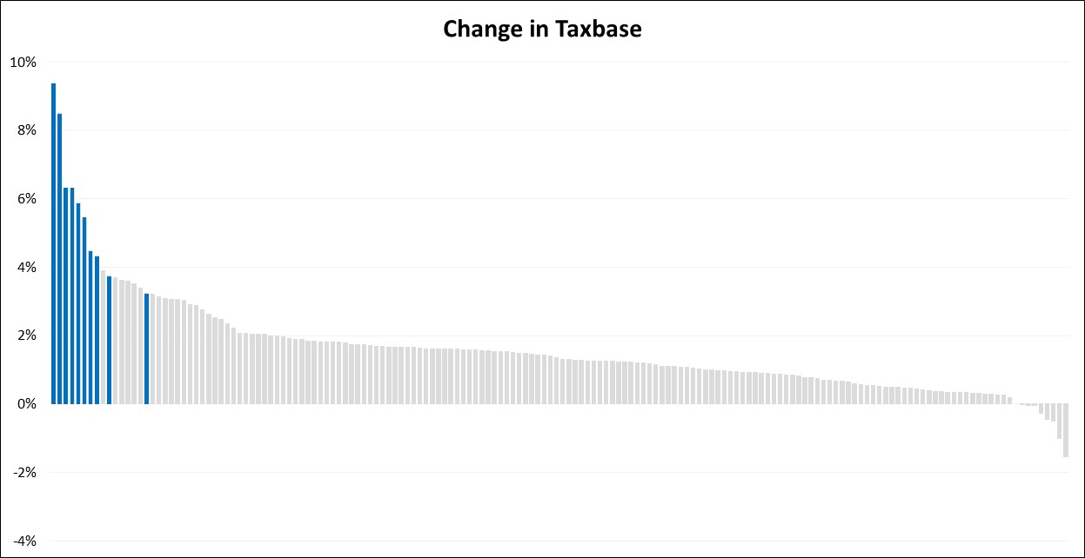
Change in taxbase – district
Impact of second homes
Graph picks out the ten authorities with the highest proportion of second homes (information taken from CTB1).
Preston and Tewkesbury very high levels of housing growth.
Spelthorne have increased assumed collection rate by 2% points.

Slide 44
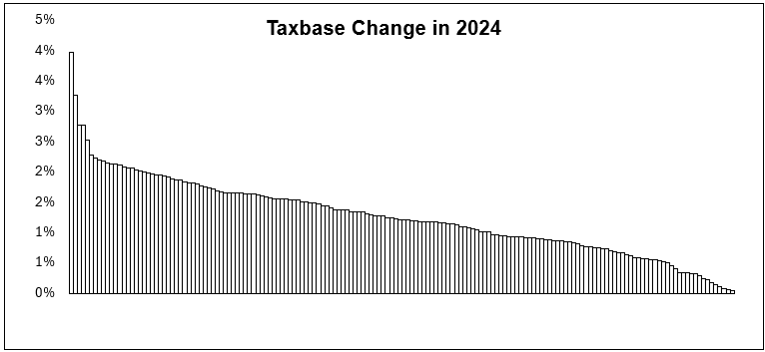
Change in taxbase – district – CTB1
More modest increases than CTR because second homes not included in CTB1 analysis.
Significant growth in taxbase across some districts.
Highest is Preston where there is significant housing growth. Second highest is Great Yarmouth where CTS significantly reduced – less claimants or tougher scheme??

Slide 45
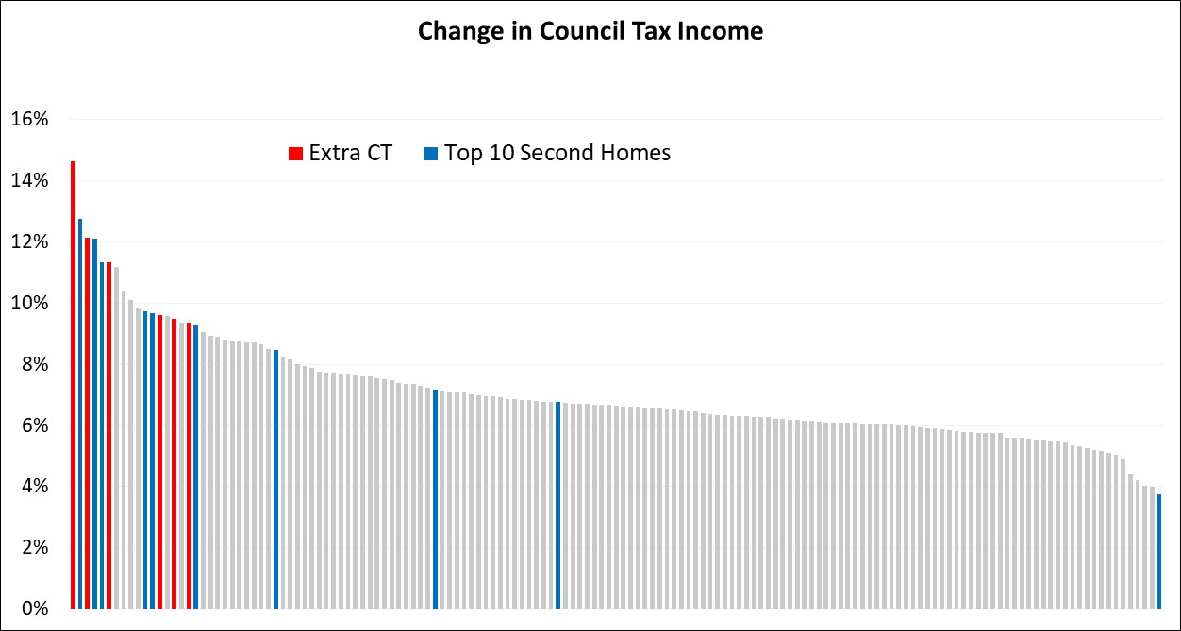
Change in CT income – upper tier

Slide 46
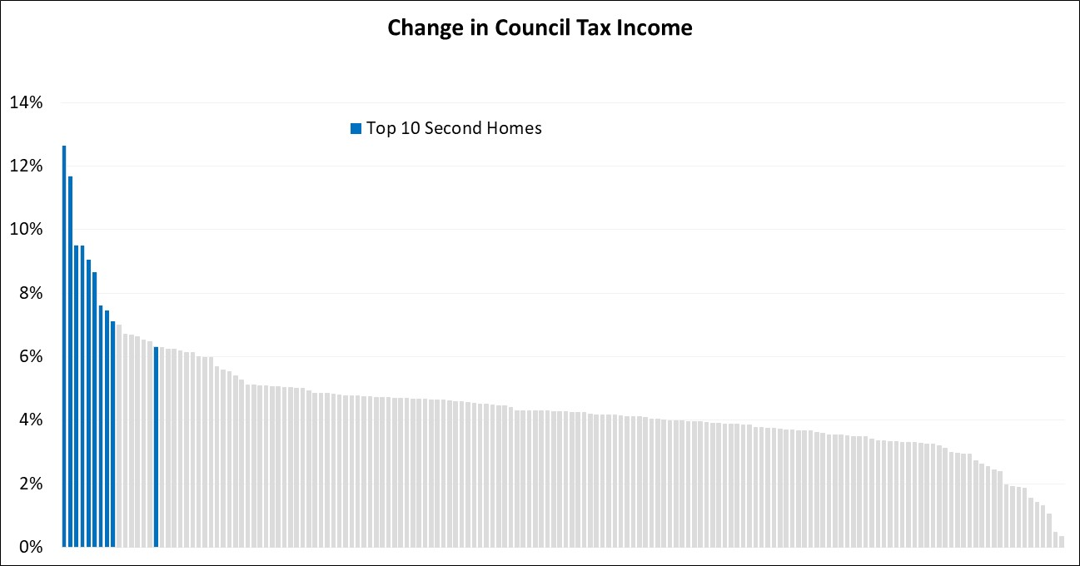
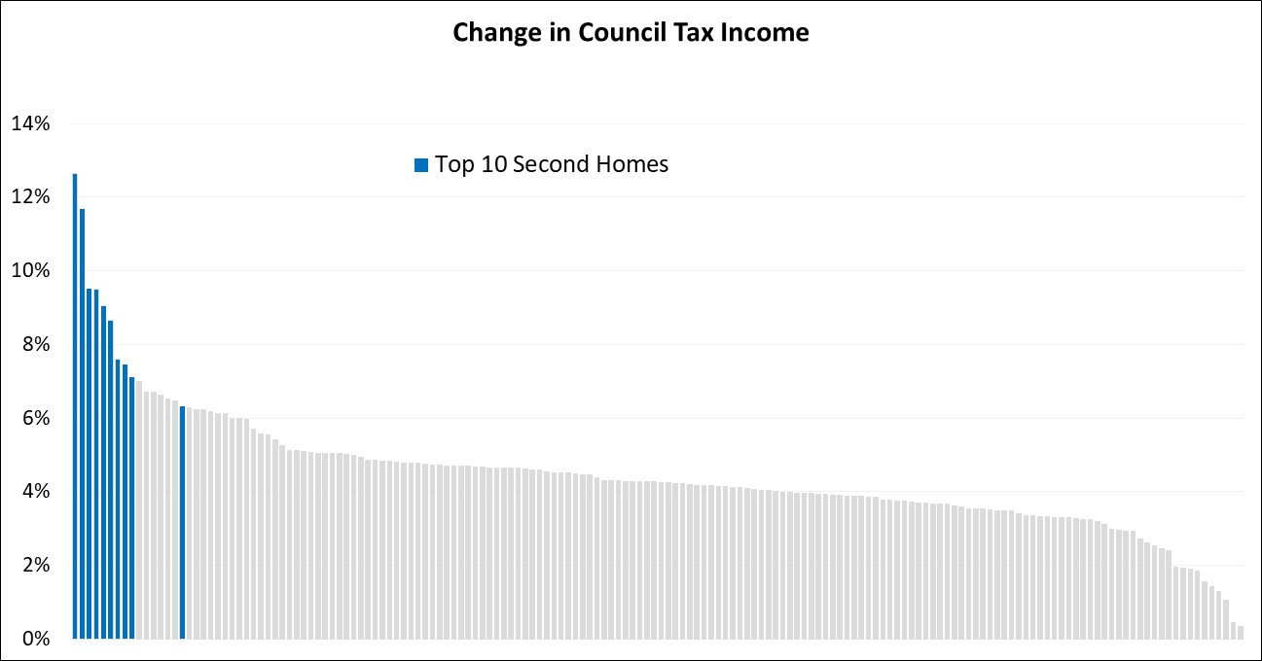
Change in CT income – districts

Slide 47
Top/Bottom 5 changes to Council Tax Income - UT

Slide 48
Top/Bottom 5 changes to Council Tax Income - Districts

Slide 49
Conclusions
There will be £311m more raised in council tax than was estimated by Government in its final settlement figures.
This is mainly due to the additional flexibility allowed for six upper tier authorities experiencing financial difficulties as well as additional income raised by those councils which chose to charge a second homes premium.
The second homes premium has provided a significant boost to income in some places – up to 9% increase in taxbase. These areas are more likely to be low needs authorities in more ‘touristy’ areas.
Housing growth (greater in the north) as well as decisions on council tax support and collection rates have also influenced council tax requirement figures.

