Slide 1

Policy Statement
Adrian Jenkins/ Stuart Hoggan
21 November 2025

Slide 2
Overview
Key changes (remoteness, population (resident and daytime) and 2025 Index of Multiple Deprivation (IMD) – including re-weighting formulas
Damping floors
Quantum – increase in funding, new burdens (food waste)
Initial view about funding distribution
Stuart Hoggan – commentary on Policy Statement
Updating the MTFP model (following Policy Statement) – change in “blending” methodology
Autumn Budget – council tax bands, business rates multipliers, new burdens, funding cuts
Business Rates Retention System (BRRS) and Business rates pooling

Slide 3
Timetable
Consultation paper 20 June 2025
Further ad hoc guidance from MHCLG
Policy statement (expected week beginning 17 November 2025)
Autumn Budget (Wednesday 26 November 2025)
Provisional settlement (week beginning 15 December 2025)
Final settlement (February 2026)

Slide 4
Policy Statement: speculation, expectations and model updates

Slide 5

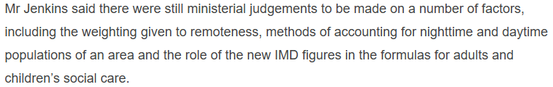
Pixel’s pre-Policy Statement expectations…
Comments from the LGC

Slide 6
Policy Statement – headlines
Using 2022-based sub-national population projections (not mid-2024 population estimates)
Using 2025 IMD and new IDACI (in Children’s RNF)
Removing “remoteness” from all ACAs, except ASC
Reducing weighting for non-resident population in Foundation Formula (no change in data)
Cap on distance in the Home-to-School Transport (HTST) RNF is increased from 20 to 50 miles
Continuing Recovery Grant payments (to UT and LT authorities) in 2026-27

Slide 7
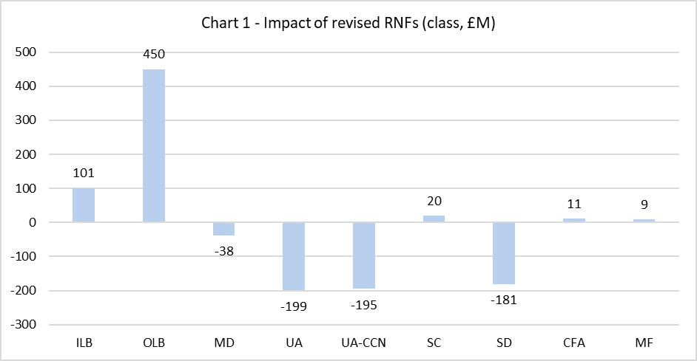
Overall change in weighted RNFs
Compared to our modelling of the June 2025 consultation paper
London is the major gainer, particularly outer London (already the largest increases pre-Policy Statement)
Shire districts also losing heavily (largely from the changes in weighting)
Mets losing, but not significantly (a number of balancing factors, including IMD, population and ministerial judgements)
Split within the county authorities – small gains in shire counties, but very significant losses in county unitaries (remoteness)

Slide 8
Overall change pre-damped resources
Compare gains/ losses (before 3-year phasing) plus Recovery Grant in Policy Statement
Not exactly like-for-like but shows the relative movement and overall gainers and losers
Shift in resources towards inner London, outer London and the Mets – from continuation of Recovery Grant and change in weighted RNFs
Smaller increase in SC (weighted RNFs) but reduction in county unitaries (remoteness)
Substantial losses for shire districts, even with continuation of Recovery Grant
Effect of damping (esp the new floors) will change shape of settlement – increase gains for Mets, and offset losses for inner London

Slide 9
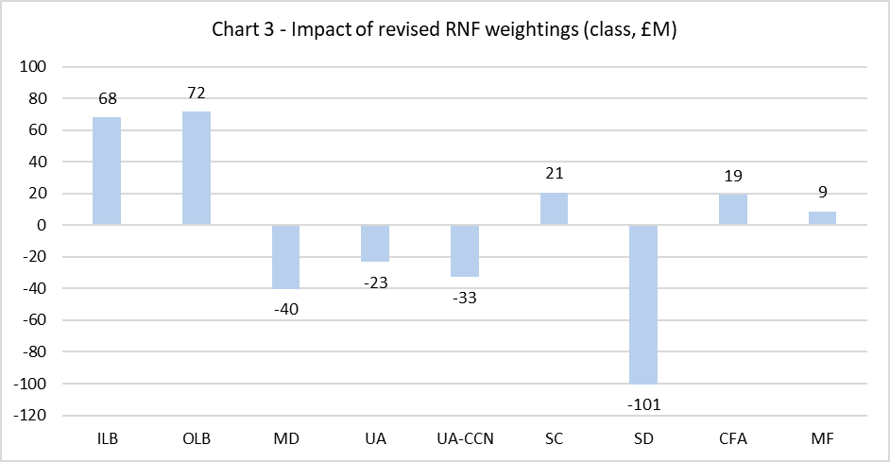
Changes in weightings of RNFs
Weightings have been updated for the latest RO data
Significant reduction in weighting for lower-tier Foundation Formula (very bad for shire districts because this is their only RNF) – possibly corrects the error in June
Big increase in Temporary Accommodation weighting, reflecting strong expenditure growth
Small reductions in both adult’s and children’s social care
Cuts in weighting for both highways and HTST – will affect counties more than other types of authority
 | Adult Social Care Relative Need Formula (weight) | Children and Young People's Services Relative Need Formula (weight) | Foundation Formula (Lower Tier) (weight) | Foundation Formula (Upper Tier) (weight) | Fire & Rescue Relative Need Formula (weight) | Highways Maintenance Relative Need Formula (weight) | Home to School Transport Service Relative Need Formula (weight) | Temporary Accommodation Relative Need Formula (weight)
June consultation | 37.54% | 23.18% | 12.36% | 14.76% | 4.30% | 3.20% | 3.24% | 1.42%
Policy Statement | 37.37% | 23.00% | 11.84% | 15.57% | 4.36% | 3.00% | 3.13% | 1.74%
Change | -0.5% | -0.7% | -4.2% | 5.4% | 1.4% | -6.4% | -3.4% | 22.6%

Slide 10
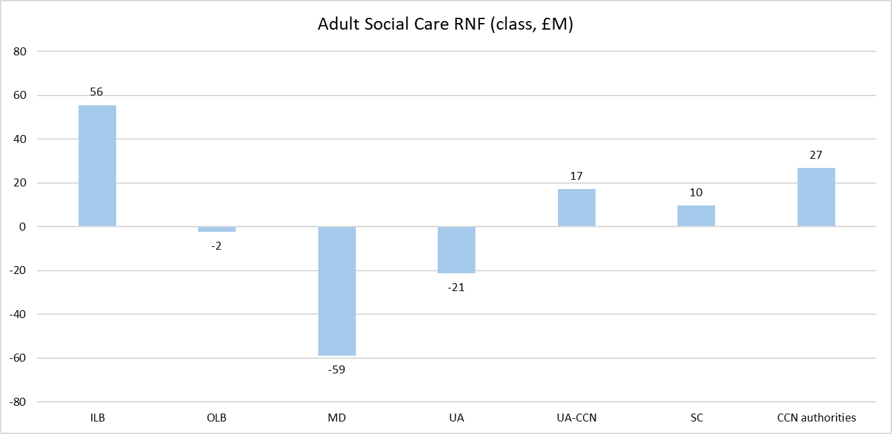
Adult Social Care RNF
Shift in funding, largely from Mets to inner London
Other changes in the needs indicators? Population projections?
Shire areas gaining – partly because there are no losses from removal of “remoteness”

Slide 11
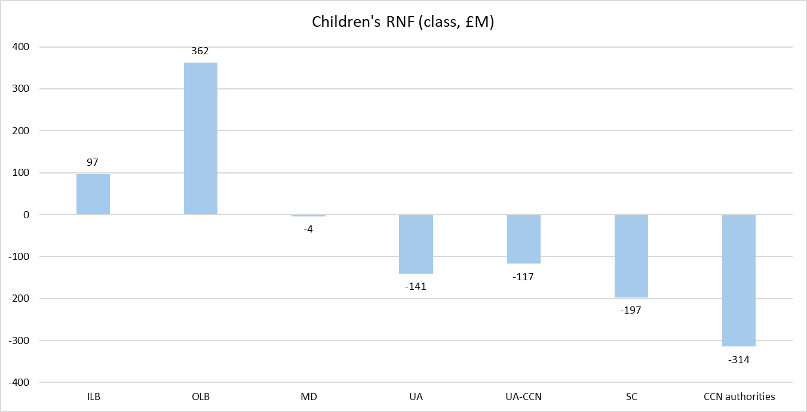
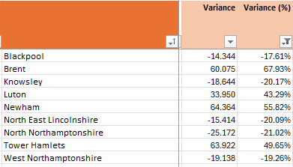
Children’s RNF
Gains in London, particularly outer London (gains of £362m)
Movements at individual authority level are extreme: some London boroughs increasing by more than 50% compared to June; some county unitaries and Mets reducing by 20% compared to June
Neutral in the Mets – but significant reduction in resources in county areas
Is this largely driven by the new IDACI numbers?
Remoteness has an impact on some county authorities (although largest reductions are not those with the highest remoteness scores)

Slide 12
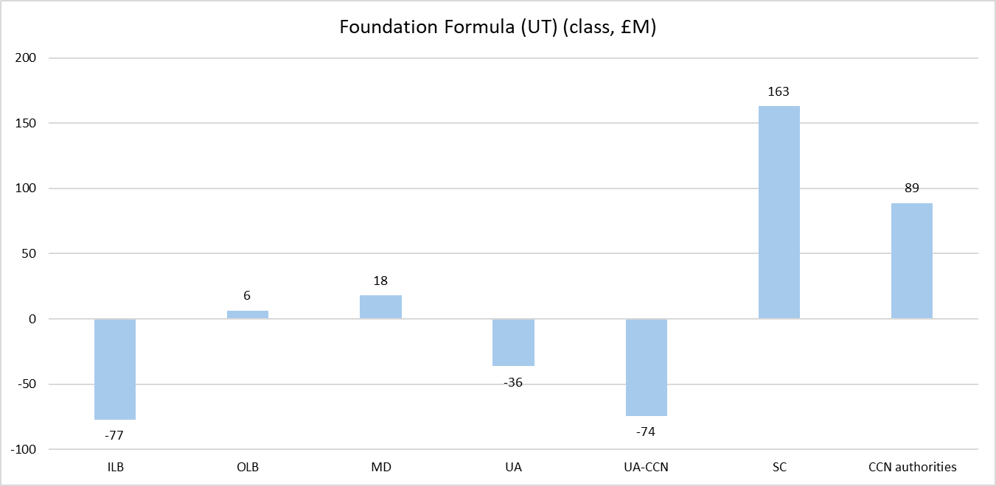
Foundation Formula UT RNF
Shire counties is the only class gaining in share – but this is driven by the increase county share
Lower weighting for non-resident population has reduced inner London share
2025 IMD should have led to gains in London and counties
Losses in county unitaries, which tend to more affected as a class by “remoteness”

Slide 13
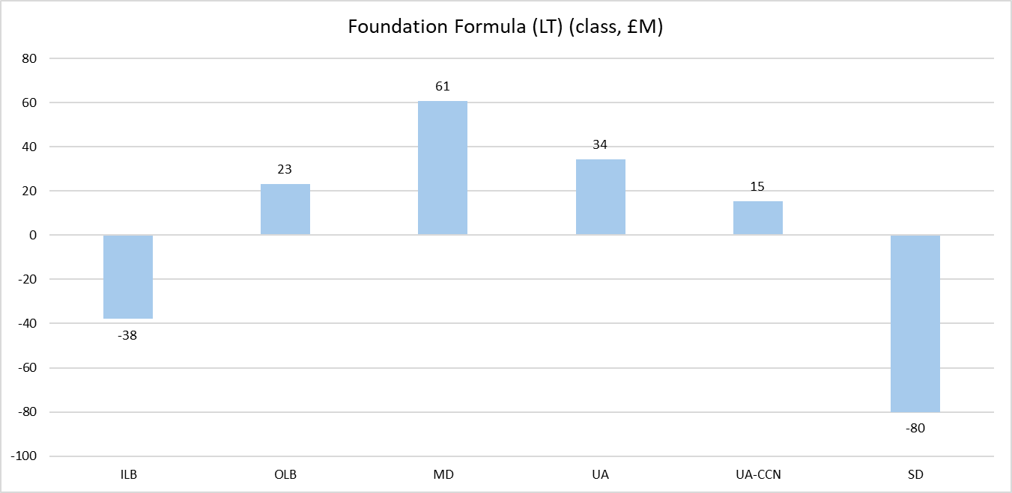
Foundation Formula LT RNF
Shire districts losing – because of the lower weighting
Lower weighting for non-resident population has reduced inner London share
2025 IMD should have led to gains in London and counties
Small gains in county unitaries despite reduction in “remoteness”?

Slide 14
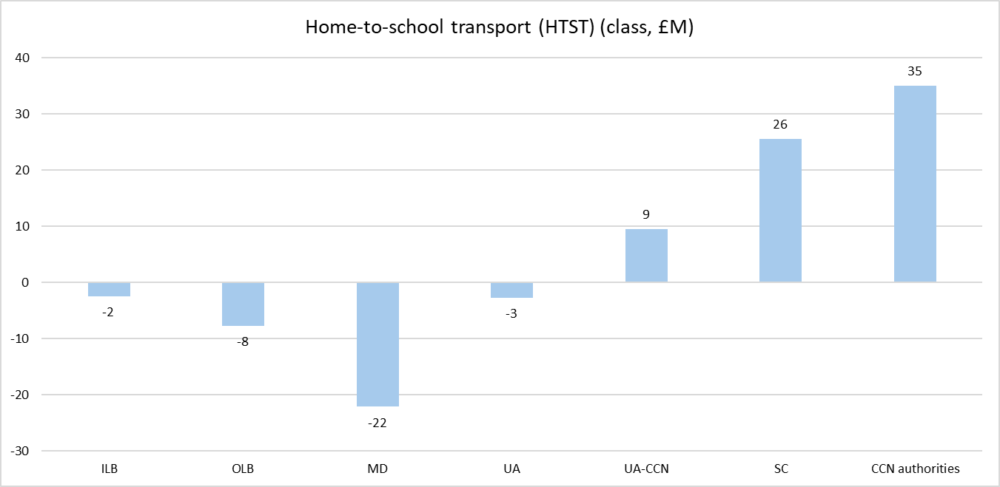
Home to School Transport RNF
Cap on journeys of 20 miles has been replaced by 50-mile cap
Favours county authorities with sparser geographies (Norfolk, North Yorkshire, etc)
Remoteness was not in the HTST ACA in June, so no negative impact of removal on county authorities

Slide 15
Population projections
June proposals based on mid-2023 population estimates
We had expected mid-2024 population estimates
Policy Statement uses 2022-based sub-national population projections
Base is earlier (2022 rather than 2024) and projections are based on past trends
We have not analysed how the 2022 population projections compare to the mid-2024 estimates
Question in consultation about whether to use latest actuals or projections (dynamic)

Slide 16
Area Cost Adjustment (ACA) – remoteness
Remoteness removed from all ACAs, except ASC
Strong “theoretical” case based on economic theory
Weighting was not derived from data but based on judgement
MHCLG have concluded insufficient evidence was available to support original weighting (in June)
Transparency – authorities will be expecting more justification for the decision
But working out the impact on individual authorities is not easy
New ACAs not yet published, and it was not possible to recreate the ACAs previously

Slide 17
Area Cost Adjustment (ACA) – remoteness
Chart shows UT authorities with the highest remoteness weightings
We estimated the gains from the ACA in June
Compared these to the changes in weighted RNF
Correlation between the two is strong – although there are other factors, remoteness appears to be the key factor reducing weighted RNF for remote authorities

Slide 18
Recovery Grant
Recovery Grant will continue to be paid to UT and LT authorities in 2026-27 onwards
No change in distribution or methodology
Share of IMD 2019 vs share of taxbase, max 3% CSP (iterative)
Case for continuing is about distribution rather than principle: it is very effectively targeted at authorities with highest levels of deprivation, and lowest ability to generate council tax income (the authorities that have had largest cuts in CSP since 2010)
Authorities receiving Recovery Grant expected (reasonably) to gain from FFR 2.0 – but was not the case for all
Continuation of Recovery Grant is a simple way of resolving this outcome – but at the expense of undermining the purity of the FFR!
Also used as a determining factor for damping baselines (effect not fully understood yet)

Slide 19
Recovery Grant
 |  | Recovery Grant 25-26 | SFA gains/ losses (in June consultation proposals)
Newham | OLB | 11.012 | -1.824
Sunderland | MD | 10.302 | -27.918
Hackney | ILB | 9.698 | -48.830
Rochdale | MD | 7.815 | -3.266
Wigan | MD | 7.045 | -7.615
St Helens | MD | 6.296 | -4.332
Gateshead | MD | 6.120 | -16.128
South Tyneside | MD | 5.940 | -21.973
Brent | OLB | 5.822 | -23.124
Sefton | MD | 5.609 | -9.346
Haringey | OLB | 5.358 | -35.173
Blackburn with Darwen | UA | 5.280 | -1.617
Lewisham | ILB | 5.279 | -31.286
Tower Hamlets | ILB | 5.130 | -25.832
Dudley | MD | 5.031 | -4.344
Waltham Forest | OLB | 4.829 | -6.850
Greenwich | ILB | 3.809 | -40.512
Southwark | ILB | 2.375 | -59.215
Torbay | UA | 2.085 | -4.045
North Tyneside | MD | 1.597 | -2.781
Islington | ILB | 1.581 | -64.962
Cumberland | UA | 1.476 | -15.404
Lambeth | ILB | 1.281 | -62.625
159 authorities received Recovery Grant in 2025-26, of which 78 are UT authorities
Some of the allocations are very significant indeed: Birmingham £39m, Leeds £20m, Liverpool £20m, Manchester £19m, Newham £11m, Hackney £9m
£573m out of £600m is in UT
In the June proposals, authorities kept two-thirds in 26-27, one-third in 27-28; in Policy Statement, authorities keep the full amount for 3 years (assume outside SFA)
Focus on those UT authorities receiving Recovery Grant – but modelling showed losses in June proposals. Half inner London boroughs, half metropolitan authorities

Slide 20
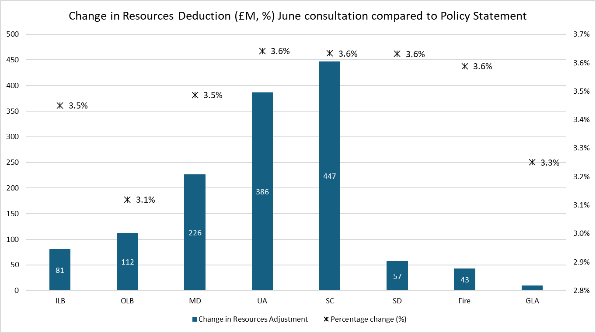
Resources Deduction
Confirmation of the Band D assumptions: £2,060 in 26-27, £2,160 in 27-28 and £2,165 in 28-29
Higher starting point (£1,998) and faster growth than we had modelled (4.9% growth vs 3.5%)
Updated taxbase (see next slide). Change in definition to include average student numbers
Update to the LCTS adjustment (2025 IMD, plus amendment to formula)
Increase in the Resources Deduction (from £38.4bn to £39.8bn), with the largest increase in shire counties

Slide 21
Council taxbase (CTB1)
CTB1 2025 data released on 6 November 2025: https://www.gov.uk/government/statistics/council-taxbase-2025-in-england
Used to update the Resources Deduction (we will use this in the updated version of the MTFP model next week)
Average increase in taxbase (per the Resources Deduction definition) is 0.47%
Manchester -3.84%, Newcastle-under-Lyme -1.32%, Reading -0.98%
Salford +2.00%, Melton +1.96%, Hartlepool +1.94%, Tewkesbury +1.66%, Preston +1.65%

Slide 22
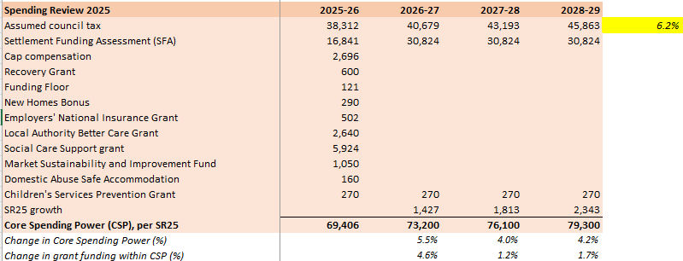
Quantum and new burdens
We are still unsure about the funding from SR25
Grant increase over 3 years is £3.4bn (i.e. £1.1bn in each financial year)
Of which:
Social care funding (£150m/ £250m/ £500m = £900m over 3 years)
A further £547m in funding for children’s social care (we assume spread over 3 years).
Leaves £1.95bn available in new grant funding within CSP over the next 3 years (less than £700m per year)
New burdens: Food waste responsibilities? Other new burdens?
Top-slice for damping floors (likely to be considerably higher than for the June proposals)?
We assumed grant funding within SFA increased to £2.3bn by 2028-29 (cumulative additional grant of £5.5bn)
Included funding for new burdens and for damping floor

Slide 23
Rolled-in grants
All grants within CSP to be rolled into SFA in 2026-27
Children’s Social Care Prevention Grant and Domestic Abuse Grant will be the only exceptions (waiting confirmation)
We assume all grants will be rolled into SFA using the overall Needs Assessment shares
Will any of the rolled-in grants have different distribution bases? Will any of the increase in SFA be distributed using a different basis (e.g. new burdens, social-care related funding)?
Value of the BRRS roll-in also has to be confirmed – we assume £1.495bn based on 2025-26 NNDR1
Plus value of the cap compensation roll-in, and the inclusion (or not) of growth/ cap compensation from pilot authorities

Slide 24
Damping floors
Tier/ class | Criteria | Protection
Upper tier | Authorities receiving Recovery Grant in 25-26 (excl shire districts) | Real-terms protection
Fire authorities | All authorities
Upper tier | <15% above funding target | Cash-terms protection
Lower tier (shire districts) | <15% above funding target
Upper tier | >15% above funding target, low Band D | 95% protection (i.e. -5% floor in 2026-27, 0% in following two years
Lower tier (shire districts) | >15% above funding target
Real-terms protection based on GDP Deflator – but set at 5%/ 6%/ 7% for Recovery Grant authorities (max £35m)
Low Band D defined as below median (for each class). >15% based on modelling (uncertain)
Important interaction with BRRS income measurement
Baseline does not include Recovery Grant, Domestic Abuse Safe Accommodation grant, or Children’s Social Care Prevention grant

Slide 25
Rolled-in grants
Much wider scope than previously indicated – some rolling into SFA, others included in the new Consolidated Grants
Grants within the current CSP will be rolled into SFA, and redistribute using the new Fair Funding Assessment (FFA) (~£24bn). This includes Social Care Grant, MSIF, NHB, Funding Floor, and ENICs grant. (There is no mention of LA BCG. We assume this is also distributed using the new FFA within SFA, but await confirmation.)
Grants that are currently part of the Children’s and Families grant, and which will be distributed (within CSP) using the new FFAs.
Grants that are new to the settlement. Most will be redistributed using the new FFAs (£1.1bn), with the others using their existing distribution (£0.07bn).

Slide 26
Grants outside SFA
Modelling guidance to assume no change in distribution. Our view: likely to use the latest RNF if this has been updated within SFA
No information yet on quantum or growth (and is this funded from within the CSP allocations?)
Public Health grant (£3.8bn)
Children’s Social Care Prevention Grant (£270m)
Local Authority Better Care Grant (£2.6bn)
Homelessness Prevention Grant (£348m)

Slide 27
Business Rates Retention Scheme (BRRS)
Levy rates and thresholds – now proposed (see our previous briefings)
Safety net and thresholds
Baseline reset (and new BRB set based on gross rates minus accounting adjustments; s31 grant payments for all reliefs, incl charitable relief/ empty property relief)
Cap compensation (from 2026-27 onwards)
Setting multipliers (from 2026-27 onwards) – Autumn Budget
Business rates pools – deadline is 24 November 2025
Business rates pilots – waiting for decision in the Autumn Budget (except GM and WM)
MTFP guidance on budgeting – starting point is that there is no above-baseline growth as at 1 April 2025.

Slide 28
Measuring business rates income
Numbers for BRRS income in a new spreadsheet (and are in MTFP model):
Income is based on the 2025-26 NNDR1, and will not be updated to take into account the outturn for 2025-26. Any surpluses and deficits will not be taken into account.
Non-domestic rating income is the starting point for the assessment, and so includes an authorities estimate of refunds and bad debts.
Only business rates income accruing to the billing authority (or preceptor) will be included. Other income will be excluded because it will continue into 2026-27 and does not need to be included in the damping baselines. This includes any income in respect of the designated areas (EZs, Investment Zones), Renewable Energy and the cost of collection.
An expansive definition of business rates income has been used. It includes actual cap compensation payments, pooling gains, and 100% pilot (“enhanced retention”) gains.
Main change is a higher starting point for many authorities (esp those with pools/ pilots, and significant growth)
MTFP modelling challenge – post-damped resources from 2026-27 will include pooling gains, which are not in our current model – in some extreme examples, 2026-27 resources are above 2025-26, even where authority is losing considerably from reset (e.g. NW Leicestershire)

Slide 29
Bespoke settlements
Greater London Authority (GLA)
Council of the Isles of Scilly

Slide 30
Stuart Hoggan – commentary on Policy Statement

Slide 31
Pixel Benchmarking Service update
Webinar 25 November 2025

