Slide 1

Policy Statement
Adrian Jenkins/ Stuart Hoggan
12 November 2025

Slide 2
Overview
Timetable/ latest speculation and reporting
Updates and changes – checklist for Policy Statement (and looking ahead to Autumn Budget 2025)
Context – funding distribution based on June 2025 consultation paper
Quantum – increase in funding, new burdens
Population (resident and daytime) and 2025 Index of Multiple Deprivation (IMD) – including re-weighting formulas
Remoteness
Stuart Hoggan – commentary on Policy Statement
Updating the MTFP model (following Policy Statement) – change in “blending” methodology
Autumn Budget – council tax bands, business rates multipliers, new burdens, funding cuts
Business Rates Retention System (BRRS) and Business rates pooling

Slide 3
Policy Statement: speculation, expectations and model updates

Slide 4
Timetable
Consultation paper 20 June 2025
Further ad hoc guidance from MHCLG
Policy statement (expected week beginning 17 November 2025)
Autumn Budget (Wednesday 26 November 2025)
Provisional settlement (week beginning 15 December 2025)
Final settlement (February 2026)
Not expecting any exemplifications until the provisional settlement…

Slide 5
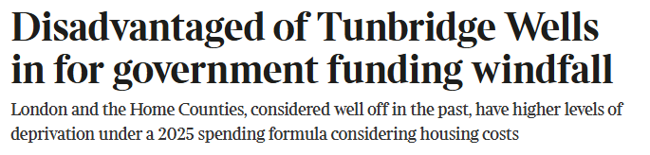
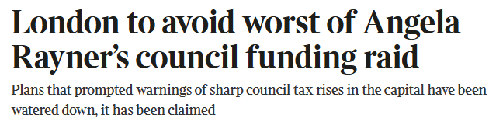
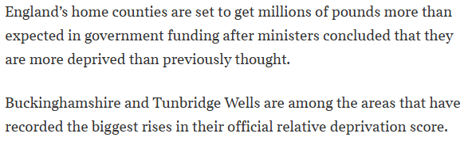

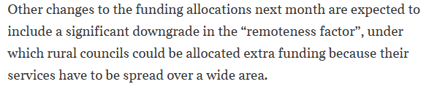


Informed speculation?
Articles in the Times (Max Kendrik). 27/ 28/ 30 October 2025

Slide 6
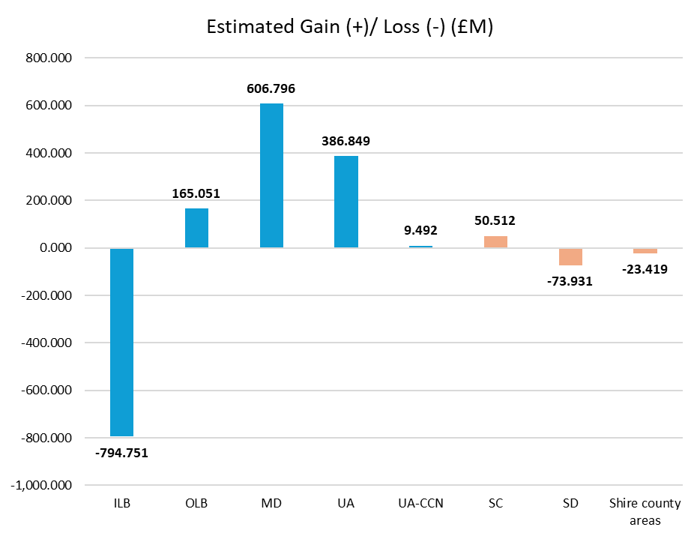
Estimated gains and losses – before phasing and damping
Estimates are based on Pixel modelling
Feedback from MHCLG that these are broadly in the right area – but not confirmed. Estimates will be updated for the Policy Statement, and confirmed in provisional settlement.
Substantial movement in funding from inner London towards metropolitan areas.
Disappointing outcome for metropolitan authorities relative to expectations.
Gains overall for county councils and county unitaries. Broadly neutral overall in county areas, with upper-tier gains offset by losses for shire districts.
New ministers – assume their objective is to minimise losses in inner London and to improve (or at least protect) the gains in metropolitan areas.
Notes:
Three-way tug-of-war: London (inner), counties (including county unitaries), and Mets.

Slide 7
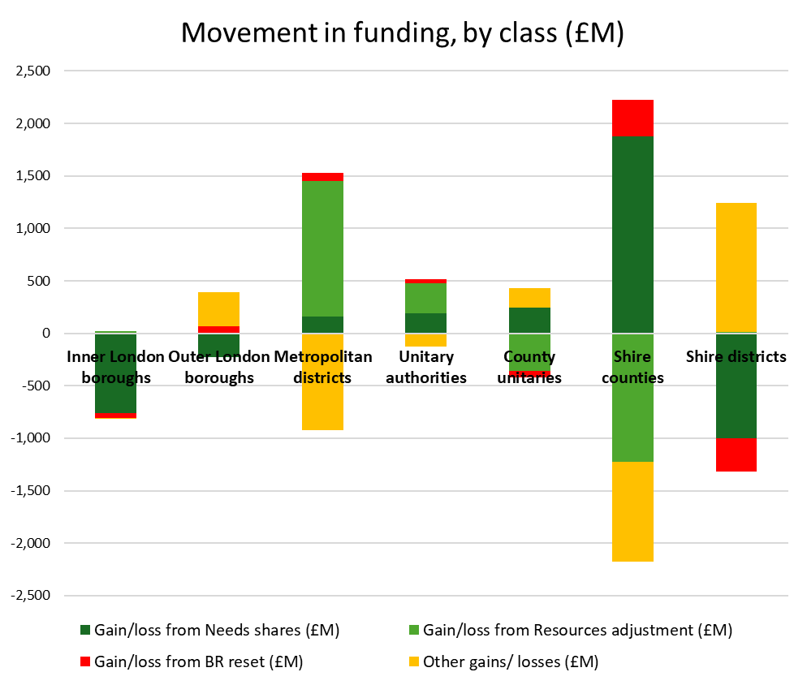
Movement in funding
Counties: major gains from “needs” shares, offsetting losses from equalisation. Largest gainer from business rates reset.
Mets: major gains from council tax equalisation, but much less from “needs”. Gains from business rates reset also very small.
Inner London: losses are driven almost entirely by reduced “needs” share.
Outer London: gains overall but gains from “other” and BR reset offset reduced “needs” share.
Shire districts: losing from “needs” and business rates reset, but gaining on “other”. Also neutral on council tax equalisation.
What is in “other”? Changes in RNF weightings, loss of ASC grants (ASC precept equalisation), baseline effects (13-14 damping, negative RSG), 16-17 cuts, etc

Slide 8
Checklist for Policy Statement
Quantum (per SR25). Council tax assumptions, £2.3bn or £3.3bn?
Funding within quantum. New burdens (esp food waste) and additional funding for social care.
Relative Needs Formulas (RNFs). Population, IMD, remoteness, changes in weighting, daytime population measures.
RNF weightings. Based on spending but some issues in methodology.
Resources deduction. Confirmation of the £2,000 Band D, assumed increase in future years.
Projections vs fixed allocations (population, taxbase)
Damping. Funding floors, thresholds. Definition of the baseline (BRRS amounts)
Blending 3-year changes.

Slide 9
Quantum and new burdens
SR25 confirmed the Core Spending Power (CSP) allocations for next 3 years (to be reviewed in Autumn Budget?)
Uncertainty about profiling (front-loading) and quantum. Likely to be the higher figure but..
What is the increase in SFA funding?
Food waste responsibilities?
Other new burdens?
Policy changes in the Autumn Budget?
What is the effect of higher-than-expected CPI (3.8%)?

Slide 10
Updates in Policy Statement
Policy Statement in advance of the provisional settlement
Changes in funding distribution should be limited, other than for data updates
But pressure on ministers to limit losses in inner London and give a better outcome to metropolitan (urban) authorities
Scheduled updates:
Quantum and phasing (funding from SR25, new burdens)
Data updates: mid-2024 population estimates, 2025 Index of Multiple Deprivation (IMD)
Ministerial judgements:
Remoteness (weighting)
Population alternatives (daytime and resident)
Updating weightings in Foundation Formula/ Children’s RNF (as a result of 2025 IMD)

Slide 11
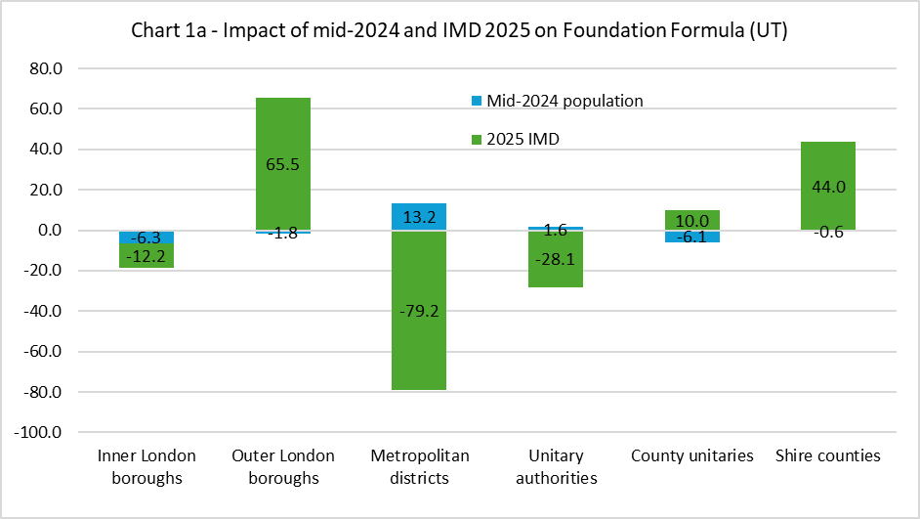
Potential impact of population and 2025 IMD
Mid-2024 population estimates. Released 30 July 2025. Relative population growth in metropolitan areas, with lower growth in London and county areas.
2025 IMD. Major change in methodology leading to lower relative deprivation scores in metropolitan authorities, and shift towards London and county areas.
IMD has a higher weighting for housing costs. Income domain measures relative deprivation based on 70% of After Housing Cost (AHC).
Will there be a change in the weightings based on updated regressions?
Notes:
Helps out inner London because reduction is much lower than had been expected (and there are actually funding gains for ILBs with the highest housing costs).
Outer London gains further.
Question is whether other changes in formula will give metropolitan authorities a better outcome than in consultation paper. Population will help (add-in gains in children’s/ adult’s, etc). But might be reliant on ministerial judgement elsewhere.

Slide 12
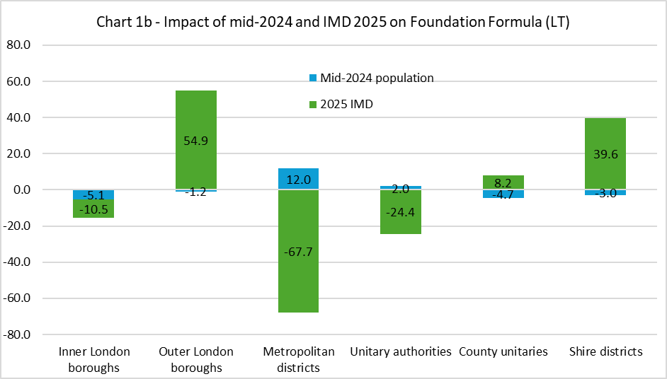
Potential impact of population and 2025 IMD
Outcome is the opposite of expectations; trend has been for metropolitan areas to have relatively higher levels of income deprivation over time.
Combined impact of IMD is a loss for Mets of ~£150m, offset by a ~£25m gain from population. Further losses in the Children’s RNF (from the IDACI), which we are unable to model
Similar estimates to other modellers – with similar constraints
Further major gains for outer London, IMD has avoided what would have been major cuts in funding in inner London. Moderate gains in county areas
Will these change in funding be acceptable to ministers? If not, what can they do to manage the outcomes?

Slide 13
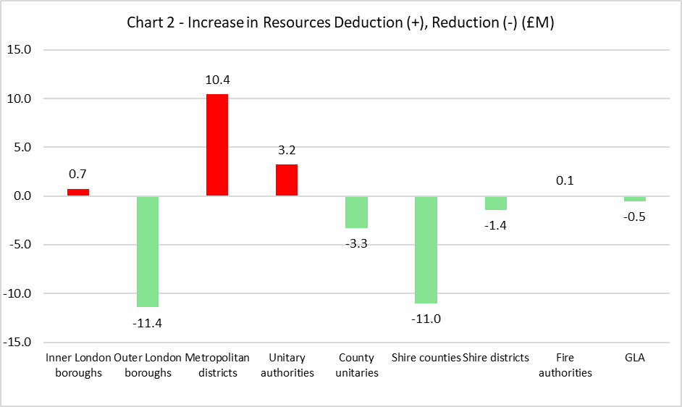
Potential impact of population and 2025 IMD
Impact on the Resources Deduction
Estimate for the cost of Local Council Tax Support (LCTS) schemes is based on IMD
Updated, with small shifts in funding (less significant than for RNFs)

Slide 14
Council taxbase (CTB1)
CTB1 2025 data released on 6 November 2025: https://www.gov.uk/government/statistics/council-taxbase-2025-in-england
Used to update the Resources Deduction (we will use this in the updated version of the MTFP model next week)
Average increase in taxbase (per the Resources Deduction definition) is 0.47%
Manchester -3.84%, Newcastle-under-Lyme -1.32%, Reading -0.98%
Salford +2.00%, Melton +1.96%, Hartlepool +1.94%, Tewkesbury +1.66%, Preston +1.65%

Slide 15
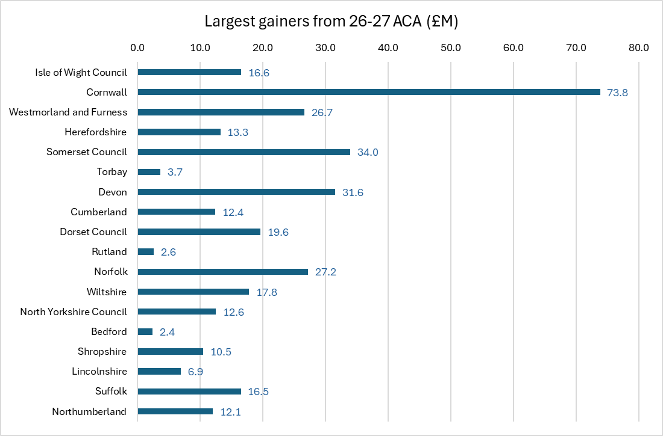
Remoteness
Remoteness uplift developed by previous government, proposed in June consultation paper.
Not able to isolate the impact of “remoteness” but those with largest ACA gain are those with highest remoteness score.
Proposal is based on strong “theoretical” basis (i.e. economic theory). Unit costs will be higher in authorities that are more remote from markets (lower competition).
Weighting needed more data/ evidence. County authorities supplied evidence of cost related to remoteness.
But weighting will ultimately be based on ministerial judgement. Likely to be a lower weighting rather than removal. But could still affect some authorities very significantly.

Slide 16
Rolled-in grants
All grants within CSP to be rolled into SFA in 2026-27
Children’s Social Care Prevention Grant and Domestic Abuse Grant will be the only exceptions (waiting confirmation)
We assume all grants will be rolled into SFA using the overall Needs Assessment shares
Will any of the rolled-in grants have different distribution bases? Will any of the increase in SFA be distributed using a different basis (e.g. new burdens, social-care related funding)?
Value of the BRRS roll-in also has to be confirmed – we assume £1.495bn based on 2025-26 NNDR1
Plus value of the cap compensation roll-in, and the inclusion (or not) of growth/ cap compensation from pilot authorities

Slide 17
Grants outside SFA
Modelling guidance to assume no change in distribution. Our view: likely to use the latest RNF if this has been updated within SFA
No information yet on quantum or growth (and is this funded from within the CSP allocations?)
Public Health grant (£3.8bn)
Children’s Social Care Prevention Grant (£270m)
Local Authority Better Care Grant (£2.6bn)
Homelessness Prevention Grant (£348m)

Slide 18
Bespoke settlements
Greater London Authority (GLA)
Council of the Isles of Scilly

Slide 19
Predictions and speculation
We are still expecting only limited change. Consultation paper sets parameters for funding distribution, and going much beyond them would leave MHCLG open to challenge.
Updating population and 2025 IMD is inevitable and will result in changes in distribution, potentially significantly for some authorities. It will help minimise losses in inner London, but reduce funding gains in metropolitan areas.
Options are limited but might include:
Reduce remoteness uplift within ACA. Very significant negative impact on a small number of (county) authorities.
Review the weightings within Foundation Formula/ Children’s RNF. Discretion limited but more likely to go ahead if benefit is to metropolitan authorities.
Other bespoke changes in distribution. E.g. daytime population measures, rolled-in grants

Slide 20
On-the-day and MTFP model update
On-the-day briefing
Follow-up briefing and analysis the following day
Plus webinar the following day (2pm)
Update MTFP model within a day (or two), depending on the complexity of the updates that are required to the model
Expecting to receive new RNF shares, RNF weightings, assumed Band D, and updated quantum

Slide 21
Stuart Hoggan – commentary on potential outcomes

Slide 22
Expectations for Autumn Budget 2025
Core Spending Power (CSP) per SR25. Will this change?
New council tax bands (or weightings)
Setting the new business rates multipliers (now 5), potentially with new cap compensation (based on what CPI rate?)
Employers’ NICs on pension contributions (potentially 15%). Additional funding?
Funding for SEND? White paper in the new year

Slide 23
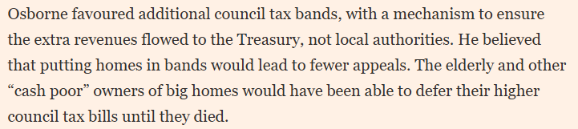


Autumn Budget 2025 – additional council tax bands?
Reports that Chancellor is considering raising additional taxation on higher council tax bands (G and H) https://www.ft.com/content/8fce8947-a283-45cc-a31c-bdd4a2daeef3
Either adding new bands (unlikely) or increasing (doubling?) the weighting on upper bands
Doubling the weighting could be implemented quickly (administratively easily), whereas new bands would take 2+ years (and require revaluations)
Additional taxation revenues could be extracted via the proposed SFA calculations (more of CSP is financed by locally-raised council tax).
Not sure of the legal status of local authorities making a direct payment of council tax to central government.
Distrbution of homes in bands G and H is heavily skewed towards SE England (and to London to some extent).

Slide 24
Business Rates Retention Scheme (BRRS)
Levy rates and thresholds – now proposed (see our previous briefings)
Safety net and thresholds
Baseline reset (and new BRB set based on gross rates minus accounting adjustments; s31 grant payments for all reliefs, incl charitable relief/ empty property relief)
Cap compensation (from 2026-27 onwards)
Setting multipliers (from 2026-27 onwards) – Autumn Budget
Business rates pools – POLL! – deadline is 24 November 2025
Business rates pilots – waiting for decision in the Autumn Budget (except GM and WM)
MTFP guidance on budgeting – starting point is that there is no above-baseline growth as at 1 April 2025.

Slide 25
BRRS – checklist for updating MTFP model
Baseline reset (and new BRB set based on gross rates minus accounting adjustments; s31 grant payments for all reliefs, incl charitable relief/ empty property relief) Change baseline so that it is based gross rates rather than NDRI (plus s31 grants for reliefs). Awaiting ministerial decision?
Change s31 grants so that they pay for all reliefs, including charitable relief and empty property relief (etc) Awaiting ministerial decision?
Indexation of the Baseline Funding Level. Working paper being developed, awaiting decision.
Levy and safety net calculations. Working paper being developed, awaiting decision.
Expand model to accommodate 5 multipliers. Awaiting decision on whether the BRRS will use 5 multipliers or whether we will proceed with the current 2-multiplier system. (BRRS will almost certainly operate with only 2 multipliers.)
Build-in adjustments in 2026-27 or in 2027-28 for any differences between draft and final data (on SCATs, etc). We don’t need to do this initially, but we will need to update the model (April 2026?) so that councils to apply the actual data and check the new results.
Revaluation data. Draft lists will be available (early December?) but we will not be able to change income levels for 2026-27 in our model until the NNDR1s are available. If the new BRBs are based on the draft revaluation data, and are published on that basis in the provisional settlement, then we will need to find a way of estimating business rates income in 2026-27 without having access to the NNDR1s. We might simply assume gross rates equals the new BRBs until we have better data.
Post-revaluation multipliers. Assume these are announced in the Autumn Budget, but they are difficult to apply until we have (a) new rating list data and (b) assumptions VOA has made when calculating the post-reval multipliers.
New cap compensation system. What is the assumption for future increases in the multiplier against which cap compensation would be measured? CPI? Is the plan to pay cap compensation on all the multipliers if they are under-indexed?

Slide 26
Pixel Benchmarking Service update
Addition of first cut of 2024-25 Revenue Outturn by LA data into the benchmark cost per head comparators
Addition of Ofsted inspection data and Children Looked After data into Children’s Social Care cost per head comparators
Addition of Care Quality Commission inspection data into Adult Social Care cost per head comparators
New Borrowing and Investments report including time series and cost per head comparators
Update of ONS Mid-Year Population Estimates data to all reports
Update of 2025-26 projections into Dedicated Schools Grant balances comparator report
Update of 2025-26 post levy retained rates data into NNDR comparator report
Improvements and standardisation of user interface to all reports for ease of navigation
Addition of archive and Benchmark Service use case examples.

Slide 27
Pixel Benchmarking Service – coming soon…
Addition of Adult Social Care Peer groups and Children’s Services statistical neighbour grouping options to existing Class, Region and Stat Neighbour grouping options
New Waste report using Revenue Outturn data and DEFRA waste data for cost per head, tonnage and recycling rate comparisons
New Reserves comparison report
Improvement to Council Tax report to include LCTS recipient data
Index of Multiple Deprivation data update
2026-27 Core Spending Power data to be added after settlement.
Webinar to outline updates on 25th Nov at 10am. Registration details will be sent out tomorrow.

