Slide 1

Fair Funding Review 2.0
Adrian Jenkins/ Dan Bates
June 2025

Slide 2
Overview
Consultation link: https://www.gov.uk/government/consultations/the-fair-funding-review-20/the-fair-funding-review-20
Relative Needs Formulas (RNFs)
Weighting and Needs Assessments
Rolled-in grants and rolled-in funding
Resources Adjustment (council tax equalisation)
Settlement Funding Assessment (SFA)
Consolidated Grants
Damping 1 – phased-in changes
Damping 2 – 0% funding floor
Damping 3 – specific funding floors for some authorities

Slide 3
Introduction
The sector has waited since 2016 or 2019 – was it worth the wait?
Very full and comprehensive
Just about enough to model the outcomes in provisional settlement
But some gaps in our knowledge, some elements not well described, and some decisions still to me made
Sharing methodologies with others (London Councils, LG Futures) – and MHCLG have offered to review the models
Outcomes are mostly in the direction we expected in our previous models (v5.15 and before)
For some, the outcomes are more negative than we expected (e.g. in inner London)
And there are some surprises (e.g. some shire district councils)
The damping is a very distinctive feature – clever way of hiding the sheer scale of the changes
At the extremes, there are questions about the financial sustainability of the cuts in funding.

Slide 4
Relative Needs Formulas (RNFs)
Adult social care
Children’s services
NEW Home to School Transport (HTST) RNF
Foundation Formula (lower tier)
NEW Temporary accommodation RNF
Foundation Formula (upper tier)
Fire and rescue RNF
Highways maintenance RNF
Full modelling of the new RNFs later in the month – which will help us to understand why/ how authorities have gained/ lost from the funding reforms

Slide 5
Deleted RNFs
Concessionary travel
Flood defence
Coast protection
Fixed costs
Capital financing
All the rolled-in grants from 2013-14 (Council Tax Freeze grant, Homelessness Prevention, Learning Disability and Health Reform, Early Intervention Funding)
What is the impact of removing these RNFs?
Has the case been made for removing them?
Plus baseline effects (Negative RSG, 2013-14 Damping)

Slide 6
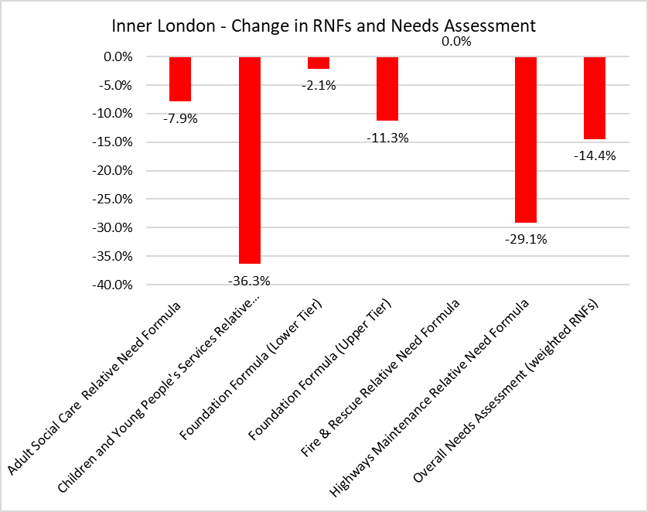
RNFs – inner London
Losing funding share in all RNFs
Losses are particularly large in children’s services (36%), and similar across all boroughs
Largest gainers and losers

Slide 7
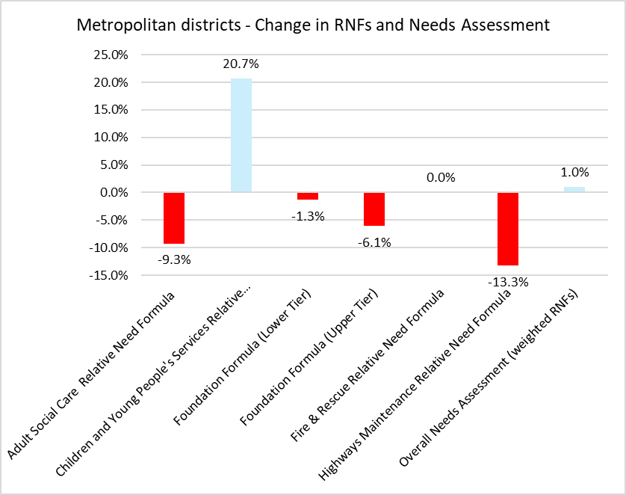
RNFs – metropolitan authorities
Only gaining funding share in children’s services
We already knew about the losses in Adult RNF
New RNFs are not beneficial for metropolitan authorities (HTST, temporary accommodation)
Reduction in funding for Highways is a result of removal of urban factors
Overall, a small increase in share of “needs” assessment compared to 2013-14

Slide 8
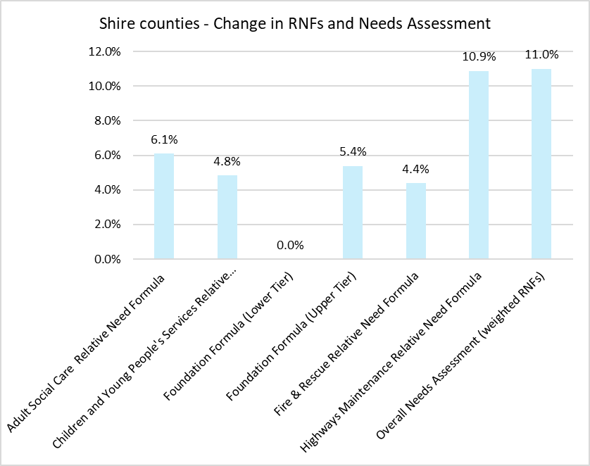
RNFs – shire counties
Gaining funding share in every RNF
Only part of the picture – offset by resources deduction
Range of outcomes within counties but all have an increased share of needs assessment
Children’s – gains in some rural authorities, losses elsewhere

Slide 9
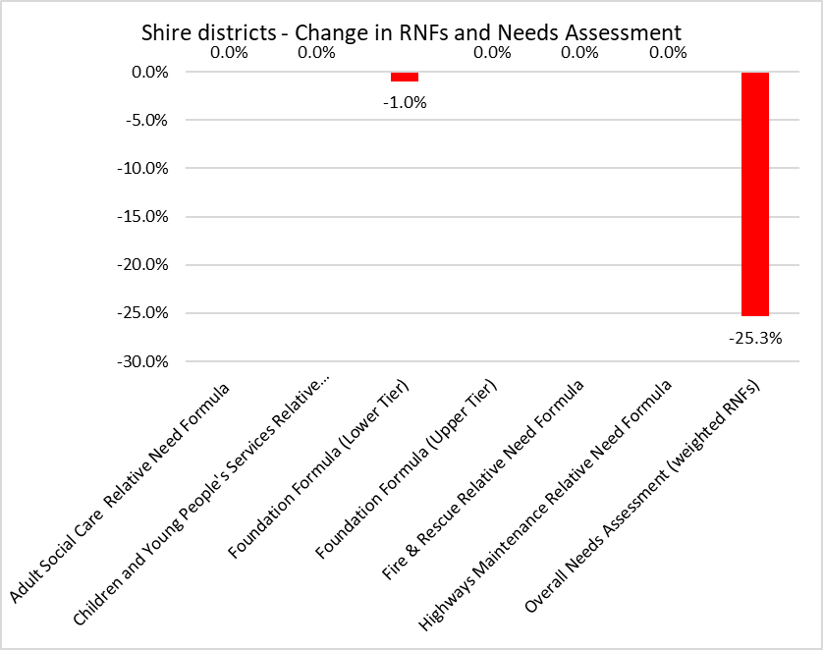
RNFs – shire districts
Gaining funding share in every RNF
Only part of the picture – offset by resources deduction
Range of outcomes within counties but all have an increased share of needs assessment
Children’s – gains in some rural authorities, losses elsewhere

Slide 10
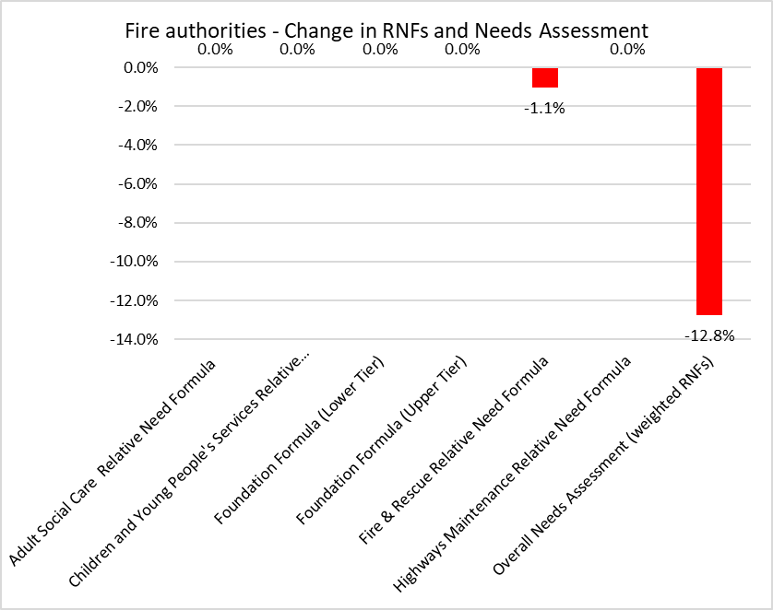
RNFs – fire authorities
Reduced share within fire authorities themselves
Increased share within county/ unitary fire functions
Again, only part of the picture

Slide 11
Weightings
“propose weighting RNFs using historical service expenditure and combining them to give overall need shares”
“proposes calculating individual ‘control total shares’for each RNF based on their share of the total national NCE”
Based on RO form (2023-24)
Line 2.1.4 covers “Home to school transport (pre 16): SEN transport expenditure”, while line 2.1.5 covers “Home to school transport (pre-16): mainstream home to school transport expenditure”.
Significant increases in weighting for children’s (from 16% in 13-14 to 26% in 26-27) and adult social care
Significant shift away from capital financing (distributional impact not stated)
Lower share for shire district councils and increased share for fire authorities (and fire function)

Slide 12
Movement in Needs Assessments, by class
All inner London boroughs are losing from the reforms, with most losing heavily (except Tower Hamlets)
Mixed picture in outer London – some moderate losses in county-type boroughs (Richmond, Bromley) but others doing very well (Hounslow, Hillingdon, Havering, Croydon, Enfield)
Strong gains in many metropolitan authorities – but needs assessments not increasing as strongly as might have been expected (but this is before council tax equalisation)
County gains in needs – with every shire county council getting an increase in needs assessment
Big reductions in needs shares for shire districts and fire authorities – but this only tells part of the story

Slide 13
Movement in Needs Assessments, by class

Slide 14
Movement in Needs Assessments, shire districts

Slide 15
Quantum – SFA and rolled-in grants
Estimate quantum of funding to be distributed, including SFA, grants rolled in from CSP, and Homelessness Prevention Grant
Note: only the TA element is rolled in (45%) – adjustment to be made
Deduct funding for GLA. This is our estimate based on the amounts in 2013-14 SUFA. London Councils has a higher amount (£1.1bn). Indexation?
Add Resources Deduction (Needs = Funding (SFA) + Resources)
Distribute all Needs funding using the Needs Assessment
Settlement Funding Assessment (SFA) 2025-26 | 16,840
New Homes Bonus | 290
Recovery Grant | 600
Minimum Funding Guarantee | 116
BRRS Surplus | 1,496
Cap compensation funding | 2,695
ENICS grant | 502
GLA (TFL Funding)
LA BCF grant | 2,640
Social Care Grant | 5,924
MSIF grant | 1,050
Domestic Abuse Safe Accommodation grant | 160
Homelessness Prevention Grant | 633
Additional ASC grant in 2026-27 (per SR25) | 350
sub-total | 33,296
Deduct funding for GLA (TFL transport funding) | -802
Add: Resources Amount | 38,067
Settlement Funding Assessment (2026-27) | 70,561

Slide 16
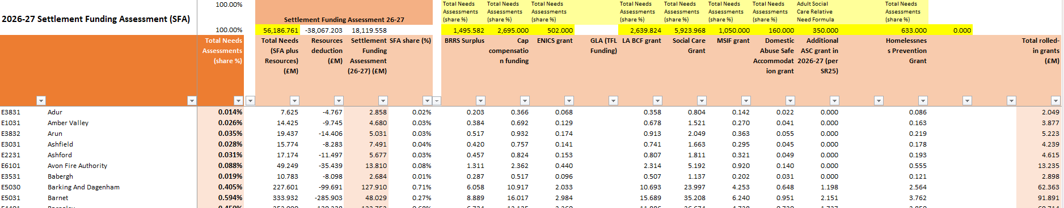
Rolled-in grants in MTFP model
Our initial approach was to distribute Needs amount using the Needs Assessments, and then distribute rolled-in grants using the most appropriate RNF (usually Adult RNF)
But the Needs Assessments are weighted for the rolled-in grants – so distributing rolled-in grants using specific RNFs effectively double-weighted them
So, you will see rolled-in grants to every authority (based on their share of Needs) regardless of whether the authority actually received that grant
MTPF model leaves open the possibility that some grants/ funding streams might be rolled in differently

Slide 17
Local Authority Better Care Fund Grant
“The Local Authority Better Care Grant acts as a legal requirement for local authorities to pool funding with the NHS and has been a key factor in the pooling of health and social care budgets nationally. We therefore propose to retain a standalone Section 31 Grant for Local Authority Better Care Grant. The distribution of the Local Authority Better Care Grant will be the same as the updated Settlement Funding Assessment, and retaining a Section 31 Grant will ensure that current Better Care Fund pooling arrangements continue. We propose the updated Local Authority Better Care Grant will be funded via a top-slice of social care authority allocations of RSG.”
Our approach:
  Roll LA BCF into SFA using the Needs Assessments shares
  Pay out SFA in three elements: Baseline Funding Level (BFL), Revenue Support Grant, and s31 grant LA BCF
Is the s31 grant payment based on (a) current distribution or (b) new Adult RNF?
Does the LA BCF remain entirely outside SFA?
Is the LA BCF rolled-in to SFA on the same basis that it is paid out (e.g. new Adult RNF)?

Slide 18
Unexpected increases in Revenue Support Grant?
Our model has substantial increases in RSG for many shire district councils
What are the explanations?
For some, an increase in share of SFA (e.g. increases in needs share)
Grants from within CSP have now been rolled-in (shire districts may previously have had payments for Recovery Grant, NHB, Minimum Funding Guarantee)
Share of BR surplus and cap compensation
Adjustments for phased damping (see later)

Slide 19
Local Authority Better Care Fund Grant
“The Local Authority Better Care Grant acts as a legal requirement for local authorities to pool funding with the NHS and has been a key factor in the pooling of health and social care budgets nationally. We therefore propose to retain a standalone Section 31 Grant for Local Authority Better Care Grant. The distribution of the Local Authority Better Care Grant will be the same as the updated Settlement Funding Assessment, and retaining a Section 31 Grant will ensure that current Better Care Fund pooling arrangements continue. We propose the updated Local Authority Better Care Grant will be funded via a top-slice of social care authority allocations of RSG.”
Our approach:
  Roll LA BCF into SFA using the Needs Assessments shares
  Pay out SFA in three elements: Baseline Funding Level (BFL), Revenue Support Grant, and s31 grant LA BCF
Is the s31 grant payment based on (a) current distribution or (b) new Adult RNF?
Does the LA BCF remain entirely outside SFA?
Is the LA BCF rolled-in to SFA on the same basis that it is paid out (e.g. new Adult RNF)?
Does this mean based on SFA, Needs Assessments, or Adult RNF?

Slide 20
Resources deduction
This is the council tax equalisation adjustment. It is based on each council’s share of notional council tax (not actual council tax)
Taxbase (CTB1, Table 1.28. Tax base (Line 26))
Deduct: second homes premium (Band D equivalent)
Deduct: pensioners LCTS (CTB1)
Estimate working-age LCTS based on formula: population-weighted IMD score x proportion of working-age population
Collection rate – assumed to be 100% for all authorities
Estimated Resources Deduction = £38.067bn

Slide 21
Resources/ needs ratio

Slide 22
Estimating gains and losses
Our approach: estimate the gains or losses from the funding reforms in year 1 (26-27).
Compare 25-26 CSP (excl council tax, incl BR income) with 26-27 SFA (incl rolled-in grants). Scale 26-27 amounts to 25-26 level.
One-third of losses (or gains) in 2026-27, two-thirds in 2027-28. Full impact of changes in funding in 2028-29.
Calculations: “SFA 26-27 to 28-29” tab, columns DB to DH

Slide 23
Estimated gains and losses
The bulk of the losses are in inner London, with forecast losses in every borough (losses range from £20m in Tower Hamlets to £108m in Wandsworth)
Metropolitan authorities have largest cash gains (largest cash increases are in Birmingham £133m and Manchester £155m). 6 Mets have cash losses (Gateshead, Sefton, South Tyneside, Sunderland, Trafford and Wigan).
Also gains for unitary and outer London boroughs with similar characteristics.
County areas have overall from both county councils and particularly shire districts (£297m overall). Net gain though for shire counties and county unitaries together.
Net position is broadly neutral for standalone fire authorities (reduced share from needs assessment offset by baseline reset and rolled-in funding)
Losses in GLA look too large here and we will review. GLA losses from baseline reset will be considerable. Top-slice possibly too low (only £820m, and could be up to £1.2bn).
See columns DB to DH in the “SFA 26-27 to 28-29” tab for your own authority’s calculation.

Slide 24
Estimated gains and losses (upper tier authorities)

Slide 25
Estimated gains and losses (shire district councils)

Slide 26
Business rates
Full reset in 2026-27, but gains and losses are damped over 3 years
Funding for cap compensation will be rolled into SFA (and distributed pro rata to “needs” assessment)
Enhanced (100%) BR arrangements have not been confirmed outside GM and WM. So, we are still awaiting decisions on the pilots in the West of England, Liverpool City Region, Cornwall and the Greater London Authority
Future of business rates pools is also unclear (likely to be less attractive in early years because retained growth will be marginal, changes in levy rates)
No consultation paper in the Autumn – but there will be papers on proposals to keep the sector up to date
There will be no changes in tier splits in 2026-27 to 2027-28 – discussions about inclusion of Strategic Authorities in the BRRS will start in April 2026

Slide 27
Consolidated grants
Homelessness and rough sleeping grant – 65% of Homelessness Prevention Grant, other grants?
Public health – “consolidated alongside other service-specific grants to create a wider Public Health grant” – we have assumed no change in distribution and no increase in funding. Other grants?
Crisis and resilience grant – Discretionary Housing Payments and Household Support Fund
Children, Families and Youth grant – “consolidate the Children’s Social Care Prevention Grant and the Children and Families Grant, alongside further investment in children’s social care reform”. Does the Children’s Social Care Prevention Grant keep its current distribution or do we apply the new RNF?
We will update the MTFP model over the next week with these consolidated grants.

Slide 28
Type 1 damping – “blended” allocations
“We propose using grant to gradually move each local authority to their updated funding allocation over the multi-year Settlement, meaning that the full impact of the new allocations is not felt by authorities in the first two years of the multi-year Settlement.”
Our approach: estimate the gains or losses from the funding reforms in year 1 (26-27).
Compare 25-26 CSP (excl council tax, incl BR income) with 26-27 SFA (incl rolled-in grants). Scale 26-27 amounts to 25-27 level.
One-third of losses (or gains) in 2026-27, two-thirds in 2027-28. Full impact of changes in funding in 2028-29.
Calculations: “SFA 26-27 to 28-29” tab, columns DB to DH
You can switch 3-year phasing on and off in the “Systems Assumptions” tab (cell B82)
Alternative method: fully recalculate SFA in 26-27 and 27-28 with 1/3 and 2/3rds of RNFs applied. More complicated…

Slide 29
Type 1 damping – scale of damping
In years 1 and 2, the bulk of damping is from the 3-year phasing
It is worth £1.3bn in 2026-27 and £600m in 2027-28 (zero by 2028-29)
The overwhelming bulk of type 1 damping is in London (£802m in inner London over two years, £522m in the GLA)
NB: these are our calculations for GLA, but specific arrangements will be in place
As we will see, phased damping does most of the heavy lifting in years 1 and 2, and effectively means a figure for “damping” in those years is hidden
This is a clever arrangement that allows a lot of damping to take place without the gainers complaining about not getting their increases quickly enough

Slide 30
Type 2 damping – 0% funding floor
“it is the government’s intention to protect the vast majority of these councils’ income through a ‘flat cash’ (or 0%) funding floor.”
Calculate funding floor based on current level of funding, fixed in cash terms. Assume increase in council tax (maximum Band D uplift, taxbase growth) and growth in grant funding/ SFA (per SR25)
Principle is that the income that authorities receive now will be taken into account in 2026-27 – decisions not made yet
We have included: all funding streams within Core Spending Power 2025-26, including council tax. Plus: retained BR income (~£1.5bn), after levy/ safety net; above-baseline cap compensation payments; Homelessness Prevention Grant (rolled in amount).
Damping baseline is £69.4bn from CSP, plus a further £2.525bn from BR elements and HPG
We have not included: gains from the business rates pools (to hard to calculate), or gains from 100% BR pilots (possibly will be included)
Damping baseline makes a significant difference to the amount of damping received – but if it puts you too far above your 2029-30 target funding, then you are more likely to have a “below cash funding floor”

Slide 31
Type 2 damping – 0% funding floor
Type 1 damps the bulk of the changes in years 1 and 2
0% funding floor provides much less damping, particularly in the early two years
Only £268m in 2026-27, with the amounts rising to £556m in 2027-28 and £826m in 2028-29
Funding floor amounts increase over the period as more of the SFA losses are introduced into authorities’ funding allocations
Again, inner London (and possibly the GLA) receive the overwhelming bulk of the damping
Problem 1: the 0% funding floor is still relatively expensive (still £826m in year 3)
Problem 2: the 0% funding floor does not move some authorities towards their target funding by year 3

Slide 32
Type 3 damping – “below cash funding floors”
“small number of councils whose new share of funding is furthest from their current share of funding about supporting them to manage larger losses”
Plus we assume authorities who are not moving towards their target with a 0% floor
41 shire districts, 1 outer London borough, and about 7 inner London boroughs
“some form of funding floor in the scenario that your funding floor is not set at the flat cash level”
Plus other arrangements, which might include above-threshold increases in Band D (for those with below-average Band D) and possibly use of reserves
Authorities have been contacted by email and will have discussions over the Summer
List of authorities has not been published (and might yet change) because MHCLG has not finalised the grant allocation and they may yet change (small changes in assumption can have significant impacts on distribution)
Our modelling predicted 37 out of the 41 shire districts but (a) 3 shire districts on the list who have not lost in our modelling and (b) 14 who are losing but are not on the list (although only 1 of these loses significantly from our modelling)
So, we need to find out more about the criteria for inclusion – and/ or whether there are changes that we need to make to our modelling
Lower funding floors for 50-60 authorities, particularly inner London boroughs, will reduce the amount of scaling-back required to fund the damping (i.e. bigger increases in funding for the gainers)

Slide 33
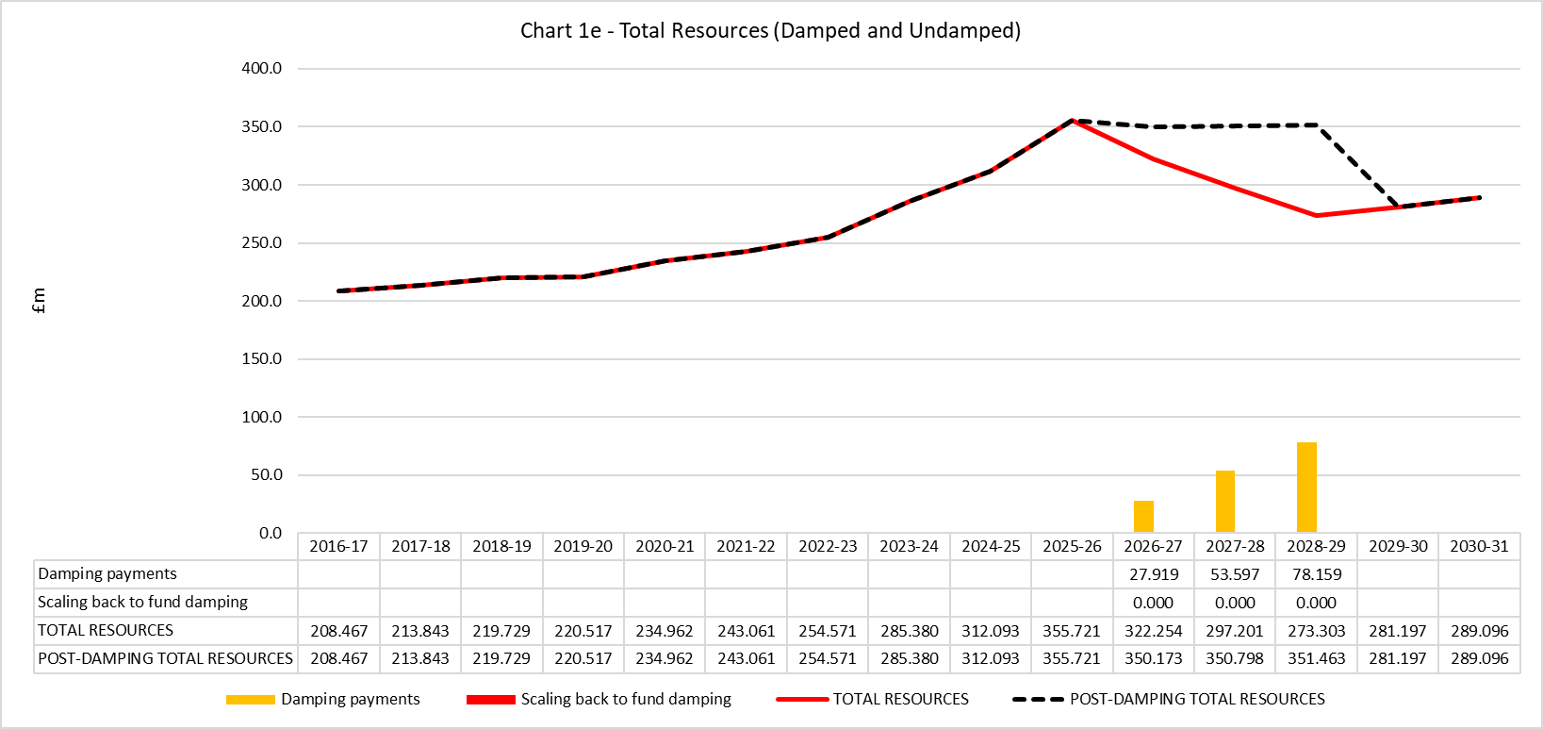
Type 3 damping - Wandsworth
Most inner London boroughs are likely to get a different funding floor (7 out of 13 boroughs, plus 1 outer London borough)
Largest cash losses, and some of the largest percentage losses as well
Largest cash losses in Wandsworth (damping 2028-29 is still worth 39% of CSP)
Assume there will be a lower funding floor of ~-7%
Wider package to include above-threshold Band D increases?
What assessments are MHCLG doing around financial sustainability?

Slide 34
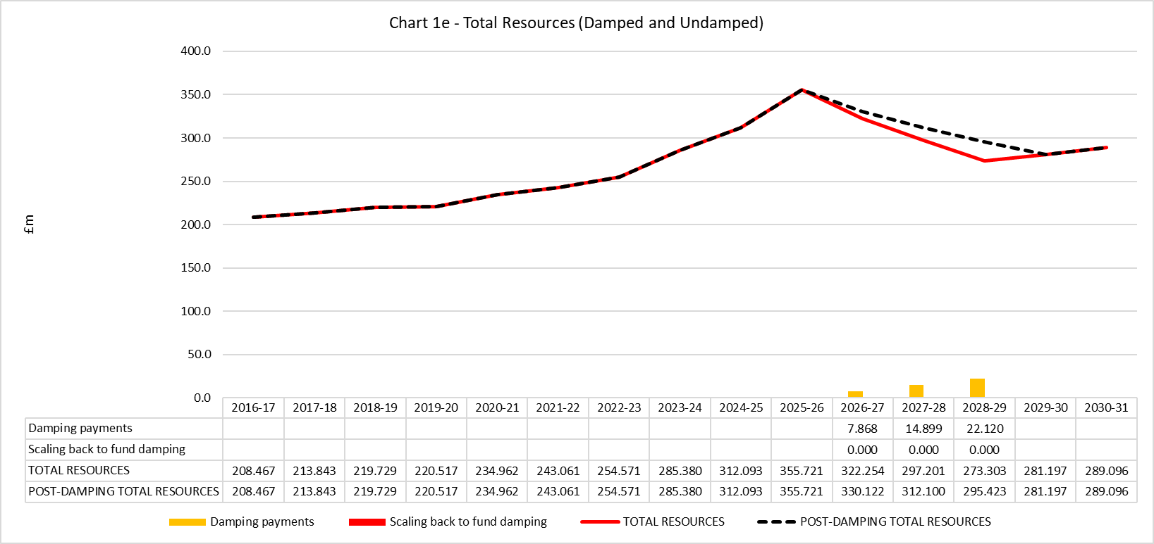
Type 3 damping - Wandsworth
Most inner London boroughs are likely to get a different funding floor (7 out of 13 boroughs, plus 1 outer London borough)
Largest cash losses, and some of the largest percentage losses as well
Largest cash losses in Wandsworth (damping 2028-29 is still worth 39% of CSP)
Assume there will be a lower funding floor of ~-7%
Wider package to include above-threshold Band D increases?
What assessments are MHCLG doing around financial sustainability?

Slide 35
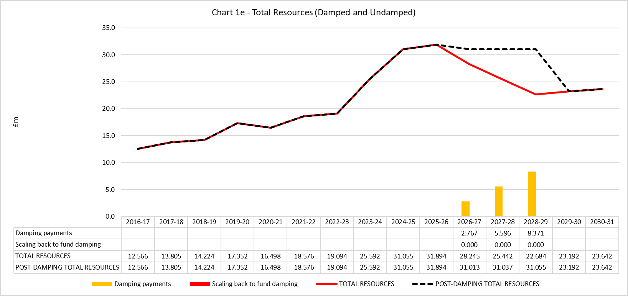
Type 3 damping – North West Leicestershire
Around 40 shire district councils
Losses are largely driven by BR baseline reset
But also losses from reductions in Needs Assessments
Damping 2028-29 is still worth 53% of CSP
Funding baseline would need to be reduced to -7% to get to target funding in 2029-30
Would there be other elements within the funding package? Expected use of reserves, or increases in Band D?

Slide 36
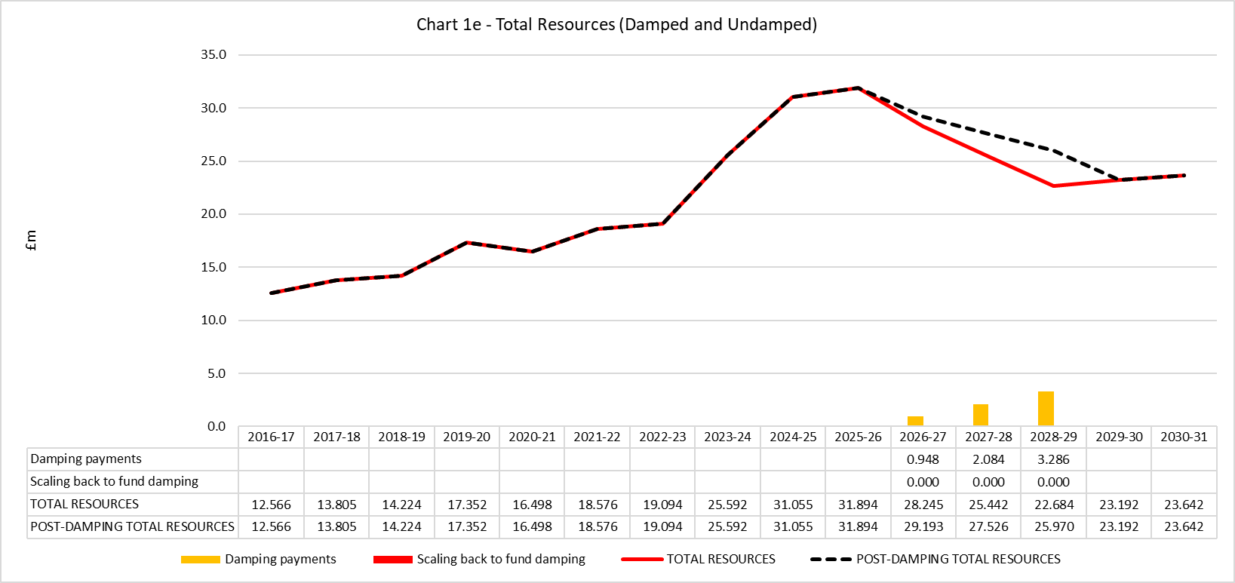
Type 3 damping – North West Leicestershire
Around 40 shire district councils
Losses are largely driven by BR baseline reset
But also losses from reductions in Needs Assessments
Damping 2028-29 is still worth 53% of CSP
Funding baseline would need to be reduced to -7% to get to target funding in 2029-30
Would there be other elements within the funding package? Expected use of reserves, or increases in Band D?

Slide 37
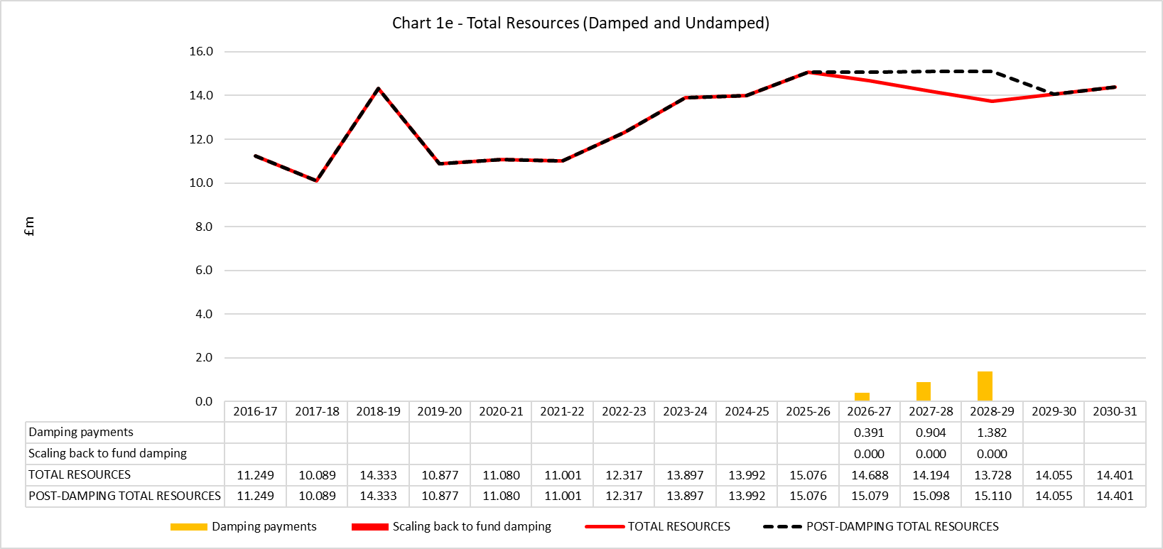
Type 3 damping – Bolsover
Losses are smaller in Bolsover than in previous two examples
But 0% funding floor does not move the authority closer to its “target” funding
Damping payment in 2028-29 is worth 10% of CSP
Funding baseline would need to be reduced to -2% to get to target funding in 2029-30

Slide 38
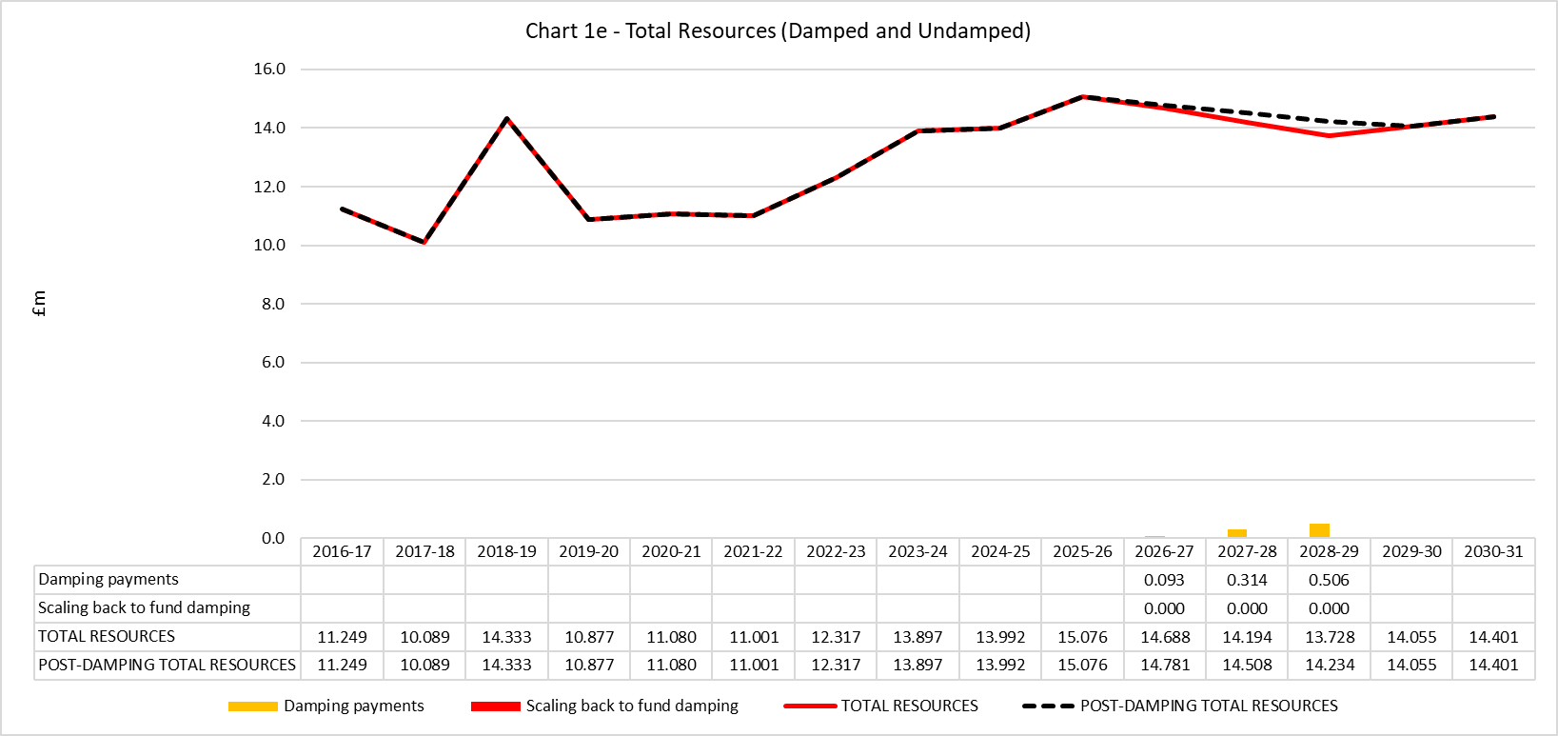
Type 3 damping – Bolsover
Losses are smaller in Bolsover than in previous two examples
But 0% funding floor does not move the authority closer to its “target” funding
Damping payment in 2028-29 is worth 10% of CSP
Funding baseline would need to be reduced to -2% to get to target funding in 2029-30

Slide 39
Type 3 damping – setting the funding floor
There does not appear to be a simple formula for setting the floor for those (a) losing the most or (b) with persistent damping
Has to take account (a) the losses to be damped, (b) increase in council tax income, and (c) increase in other grant funding (per SR25)
Potentially also other contributory factors (Band D, reserves)
It seems unlikely that damping will be allowed to continue for more than the 3 years – but this might be an option
We can propose alternative damping floors based on our analysis
We can also update the model with funding floors proposed by MHCLG (if you wish)
Do you want a pre-meeting before next Friday (aka therapy session!)?
Outcomes are likely to change over coming months, and are sensitive to decisions taken by ministers

Slide 40
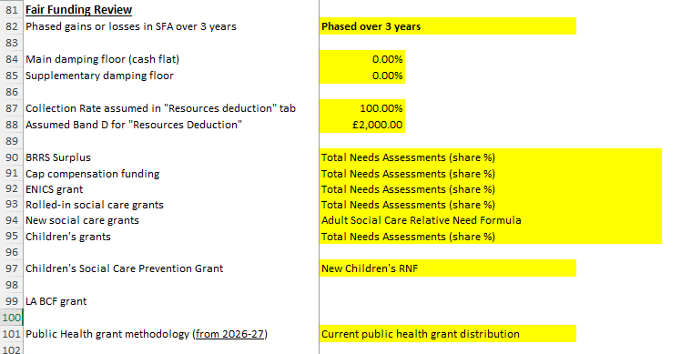
Key assumptions in the MTFP model
Funding distribution for 2026-27 is not “locked down” yet
There are gaps in our knowledge (and the sector generally) and also decisions not yet made
Some of the key assumptions are set out in the “Systems Assumptions” tab
Further potential assumptions around weightings, baseline roll-ins, and council tax assumptions
We will keep the model up-to-date following checking process with MHCLG this week – and with further announcements

Slide 41
Stuart Hoggan

